Slide 1
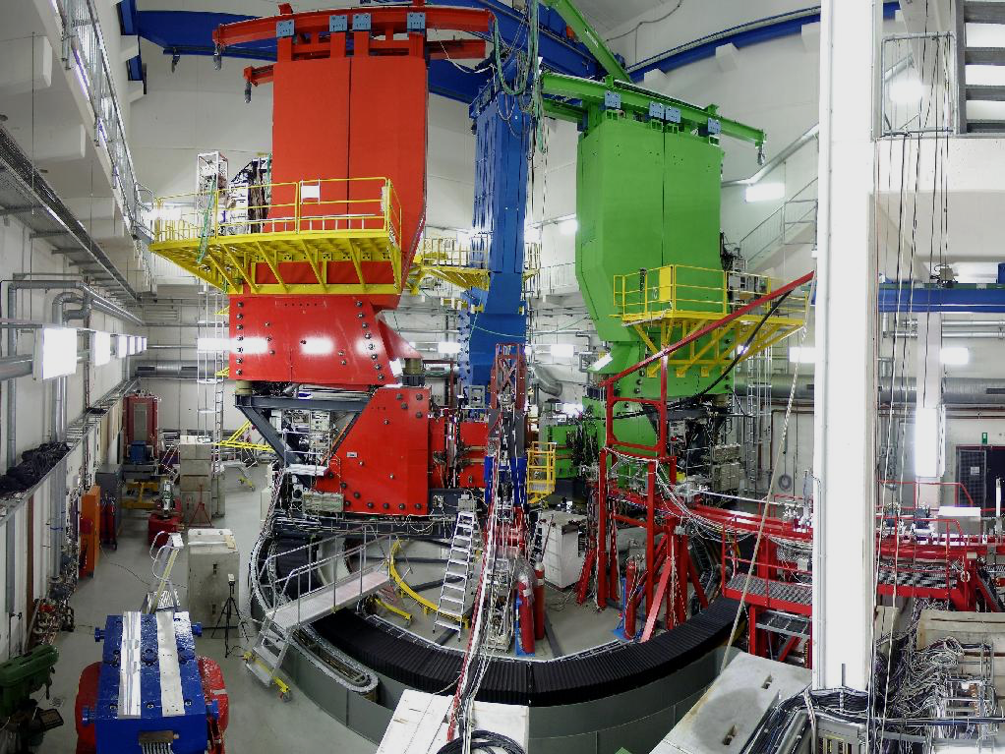
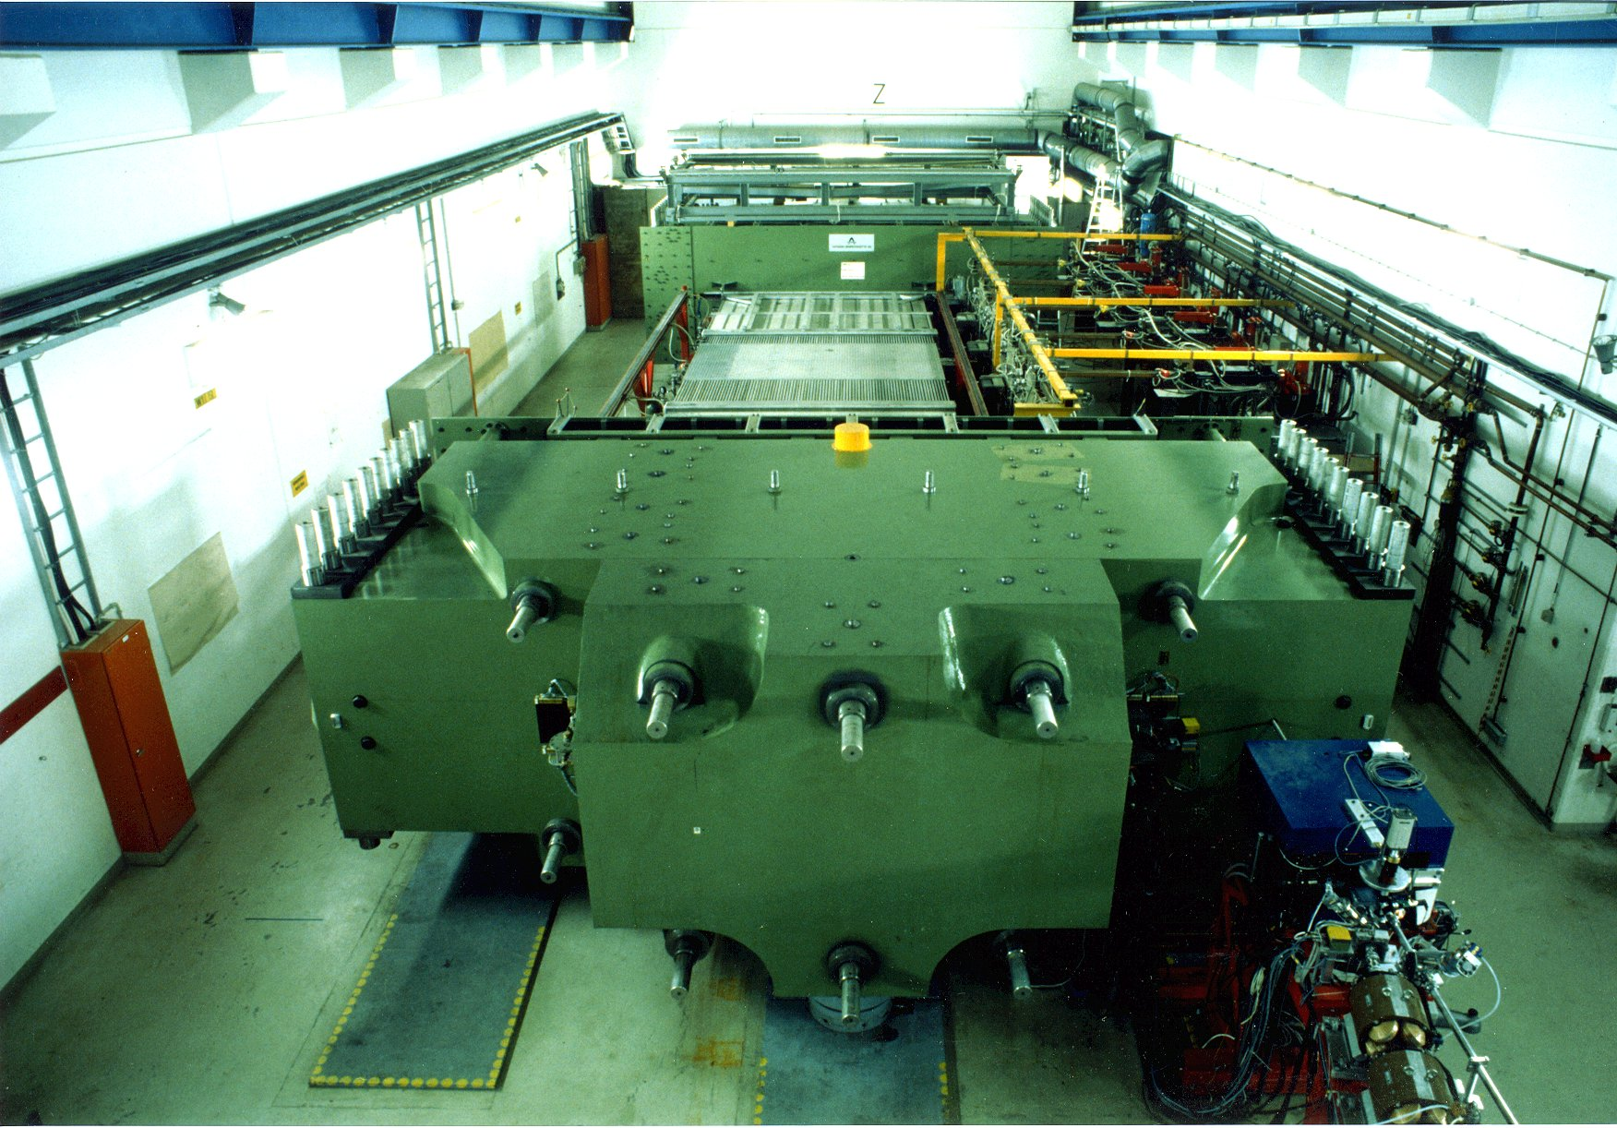
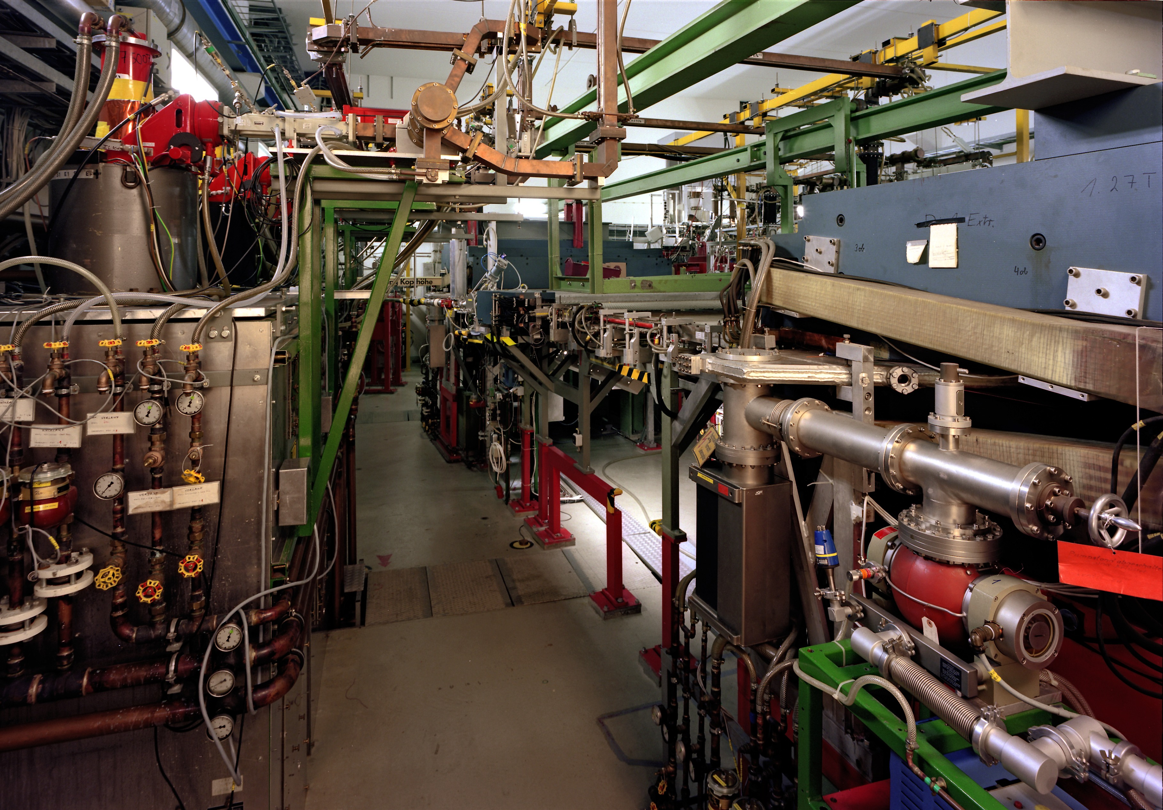



ISR Experiment at MAMI
Miha Mihovilovic
JGU Mainz and JSI
LEPP Workshop, Mainz 2016
Notes:
Hello everybody and welcome to my talk. I would also like to thank organizers for
inviting me to this workshop and for giving me opportunity to talk about our ISR
Experiment, which is dedicated to studying EM properties of the proton at small
Momentum trasnfers.

Slide 2

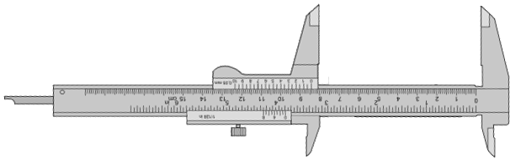
The proton radius problem
The 8σ discrepancy in the r_{p} measurements questions QED.
Nuclear results questionable due to the lack of data at very low Q².
ISR aims to provide new insight into the matter!
Notes:
Our experiment aims to provide new measurements of the proton charge FF and
Has of course been motivated by the proton radius problem, that has been
Discussed in the previous session. In this presentation, I would like to describe
The idea of the experiment which was inspired by a similar approach in particle
Physics, the expereiment it self, the problems that we enounters, which may be
Interesting for the people that are planning future experiments and in the
Of course some results.

Slide 3
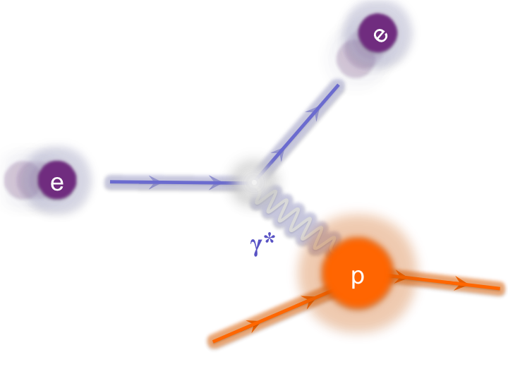
Radius via Cross-section measurement
Extraction of FF via Rosenbluth Separation.
Best estimate for radius:
Notes:
In the scattering experiments the radius of a proton is obtained indirectly by measuring
the cross-section for the electrons off Hydrogen.The measured cross section depends on
two form factors GE and GM, which carry the information about the charge and magnetization
distribution inside the proton. To extract these form-factors from the data, Rosenbluth separation
is typically employed, which requires CS measurements at different Q^2 and different values of epsilon.
And once we know the form, we can get the best estimate for the proton charge radius, by calculating
The slope of the Charge form-factor at Q^2=0.
Of course, A known problem of this technique is, that for calculation of charge radius a derivative
of the FFs at Q2=0 is required, where no data exist. The measurements exist at very small values,
but data at Q2<0.005 are still missing. Therefore we need to rely in our Calculations on the
extrapolation of the Form-Factors to Q2. This means, that If by any chance something strange is
happening with FFs at very low Q2<0.005, this could result in a different value of the Proton charge
radius.

Slide 4
Proton’s charge form-factor
Data available only for Q² > 0.004 (GeV/c)².
Extrapolations to zero are needed!
Instabilities related to extrapolation are sources of systematic offsets.
Notes:
And here is the current status of the available data for the charge form factor, shown as a fucntion of the Q2.
In the ploh is the FF shown relative to the standard dipole approximation, which is a
Usual way to show these results. The points in the plot represents the world collection of the
Data in this Q2 range, except of the Bernauer results, which are shown in this plot with this
Blue band and corresponding errorbars. Here I want to ephasize one more time, that
This line are experimental results, but Because of the different approach in the analysis, his
result is not a discrete set of points but A smooth curve. You can see, that all the existing measurements
Are already very precise but the problem is, that even the best experiments provide data only
Down to Q2 of 4E-3. This means, that in order to calculate the radius, the data need to be extrapolated
Towards zero, can be unstable and can lead to systematic offsets of the extracted
Radis. And as you, how to properly model the FF in this region and how to fit the data without introducing
Unwanted bias has been a subject of an extensive debate in the last few years.

Slide 5
New electron scattering experiment
Determination of proton radius depends on the slope of FF (Q²->0).
No data at lowest Q².
- Region of Q² < 0.004 (GeV)²
is extremely hard to reach.
Kinematic range is limited
by available experimental
apparatus.
Novel techniques are
needed to explore
extremely low Q² regime.
?
Here no data exist!
For precise radius determination new measurements at even lower Q² are needed.
Notes:
So, to overcome the problem, we need new measurements at even smaller
Q2 in order to see how the really behave in this yet unexplored region
And also to more precisely determine the absolute normalization of the
Measurements. Of course the problem of these measurements is,
that this Q2 region is Experimentaly extremely hard to reach,
requiring some novel approaches And ideas to investigate this
region.

Slide 6
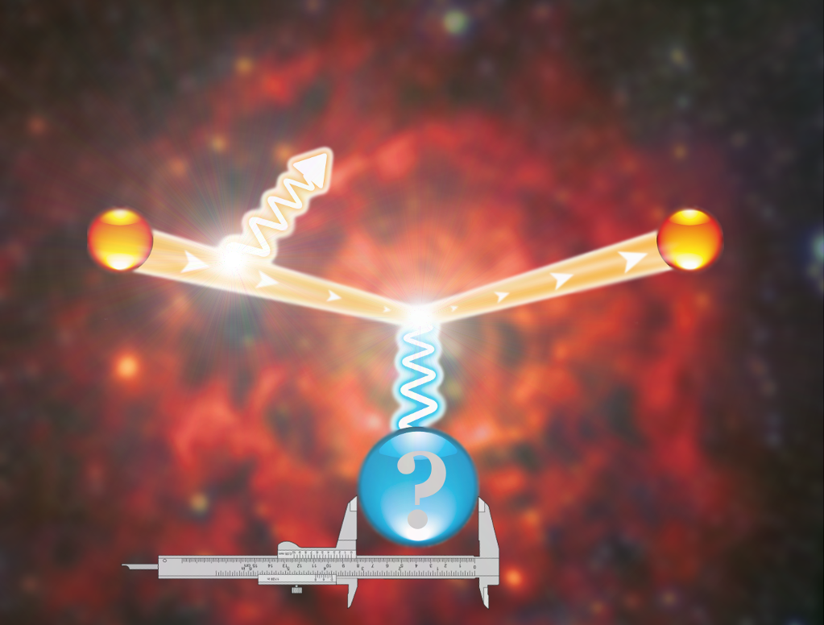
ISR Experiment at MAMI
Elastic
peak
#
Radiative
tail
p
Notes:
And the idea of our exeriment to come down to this region, by using not
Only the elastic data, but also exploit the information hidden inside the
Radiative tail of the elastic peak.

Slide 7
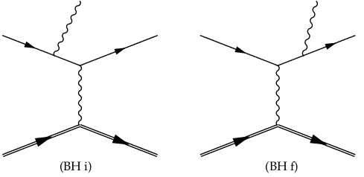
Radiative tail
Dominated by coherent sum of two Bethe-Heitler diagrams.
FSR
2
+
=
ISR
G_{E}
In data ISR can not be distinguished from FSR.
Combining data with the simulation, ISR information can be reached.
Redundancy measurements at higher Q² for testing this approach in a region, where FFs are well known.
Notes:
The radiative tail of the elastic peak is dominated by the contributions of two Bethe-Heitler
diagrams. The initial state radiation graph, where the incident electron emits real photon
before interacting with proton and final state radiation diagram, where photon is emitted
only after the interaction.
The plot here on the right shows the results of the MC simulation for the elastic scattering,
Considering The initial state and final state radiation, as a function of measured or
reconstructed Q2 and The vertex Q2, so true Q2 of a photon that interacts with the proton.
You can see, that in the case, when real photon is emitted before the interaction
Q2Reconstructed agrees with the Q2 at the Vertex. However, when the scattered electron
emits real photon, then Q2Vertex remains constant, While the reconstructed Q2 is lowered
for the energy taken away by the real photon.
Unfortunately in the experiment we can measure only ReconstructedQ2, which means, that
Looking only at data, we can not distinguish ISR from FSR. However, by combining the data
to this simulation, we believe that information corresponding to ISR can be reached. And this
Is the basic idea of this new MAMI experiment, which will hopefully allow us to extract FFs for
Q2 as low as 10E-4.
The experiment is desiged such that the data also at higher Q2s are collected, such that tail of all three
settings overlap. This will allow us to test our procedure in a region where FFs are well understood.
In other words, in these tests, we will extract FFs from that radiative tail and compare it to the FFs
from the peak.

Slide 8
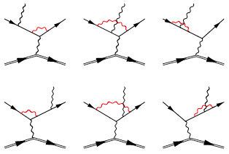
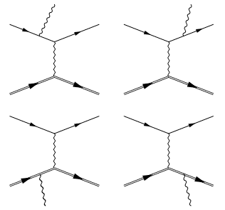
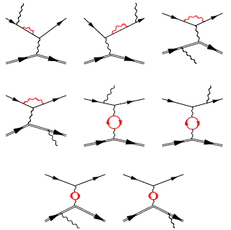
Simul++
Based on standard A1 framework.
Detailed description of apparatus.
Exact calculation of the leading order diagrams:
The NL-order virtual and real corrections included via effective corrections to the cross-section.
ISR
…
Notes:
Of course, for a comprehensive comparison with the
Data and precise extraction of the FF we of course need a detailed
simulation. And what we use is the standard A1 simulation package,
Which has ben proven to work well for a serious of past experiments
And includes a detailed description of the spectrometer setup. For our
Experiment the framewark was upgraded by a sophisticaed generator
Of events, that was written primarly for theestimation of the bacground
In the VCS experiments. This generator exactly calculates the Feynman
Diagrams for the first order diagrams shown here. Then we also include
Second order virtual and real corrections. However, because the virtual
Corrections shown here require integrations of the loops, the calculations
Of these diagrams was done separattely and re used as effective corrections
to the crossections. And with all these things considered, the simulaion
Provides a subpercent description of the radiative tail in the region, that
Etends more than 100 MeV away from the elastic line.
And with the simulation available we could then go on and perform the experiment.

Slide 9
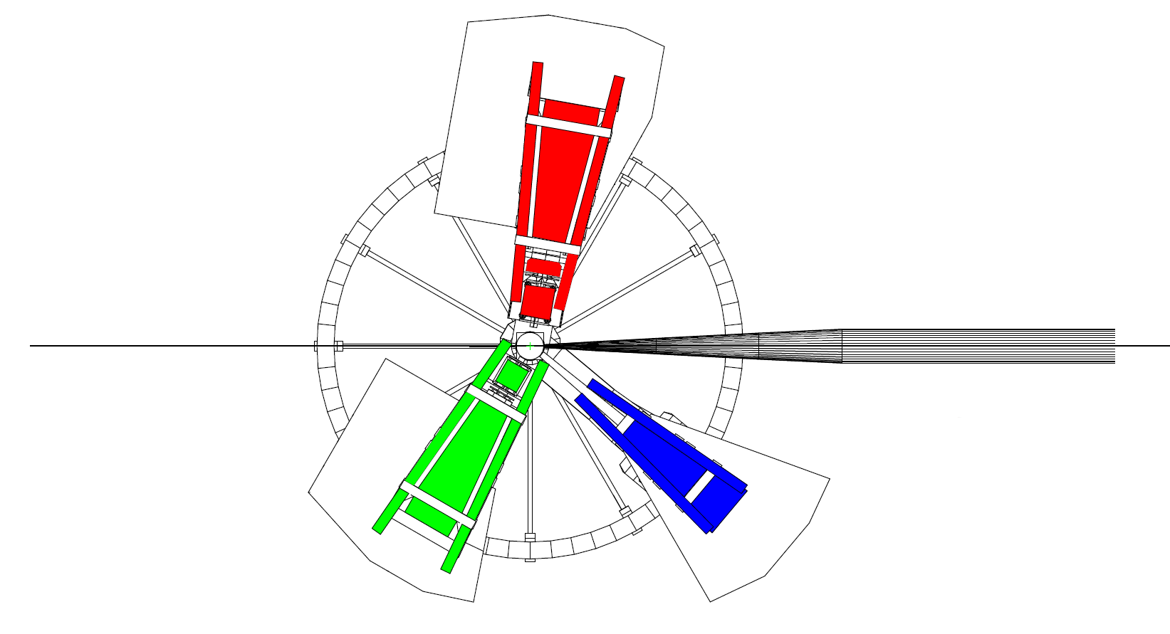
The ISR experiment
Full experiment done in August 2013. Four weeks of data taking.
Spectrometer A:
- Luminosity monitor (const. setting)
- Momentum: 180, 305, 386 MeV/c
- Angles: 50°, 60°
Electron Beam:
- Energy: 195, 330, 495 MeV
- Current: 10nA – 1μA
- Rastered beam
BPM
SEM
Förster probe
Spectrometer B:
- Data taking
- Angle: 15.3°
- Momentum:
48 - 194 MeV/c (35 setups)
156 - 326 MeV/c (12 setups)
289 - 486 MeV/c (9 setups)
pA
Luminosity monitors:
- pA-meter
- Förster probe
- SEM
Spectrometer C:
- Not used
Beam control module:
Communicates with MAMI and ensures very stable beam.
BPM and pA-meter measurements performed automatically every 3min.
Notes:
In this experiment, rastered electron beam with energies 195,
330 and 495 MeV was considered in combination with the Liquid Hydrogen target.
Beam currents were chosen to be between 10nA and 1uA, depending on the setup,
and were measured by two probes. The non-invasive flux-gate magnetometer, which
is a usual cavity and an invasive pA-meter, which is A simple calorimeter and
We also added a Secondary electron emission monitor inside The scattering chamber.
Unfortunately at low beam currents and low beam energies neither of the probes is
accurate enough. Therefore spectrometer A was set to a constant
elastic setting and was employed as a luminosity monitor. For the
radiative tail measurements spectrometer B was utilized.
It was positioned at the fixed angle, while its central momenta were being changed to
record the whole radiative tail at each beam Energy.
Experiment benefited a lot also from a newly installed automatic
Beam position control, This small Computer module communicates
with MAMI and every three minutes automatically measures Beam
position using cavities in front of the target and then makes corrections
If necessary. Additionally, is also measures beam current using invasive
pA meter. This resulted in incredibly stable beam conditions.

Slide 10
Entrance flange contributions
Target
Good track
Collimator
Spectr. B
Bad track
Target
Nominal
acceptance
Spec. B encompasses a long entrance flange.
Events rescattered from the snout cover the whole vertex acceptance.
Notes:
The second issue that we hadn’t foreseen is related to the spectrometers B long entrance flange,
Shown here, which connects the scattering chamber and the magnet. And that happened was
Very similar to what we have seen before, Elastic events, and we have many of them, rescatter in
In the think metal pieces and reenter our acceptance with smaller momentum and different angles.
And on this plot I am showing the distribution of events at the entrance window of the
Spectrometer. So in the middle you see good events that go thorough the nominal acceptance
Of the spectrometer, and those on the sides, that hit the frame and scatter back into the acceptance.
And the problem is that with decreasing momentum this peak is larger and broader. And if we now
Project these events to the target is this what we get. When close to the elastic setting we see the
Target peak and small tail what comes from the snout. However, when at the end of the elastic line
You can seen that all that we see is only the snout!. Unfortunately such data can not be used for a
Detailed Analysis, of the CS and forced us to limit our reach to 1E-3 instead of 1E-4.

Slide 11
Preliminary Results
Existing apparatus limits reach and resolution of present ISR experiment to Q² ~ 10⁻³ GeV².
Pion production processes contribute ~10% at smallest momenta.
Simulation performed with Bernauer parameterization of form-factos.
A sub-percent agreement between the data and simulation validates the ISR technique.
Notes:
And this brings me to our experimental results which are shown
Here on the right side of the plot. So, what you can see here is
The Comparison between the data shown with black Points and simulation in
blue that was run with Bernauers parameterization of the form-factors. In
The simulation we also considered effects of the pion production
processes via Maid model and The residual contributions of the target
walls which contribute Due to finite resolution of the spectrometers.
Now on the bottom plot you see the comparison of the data to the
Simulation, and the sub-percent agreement between the
Demonstrates that the presented iSR technique really works and
Offers a new way of measureing FF in the region where FF havent been
Measured before.
Now of course we can go a step further and use these results to extract
New values of the proton-charge FF.

Slide 12
ISR form-factors (Preliminary)
First measurement of G_{E}^{p} at 0.001 GeV² ≤ Q² ≤ 0.004 GeV²
The determination of the radius follows.
Notes:
Which are shown here with the red points, together with the
Bernauer parameterization shown in blue and other measurements
Shown with the empty points. And the points that we get, can be divided
into two groups. The points above Q2=4E-3 in region were the FF have been measured
Before serve us again to demonstate, that the ISR approach works, while the
Points below this line, represents the first FF measurement in this region
And extend the existing range for a factor 4.
Of course now that we know that method works, we want to further improve
The uncertainty of the obtained results and the to further extend the reach.
And the NXTGEN experiments are already being planned, first a A1 and
Ultimatively then at MESA.

Slide 13
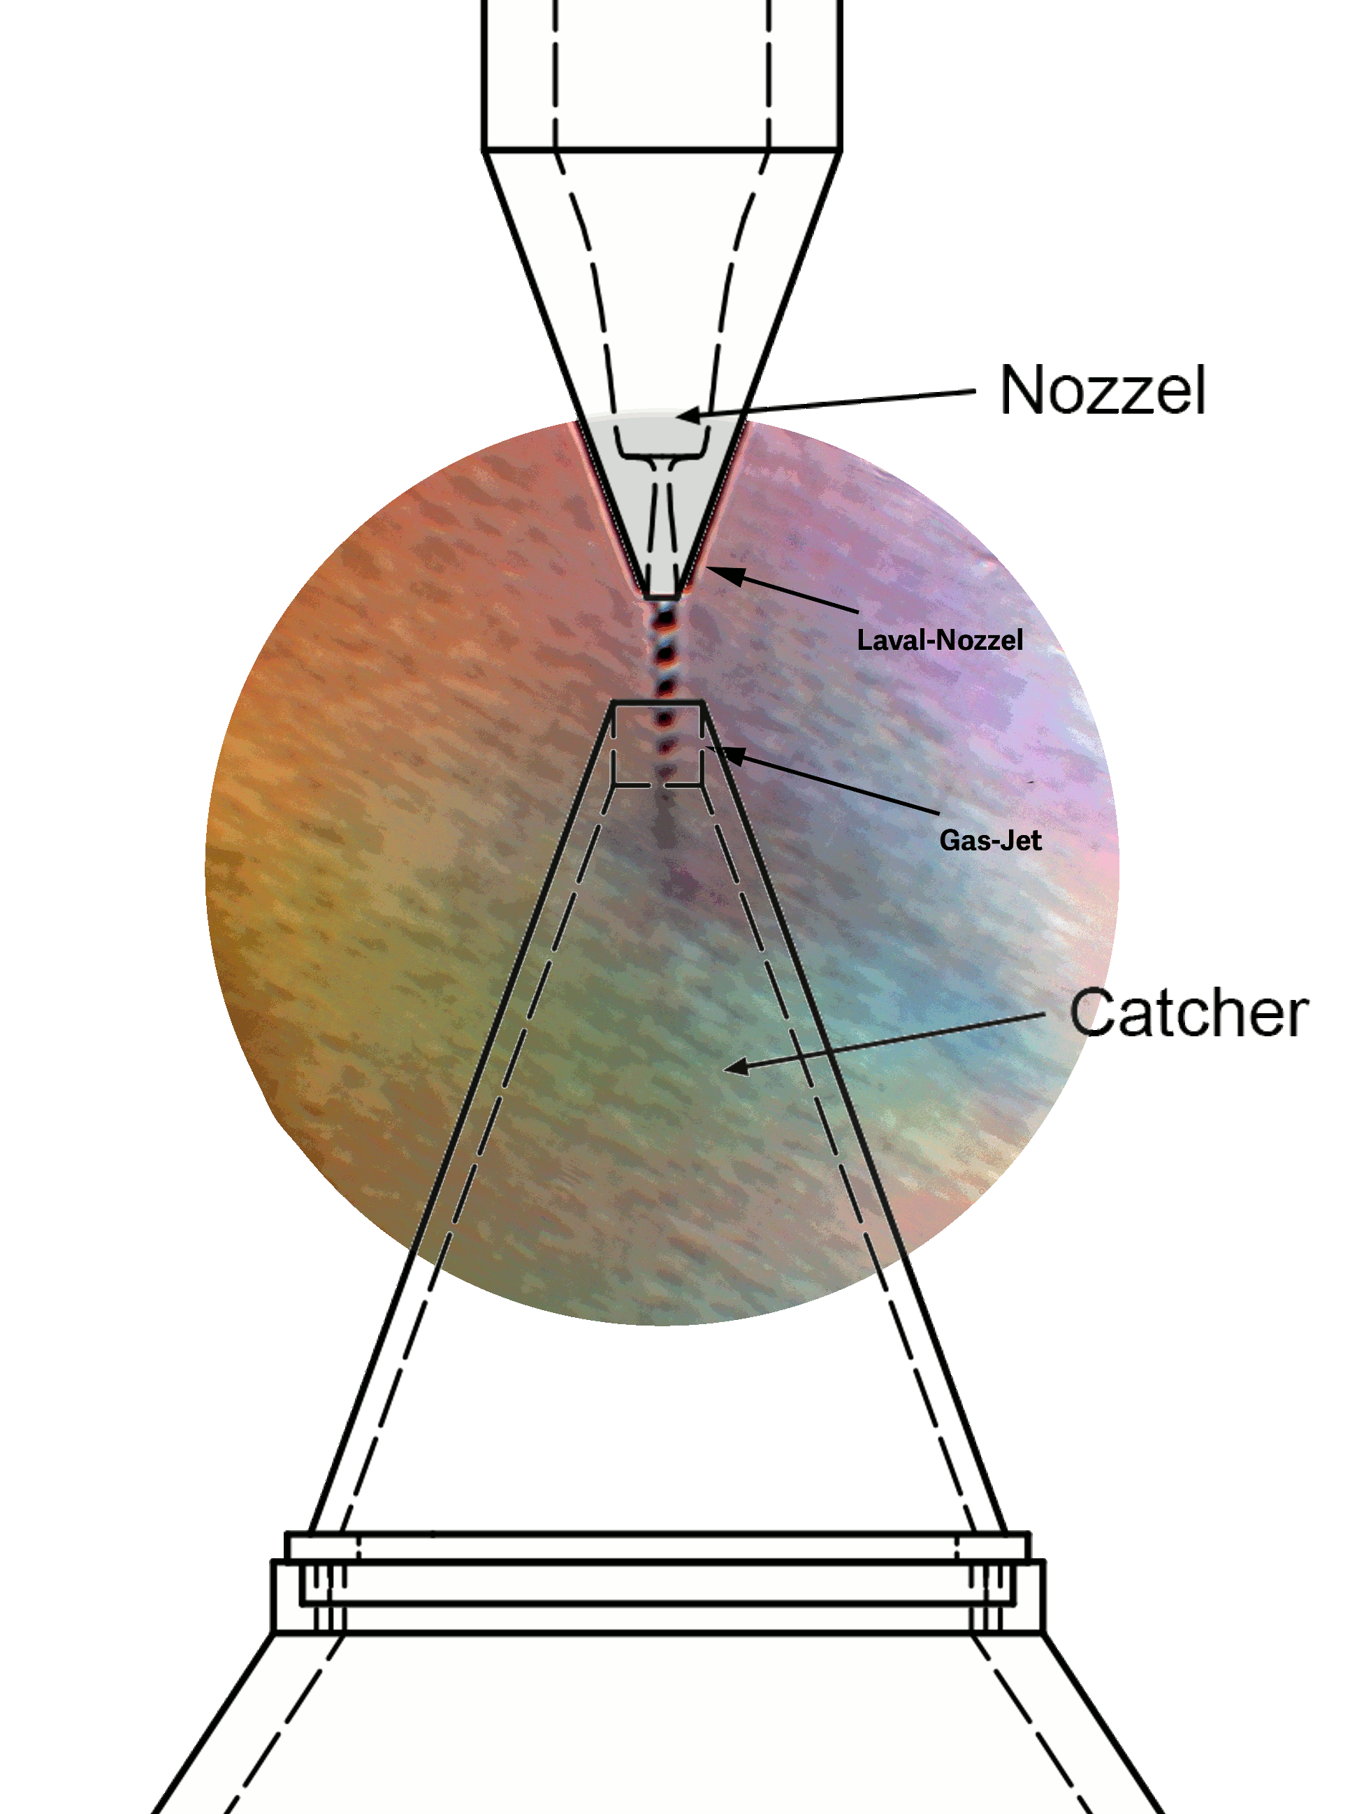
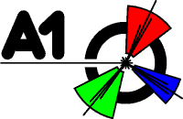

Future measurements
Next generation of experiments foreseen at:
ISR valuable technique for future experiments.
Modifications to the spectrometer setup required.
A point-like target without extensive frame needed.
(Solid-state plastic target not an option).
Hypersonic gas jet target for measurements with minimal background contributions.
Notes:
However, to be able to perform better measurements, we need to modify the
Spectrometer setup, to avoid contributions of backscattered events and we
Need a new, point like-target withour extensive frame. And perfect for this
Will be the newly designed windowless hypersonic jet target that has been
Designed For the MAGIX experiment.

Slide 14
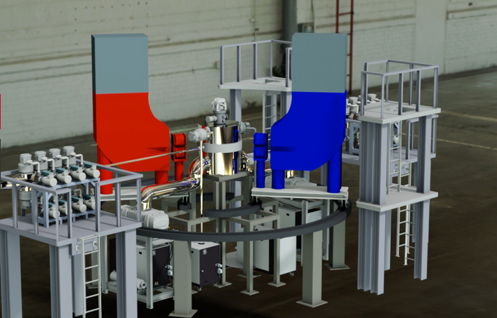
Summary
A pilot experiment has been performed at MAMI to measure G_{E}^{p} at very low Q².
A new technique for FF determination based on ISR has been successfully validated.
Reach of the first ISR experiment limited by unforeseen backgrounds.
Next generation experiments are scheduled/foreseen at the A1 and at the new accelerator MESA.
Notes:
And this brings me to the conclusions. Proton radius is a persiting open
Question of todays nuclear physics that most definetly deserves our attention.
I have presented you an ongoing experiment at MAMI, which provides
measurment of the proton Charge form-factor in the low Q2 region, that has
not been investigated before. For that we used a new techninque based on ISR.
Which has proven to be working well. Unfirtunately, due to the unforeseen backgrounds
We could not provide measuemnets down to 10E-4 but only to 1E-3, and let this
Missing part of the Q2 range to be investigated by the next generation experiments
At MAMI and at MESA.

Slide 15
Thank you!

Slide 16
Kinematic settings
Neighboring setrings overlap for ½ of the acceptance.
Three kinematic regions overlap to verify ISR approach.
Test of ISR
Overlap for ½ of
the acceptance
Notes:
The kinematic points measured in the experiment are shown on this next plot, together
With the corresponding values of the Q2 at the vertex. We measured CS in 56 kdifferent
points at three different beam energies, where the settings were chosen such, that two
neighboring settings overlap for Half of the acceptance, To minimize systematic uncertainties.
And As I have already explained before, kinematic points for all three energy settings have an
Overlap, which will give us ability to test the ISR approach, by comparing The FF from the tail
With the values measured from the elastic peak.
It took us four weeks to measure all the settings with enough statistics , and although the
Experiment was executed without major problems, we were still facing difficulties, all of
which were not foreseen before the experiment and caused the offline Analysis to be
much more difficult than originally planned.

Slide 17
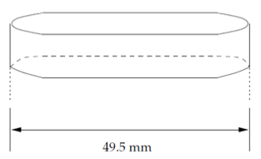
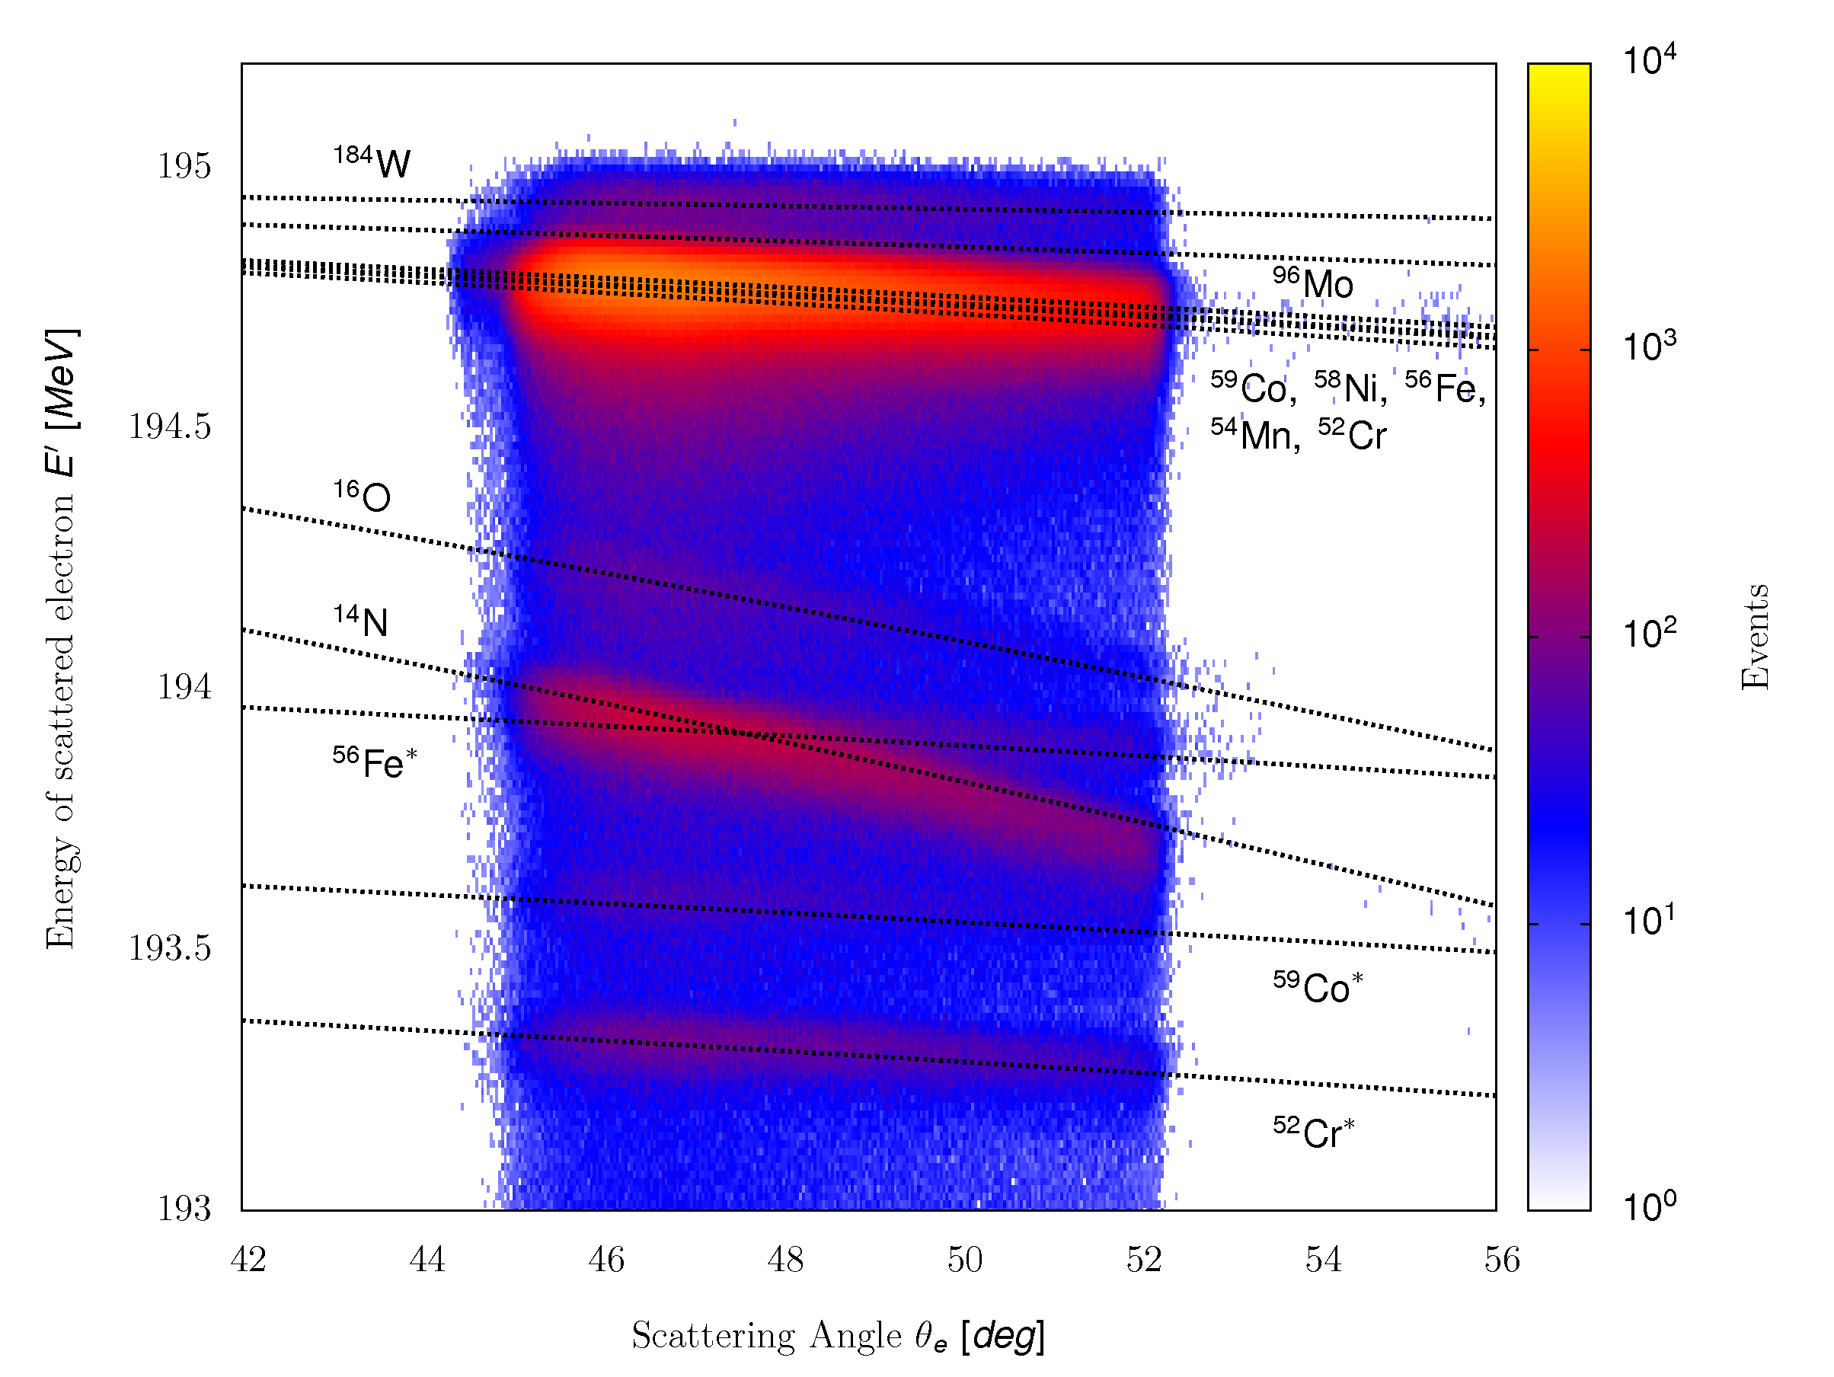
Cryogenic depositions
Disturbs Luminosity determination.
Good vacuum in target chamber (10⁻⁶ mbar)
Fixing Spectrometer A to elastic settings to see effects of snow gathering more clearly.
Spectrometer A has enough
resolving power for clear
identification of Nitrogen and
Oxygen.
Notes:
Since we were using the Cryogenic H2 target the frist challenge were the
Ccyogecin depositions that can gather around the target due to
The finite vacuum in the scattering cgamber and distort our measured
Spectra. This problem was know already from before and we took extra
Precautionsto minimize these effects. We installed extra aramid foils
Around the scattering chamber and this way ensured almost 2orders of magnitude
Better vacuum than before and significantly improve the conditions.
Than you see on this plot is a distribution of events along the target relative to
The first run for an old expeirment, and you can see that with time due to ice
Gathering, the amount of events coming from the walls grew. Then at this points
The high current run was taken which melted the ice and then the ration changed.
In the bottom you see the conditions during our experiment, and you can seen, that
We have almost perfect conditions, with only small amount of ice.
Then we also went even a step further and decided to precisely monitor
Also the residual cryogens. Therefore was one of the spectromers always positioned
Such, that were O2 and N2 elastic peaks within the acceptance and then used
The missing Mass spectra for identifying the amount of snow.
This plot shows a momentum distribution of scattered electrons as a function of scattering
Angle, for a typical production run. One can see that we have enough resolving power do
Distinguish elements inside the target walls and clearly see contributions of Nitrogen and
Oxygen.

Slide 18
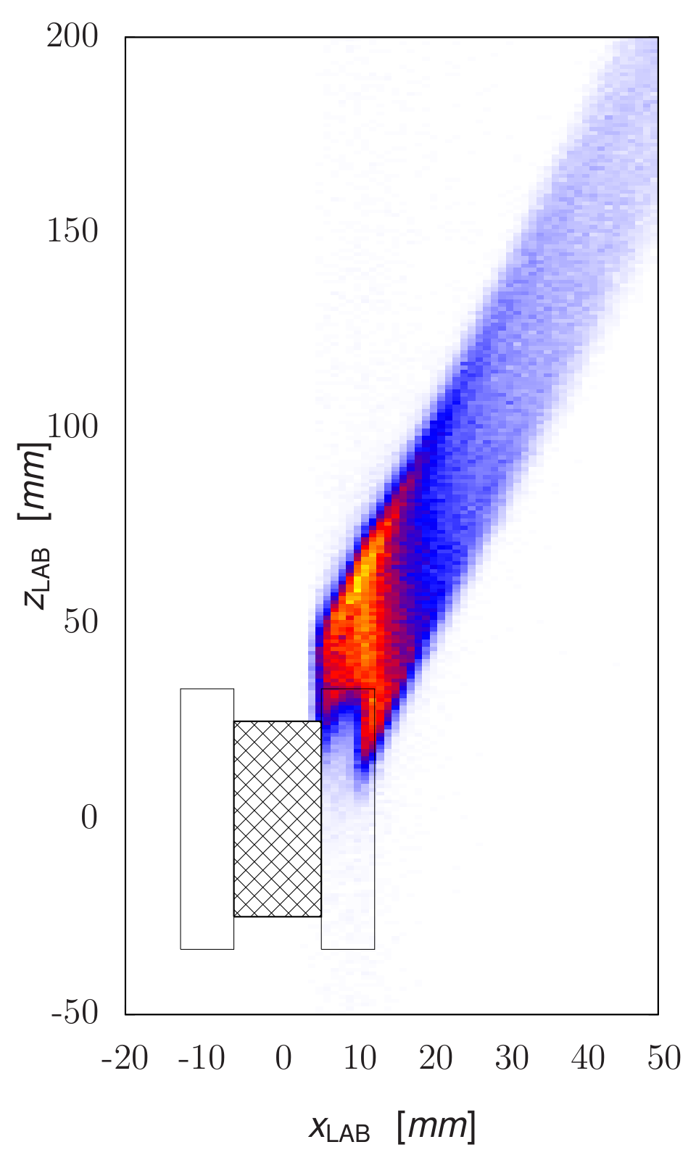
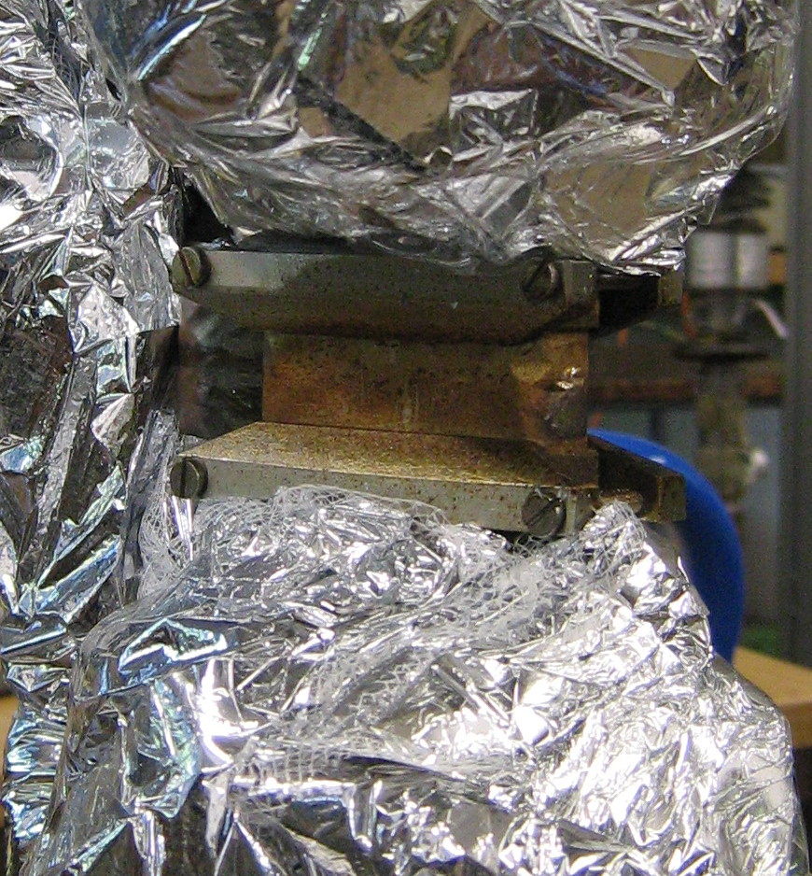
Target Frame contributions #1
Presence of target frame results in the deficiency of the elastic events .
Elastically
scattered
electron
Incoming
electron
Scattered electron
annihilated in
the frame
Projection
plane
Notes:
However, the effects that we did not anticipate is related to the support frame
Of the target. As you can see on this plot is our 5cm target mounted to the cryoloop
With help of these metal pieces which are usually outside the acceptance. However,
In our case the spectrometer B was standing at very small scattering angle, and there
The part of its acceptance was blocked by the frame. And this is excatly what you can see
On this plot. If we look at the projection of the Elastic! events detected by the spectrometer at this
horizontal plane, you can see, that the edge is missing.
Now you may say that this should not be a problem and that we should simply cut this part
Of the acceptance away. This would be true….

Slide 19
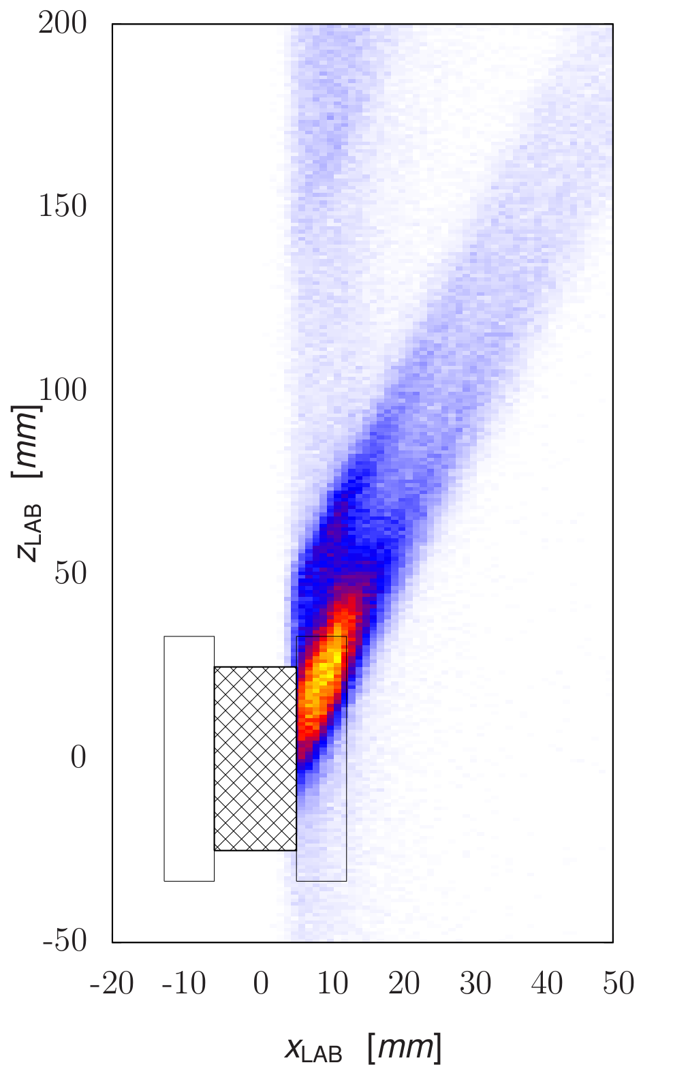
Target Frame contributions #2
… and in the abundance of bogus events in radiative tail of the elastic peak.
ISR+FSR
electrons
Incoming
electron
Projection
plane
Reemerging elastically
Scattered electrons
Notes:
… when measureiong than in the tail region these events would not reemerge and cause
The excess of events here. And since these events come out under different angles, our
Cuts had to be very strict, if we did not want to ne affected by this phenomenon. And
Because of this we lost more than ½ of the statistics.

Slide 20
Extracting G_{E}^{p} from data
Scattering angle of emitted photon offers clear separation of ISR and FSR and gives insight into the G_{e}^{p} depedence of measured cross-section.
A lookup table used to transform data to the G_{e}^{p} .
ISR
FSR
Notes:
To achieve this we first inspected simulation in the terms of the angle of the
Emitted real photon, which offers a good separation between the ISR here on the
Left and FSR on the right. Then we used this plot, we investigated how the simulated
CS changes if we change the FF for the ISR, while keeping the FSR peak at the same value.
Doing this for all the momenta we got a look-up table, which tells us,how the measured CS
Transform into the FFs. An applying this table to the plot in the previous slide,
We get our onw values of the FF…

