Slide 1
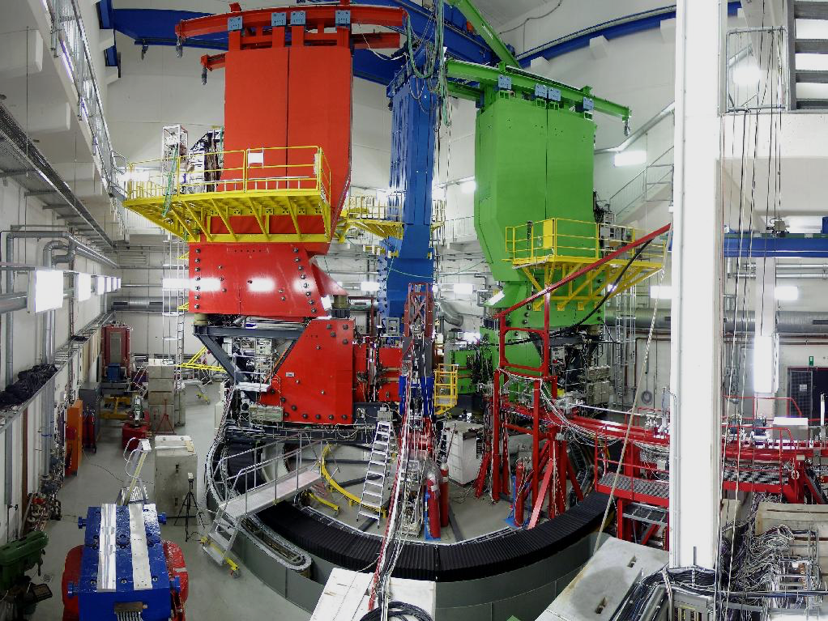
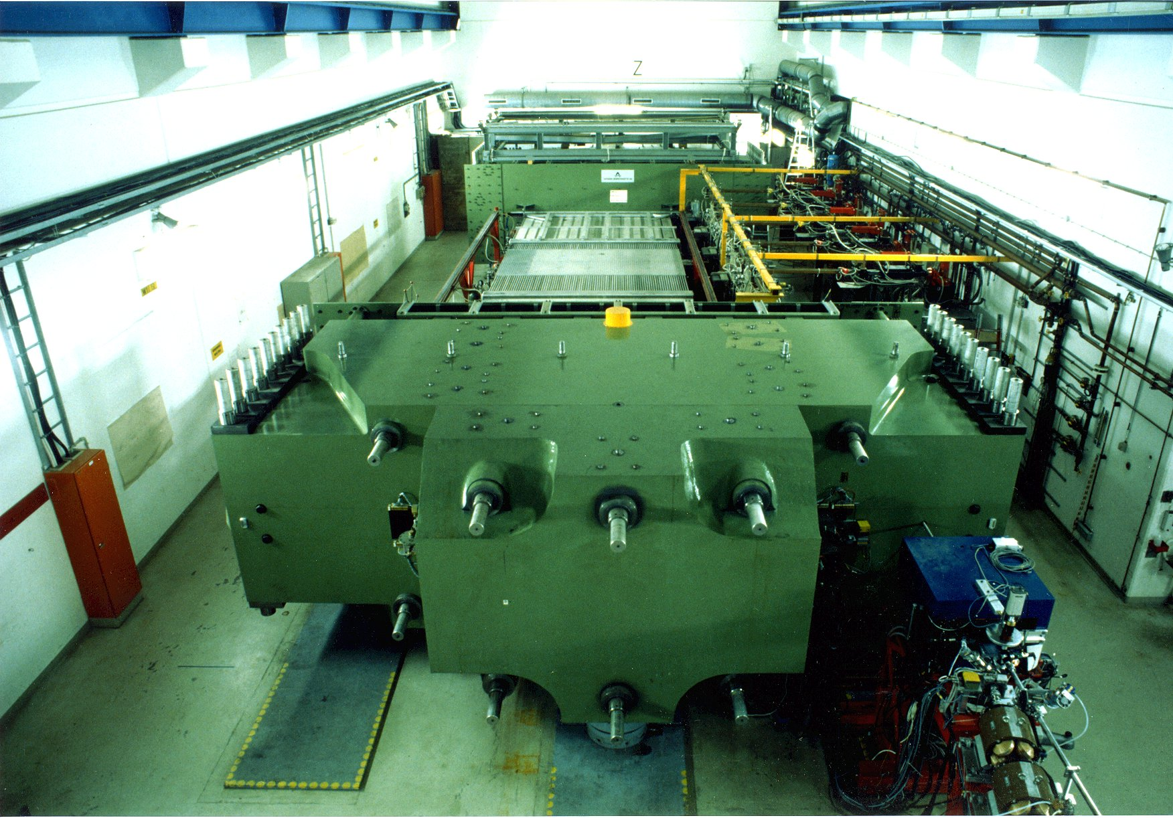
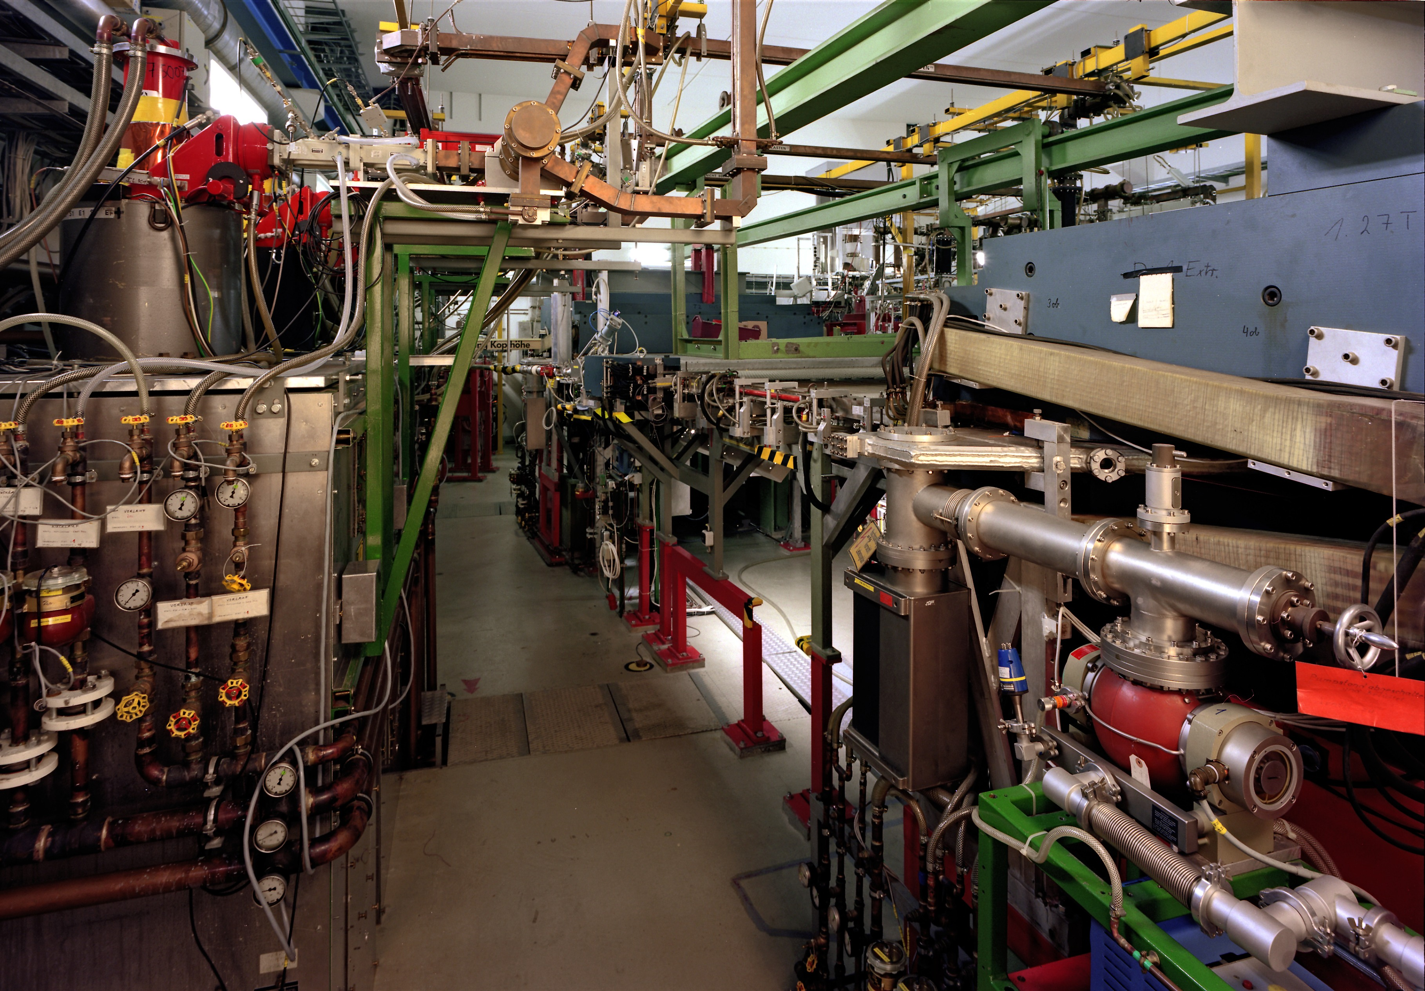



Proton form-factor measurements at A1 -MAMI
Miha Mihovilovic
JGU Mainz and JSI
GRC, Holderness 2016
Notes:
Hello everybody and welcome to my talk. I would also like to thank organizers for
inviting me to this conference and for giving me opportunity to talk about our endeavors
to study electro-magnetic properties of the proton.
To talk about the proton our proton form-factor studies at MAMI. Actually I would like to briefly
Discuss with your two of our more recent project.

Slide 2
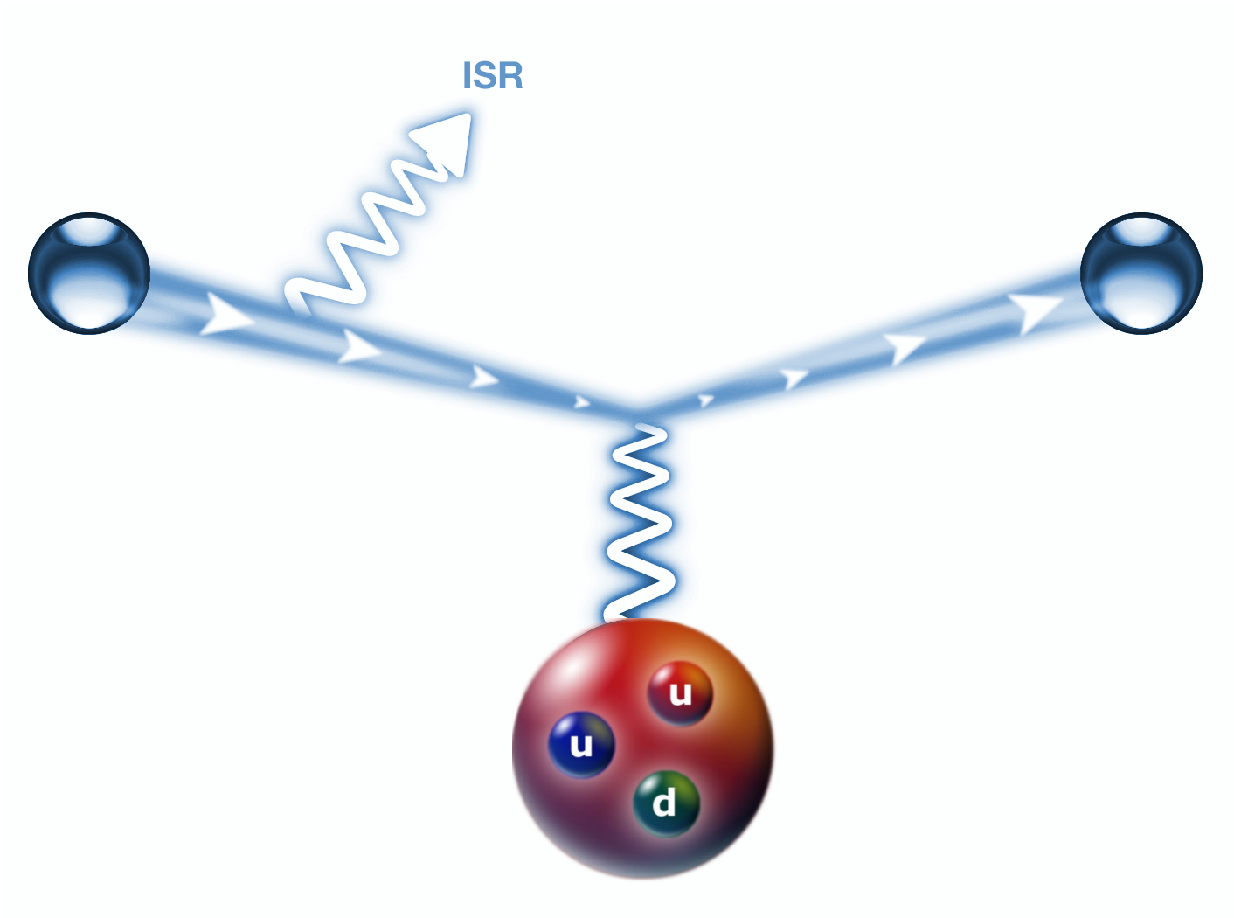

A1 Experiments
ISR Experiment:
Form-factor measurement
at extremely low Q²
Deep/Ceep Experiment:
Searches for in-medium modifications of form-factors
Notes:
I want to talk about the measurement of form-factor at very low momentum
Transfers And about pursuit of possible modifications of
the electromagnetic properties of the nucleon, When nucleon is inside
the nucleus. First lest look at this experiment which is interesting in content of
The proton radius problem.

Slide 3

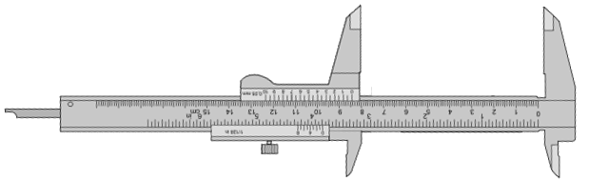
The proton radius problem
The 5σ discrepancy in the r_{p} measurements questions QED.
Nuclear results questionable due to the lack of data at very low Q².
ISR aims to provide new insight into the matter!
Notes:
As you may have heard there is a 5sigma discrepancy between the proton charge
Radius extracted from the nuclear scattering experiment and the extremely precise
value obtained with the laser spectroscopy of the muonic –hydrogen. Since
This discrepancy could be a indication of the inconsistency in the QED or a
A hit of a new physics, it attracted a huge attention of the physics community,
Which now tries to find the answers for the observation. And our aim is to
provide new measurements of the proton charge form-factor at extremely small
Q2, where measurements did not exist before, and with this bring additional
Insight into this matter.

Slide 4
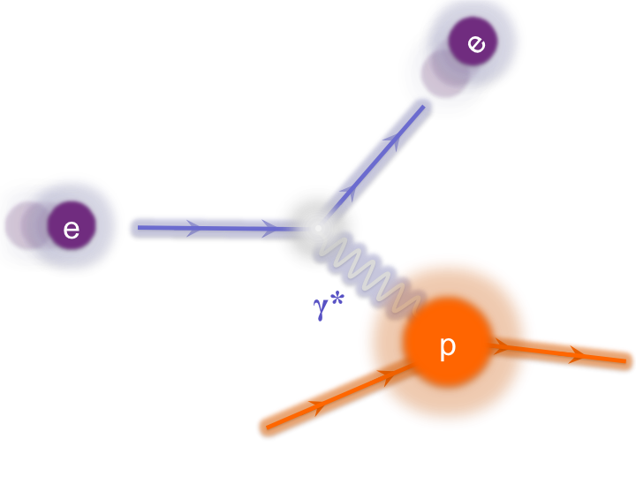
Radius via Cross-section measurement
Extraction of FF via Rosenbluth Separation.
Best estimate for radius:
Notes:
In the scattering experiments the radius of a proton is obtained indirectly by measuring
the cross-section for the electrons off Hydrogen.The measured cross section depends on
two form factors GE and GM, which carry the information about the charge and magnetization
distribution inside the proton. To extract these form-factors from the data, Rosenbluth separation
is typically employed, which requires CS measurements at different Q^2 and different values of epsilon.
And once we know the form, we can get the best estimate for the proton charge radius, by calculating
The slope of the Charge form-factor at Q^2=0.
Of course, A known problem of this technique is, that for calculation of charge radius a derivative
of the FFs at Q2=0 is required, where no data exist. The measurements exist at very small values,
but data at Q2<0.005 are still missing. Therefore we need to rely in our Calculations on the
extrapolation of the Form-Factors to Q2. This means, that If by any chance something strange is
happening with FFs at very low Q2<0.005, this could result in a different value of the Proton charge
radius.

Slide 5
Proton’s charge form-factor
Data available only for Q² > 0.004 (GeV/c)².
Extrapolations to zero are needed!
Instabilities related to extrapolation are sources of systematic offsets.
Notes:
And here is the current status of the available data for the charge form factor, shown as a fucntion of the Q2.
In the ploh is the FF shown relative to the standard dipole approximation, which is a
Usual way to show these results. The points in the plot represents the world collection of the
Data in this Q2 range, except of the Bernauer results, which are shown in this plot with this
Blue band and corresponding errorbars. Here I want to ephasize one more time, that
This line are experimental results, but Because of the different approach in the analysis, his
result is not a discrete set of points but A smooth curve. You can see, that all the existing measurements
Are already very precise but the problem is, that even the best experiments provide data only
Down to Q2 of 4E-3. This means, that in order to calculate the radius, the data need to be extrapolated
Towards zero, can be unstable and can lead to systematic offsets of the extracted
Radis. And as you, how to properly model the FF in this region and how to fit the data without introducing
Unwanted bias has been a subject of an extensive debate in the last few years.

Slide 6
New electron scattering experiment
Determination of proton radius depends on the slope of FF (Q²->0).
No data at lowest Q².
- Region of Q² < 0.004 (GeV)²
is extremely hard to reach.
Kinematic range is limited
by available experimental
apparatus.
Novel techniques are
needed to explore
extremely low Q² regime.
?
Here no data exist!
For precise radius determination new measurements at even lower Q² are needed.
Notes:
So, to overcome the problem, we need new measurements at even smaller
Q2 in order to see how the really behave in this yet unexplored region
And also to more precisely determine the absolute normalization of the
Measurements. Of course the problem of these measurements is,
that this Q2 region is Experimentaly extremely hard to reach,
requiring some novel approaches And ideas to investigate this
region.

Slide 7
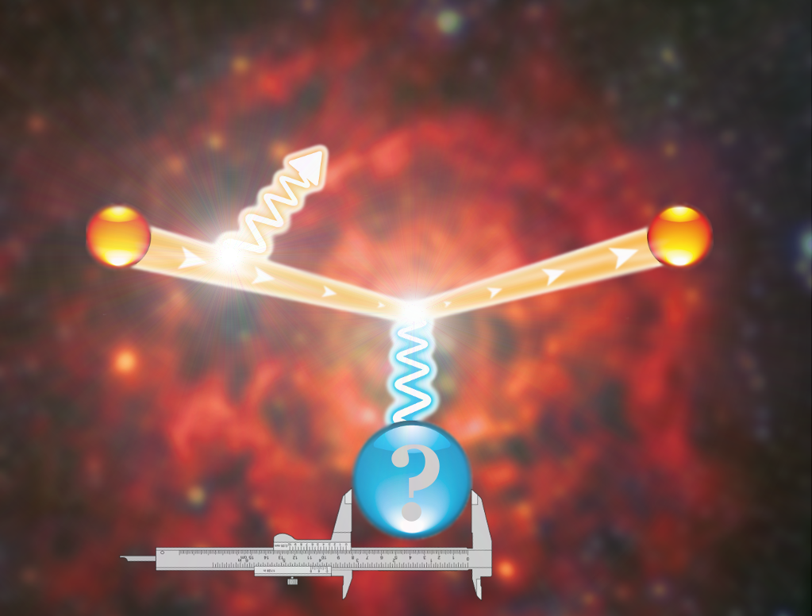
ISR Experiment at MAMI
Elastic
peak
#
Radiative
tail
p
Notes:
And the idea of our exeriment to come down to this region, by using not
Only the elastic data, but also exploit the information hidden inside the
Radiative tail of the elastic peak.

Slide 8
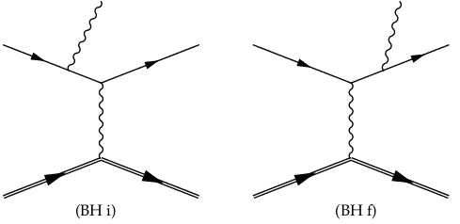
Radiative tail
Dominated by coherent sum of two Bethe-Heitler diagrams.
FSR
2
+
=
ISR
G_{E}
In data ISR can not be distinguished from FSR.
Combining data with the simulation, ISR information can be reached.
Redundancy measurements at higher Q² for testing this approach in a region, where FFs are well known.
Notes:
The radiative tail of the elastic peak is dominated by the contributions of two Bethe-Heitler
diagrams. The initial state radiation graph, where the incident electron emits real photon
before interacting with proton and final state radiation diagram, where photon is emitted
only after the interaction.
The plot here on the right shows the results of the MC simulation for the elastic scattering,
Considering The initial state and final state radiation, as a function of measured or
reconstructed Q2 and The vertex Q2, so true Q2 of a photon that interacts with the proton.
You can see, that in the case, when real photon is emitted before the interaction
Q2Reconstructed agrees with the Q2 at the Vertex. However, when the scattered electron
emits real photon, then Q2Vertex remains constant, While the reconstructed Q2 is lowered
for the energy taken away by the real photon.
Unfortunately in the experiment we can measure only ReconstructedQ2, which means, that
Looking only at data, we can not distinguish ISR from FSR. However, by combining the data
to this simulation, we believe that information corresponding to ISR can be reached. And this
Is the basic idea of this new MAMI experiment, which will hopefully allow us to extract FFs for
Q2 as low as 10E-4.
The experiment is desiged such that the data also at higher Q2s are collected, such that tail of all three
settings overlap. This will allow us to properly normalize the data.

Slide 9
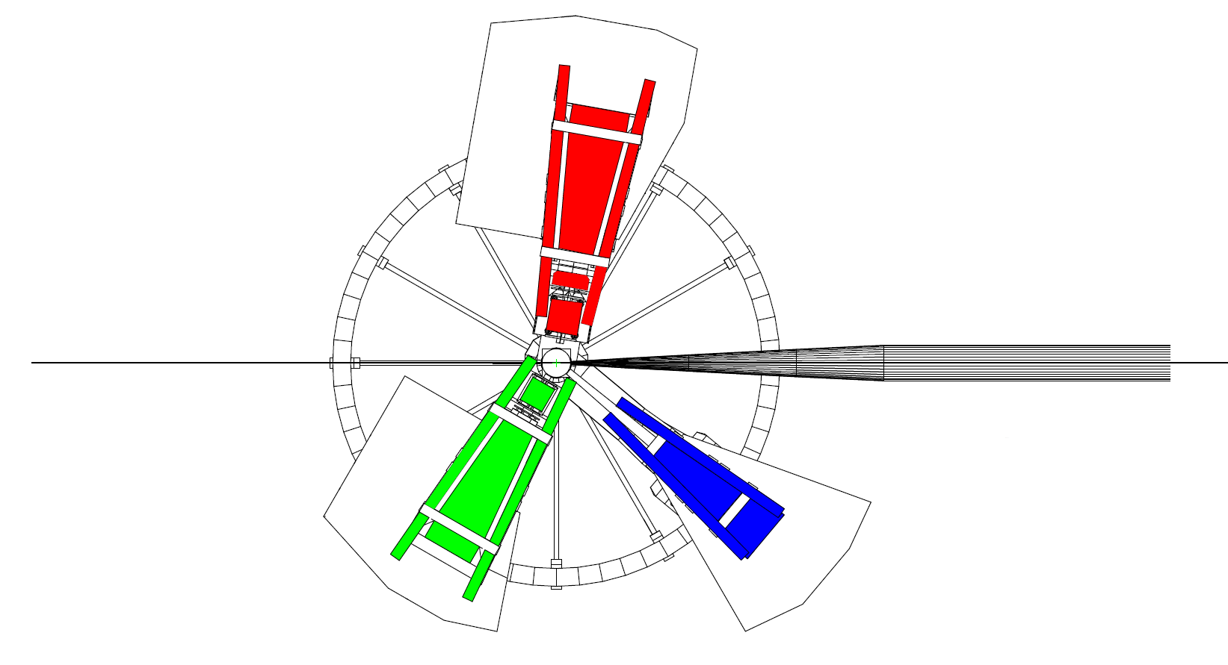
The ISR experiment
Full experiment done in August 2013. Four weeks of data taking.
Spectrometer A:
- Luminosity monitor (const. setting)
- Momentum: 180, 305, 386 MeV/c
- Angles: 50°, 60°
Electron Beam:
- Energy: 195, 330, 495 MeV
- Current: 10nA – 1μA
- Rastered beam
BPM
SEM
Förster probe
Spectrometer B:
- Data taking
- Angle: 15.3°
- Momentum:
48 - 194 MeV/c (35 setups)
156 - 326 MeV/c (12 setups)
289 - 486 MeV/c (9 setups)
pA
Luminosity monitors:
- pA-meter
- Förster probe
- SEM
Spectrometer C:
- Not used
Beam control module:
Communicates with MAMI and ensures very stable beam.
BPM and pA-meter measurements performed automatically every 3min.
Notes:
In this experiment, rastered electron beam with energies 195,
330 and 495 MeV was considered in combination with the Liquid Hydrogen target.
Beam currents were chosen to be between 10nA and 1uA, depending on the setup,
and were measured by two probes. The non-invasive flux-gate magnetometer, which
is a usual cavity and an invasive pA-meter, which is A simple calorimeter and
We also added a Secondary electron emission monitor inside The scattering chamber.
Unfortunately at low beam currents and low beam energies neither of the probes is
accurate enough. Therefore spectrometer A was set to a constant
elastic setting and was employed as a luminosity monitor. For the
radiative tail measurements spectrometer B was utilized.
It was positioned at the fixed angle, while its central momenta were being changed to
record the whole radiative tail at each beam Energy.
Experiment benefited a lot also from a newly installed automatic
Beam position control, This small Computer module communicates
with MAMI and every three minutes automatically measures Beam
position using cavities in front of the target and then makes corrections
If necessary. Additionally, is also measures beam current using invasive
pA meter. This resulted in incredibly stable beam conditions.

Slide 10
Preliminary Results
Existing apparatus limits reach and resolution of present ISR experiment to Q² ~ 10⁻³ GeV².
Pion production processes contribute ~10% at smallest momenta.
Simulation performed with Bernauer parameterization of form-factors.
A sub-percent agreement between the data and simulation validates the ISR technique.
Notes:
And this brings me to our experimental results which are shown
Here on the right side of the plot. So, what you can see here is
The Comparison between the data shown with black Points and simulation in
blue that was run with Bernauers parameterization of the form-factors. In
The simulation we also considered effects of the pion production
processes via Maid model and The residual contributions of the target
walls which contribute Due to finite resolution of the spectrometers.
Now on the bottom plot you see the comparison of the data to the
Simulation, and the sub-percent agreement between the data and
Simulation along the whole length of the radiative tail Demonstrates
that the presented iSR technique really works. And This was our first
main goal, to show that this approach works and to Offer a new way of
measureing FF in the region where FF havent been Measured before.
So we are happy that things work well in the tail, but what about the elastic
Peak? I mentioned before, the potential problems in the description of the
Peak and we indeeed encounter the problems there.

Slide 11
ISR form-factors (Preliminary)
First measurement of G_{E}^{p} at 0.001 GeV² ≤ Q² ≤ 0.004 GeV²
Final systematic checks remain to be made!
(Improve the theoretical description at the elastic line!)
Notes:
Which are shown here with the red points, together with the
Bernauer parameterization shown in blue and other measurements
Shown with the empty points. And the points that we get, can be divided
into two groups. The points above Q2=4E-3 in region were the FF have been measured
Before serve us again to demonstate, that the ISR approach works, while the
Points below this line, represents the first FF measurement in this region
And extend the existing range for a factor 4.
These results are still preliminary, but we believe that we are very close
To finalizing the results. We need to make some last systematic checks
But then we hope we can publish these results.
And with Form-factors now available we can now try to say something
About the radius.

Slide 12
ISR Proton radius (Preliminary)
G_{E}^{p} modeled with the polynomial fit.
Higher order terms (a,b) known from previous analyses [Distler et al.]
Notes:
Since our precision is finite and range in the Q2 limited we decided to use
A simple polynomial model for the form-factor. We used this model such that
Normalization and radius were free parameters, while the curvature and
Third order parameter were taken from the fit to the world data. And with this
Fit we get a following value for the proton charge radius. As expected, this
Value is inferior to the present best measurements, which has been
Expected but a bit said because we were really hoping for a better
Measurements. We haven’t lost our faith and decided to continue working
On this and try to further improve the uncertainty of the obtained results
and the to further extend the reach. And the NXTGEN experiments are
already being planned, first a A1 and Ultimatively then at MESA.

Slide 13
In-medium modifications ?
Is the nucleon structure modified within the nuclear medium?
Modifications result in observable changes in the EM form-factors.
Notes:
Here it is now important to say that this radius we are discussing is the charge
Radius of a free proton. Now if we look at the proton, that is contained
Inside a nucleus, where there is not much free space, it is resonable to expect
That the charge radius will change. And this brings me to the second part of my talk,
Where I would like to discuss the in medium effects. In particular we are interrested,
How the EM form-factors change, when proton in inside a nuclear medium.

Slide 14
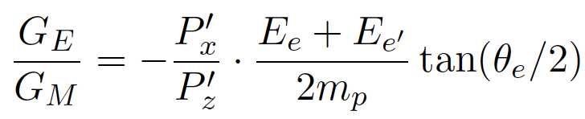
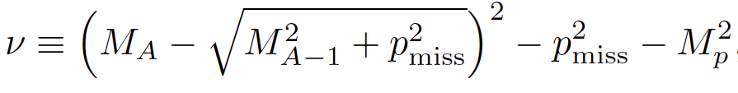
Quasi-Elastic Electron Scattering
Probing a single nucleon inside the nucleus.
Sensitivity to medium modifications via polarization transfer in QE nucleon knockout (PWBA):
Effect camouflaged by FSI and MEC effects.
Observable: Virtuality – how far off shell is the nucleon:
Is the effect caused by nuclear density or by momentum of the proton inside the nucleus?
Notes:
Now if we want to study such effects, we need an access to a single proton inside the
Nucleus., and a good way to do is via mesurement of polarization transfer from the
photon to outgoing Proton measurements in quasi elastic Processes, which gives us
access to small Effects, which would not be accessible via classical cross-section
measurement. In the simplest PWBA is the ratio of measured polarization directly
Proportional to the ratio of the two form-factors. And if we now do this measurement for
The proton inside the nucleus and compare it to the values for a free proton, we can
Get an idea about the influence of medium on the proton FFs.
Problem is of course, that these modifications are competing with other effects
That are happening inside the nucleus such as FSI and MEC, which camuflage
The effect we are after. So, if we want to learn about the modifications, we need models
Which precisely consider also these effects. Available are different calculations
Are available for few light nuclei and they predict a strong correlation of the effect
With the momentum of the nucleon inside the nucleus. Hence, a good variable to
Look at is the so called virtuality, which in the PWBA tells us, how much off-shell
was the proton inside the nucleus before the interaction.

Slide 15
Polarization transfer in ²H @ MAMI
I.Y., D.I. et al. arXiv:1602.06104
General agreement with the calculations (with Bernauer FFs). Effect is predominantly due to proton motion and FSI in the deuteron.
Remaining 10% gap between the data and theory indicates the need for modification of of the bound nuclear structure.
Effect independent of Q².
Notes:
The experimental approach is analogous to the Jlab experment with the difference, that
We covered much larger range in the virtuality. Results that we get are presented on this next plot.
The new measuements are shown with full black points, together with different
Calculations of Arenhoevel, using free form-factor paramaterizations. The purpule
Line shows the PWBA while the full calculations including FSI etc are shown in BLUE.
And the results clearly demonstrate, that the majority of the effect is due
To FSI as was observed in the He results in the previous slide. However, if one
Looks more closely, one sees, that the data are approx 10% higher than the
Calculations, which could be an indication for the need for the modification of
The FFs – again similarly as in the 4He data.
Plot also shows the old deuterium measurements from Jlab, which were done
At much higher Q2 and are shown with open circles. And good agreement with
Our new data demonstrate, that the effect does not depend on Q2, but really
Depends on on the momentum of the proton inside the nucleus.

Slide 16
⁴He vs. ²H
I.Y., D.I. et al. arXiv:1602.06104
Excellent agreement between weakly bound ²H and strongly bound ⁴He.
Deviations from free proton value do not depend on nuclear density.
New measurements at JLab and MAMI scheduled.
What about other nuclei?
Notes:
Then, came another surprise, when the data were compared to the previously
Shown Helium data, which are shown here in green, and you can see, that
The two data sets agree perfectly which means, that within our errorbars,
The observed deviation from the free form-factors really does not
Depend on the nuclear density, but only on the virtuality.
Of course we are very enthusiastic about these results, but we are aware,
That with this kind of statements, we still needs to be cautious, because
The effect is small, and our data are limited. Therefore we are already new
Measurements underway, where we want to virtuality for positive p_miss,
Which could give us a further insight into the matter. And also Jlab is planning
New measuemnets on both 2H and 4He, to cover the larger range in pmiss.
Now, What would be now interesting to see is if the observed behavior
Is also valid for other nuclei? Therefore, our Israeli collegues decided to do
The polarization transfer measurements in 12C

Slide 17
New measurement on ¹²C @ MAMI
Preliminary
New polarization transfer measurement on ¹²C.
First preliminary findings support results from ²H and ⁴He.
Universal behavior of polarization transfer ratio in nuclei?
Analysis on going ➔ See poster of David Izraeli for details.
Notes:
The experiment was performed Last year and the analysis of the data
is still ongoing. However, from the preliminary Results, which are curtsey
of David Israeli, and are shown on the plot with red color, you can see, that
Are consistent with the results on 2H and He and this way indicate a
Universal behaviour of the polaruization transfer ration in nuclei. As said
These results are not final yet and if you are interrested in th precise status
Of the analysis I would like to invite you to a visi poster of David Israeli,
Who is together with Tilen Brecelj analyzing these data.

Slide 18
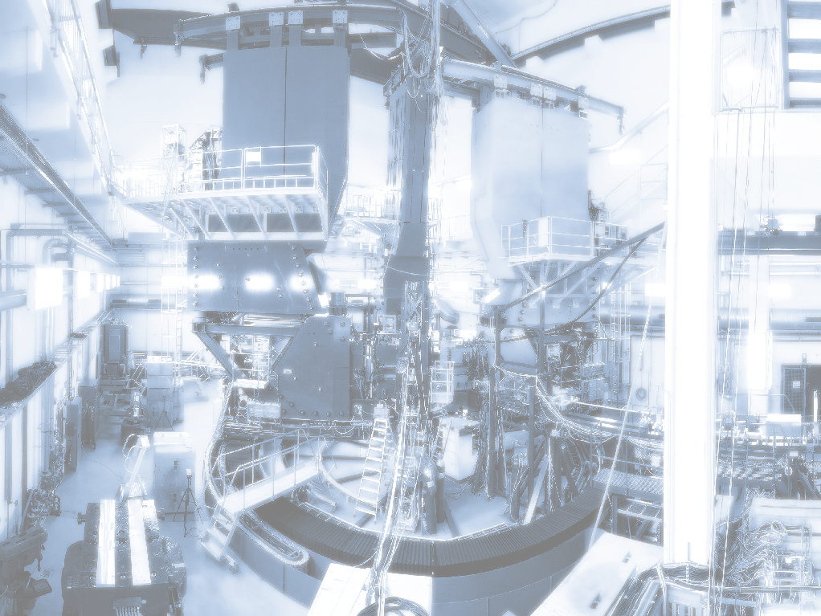
Summary
MAMI has a long tradition of form-factor measurements.
Several new experiments on light nuclei (H, ²H, ³He, ⁴He, Li) are underway at A1. Motivated by proton-radius puzzle.
A pilot experiment has been performed at MAMI to measure G_{E}^{p} at very low Q² using new technique based on ISR.
Reach of the first ISR experiment limited by unforeseen backgrounds but next generation experiments already foreseen at A1 and at MESA.
Polarization transfer measurements on ²H and ¹²C indicate a universal dependence on virtuality and direction of missing momentum.
New experiments are underway to cover broader range in virtuality.
Notes:
And with this invitation I would like to conclude. MAMI facility in Mainz
Has a long tradition of investigating EM structure of light nuclei and
We are motivated to pursuit this path even further. There are
Several projects now going on, that are dedicated to measure
Electromagnetic properties of light nuclei and most of them was motivated
By the proton radius puzzle. Today I presented you two of our more
Recent projects. The initial state radiation experiment, that aims to
Measure the charge form factor of proton at extremely small q2 . The results
That I presented you demonstrate that our new approach works
And can be used to measure FF. We have also provided new FF
Values, but due to unforeseen backgrounds we could measure
Only down to 10-3 and not to 10-4 as originally planned. However,
Now we know how to avoid the problems and we are alrady planning
Next generation experiments at MAMI and MESA.
In the second part of my talk I have shown you our latest results
From the polarization transfer measurements on 2H and 12C, which
Together with the helium results from Jlab indicate a universal behaviour
Of the form-factor ration inside the nucleus, which is independen of
The nuclear density and the Q2. The ratio depends only on the virtuality
And is predominantly governed by the FSI. However, with the present
Precision of the data we can not confirm the in medium modifications
Of the form-factors.

Slide 19
Thank you!

Slide 20
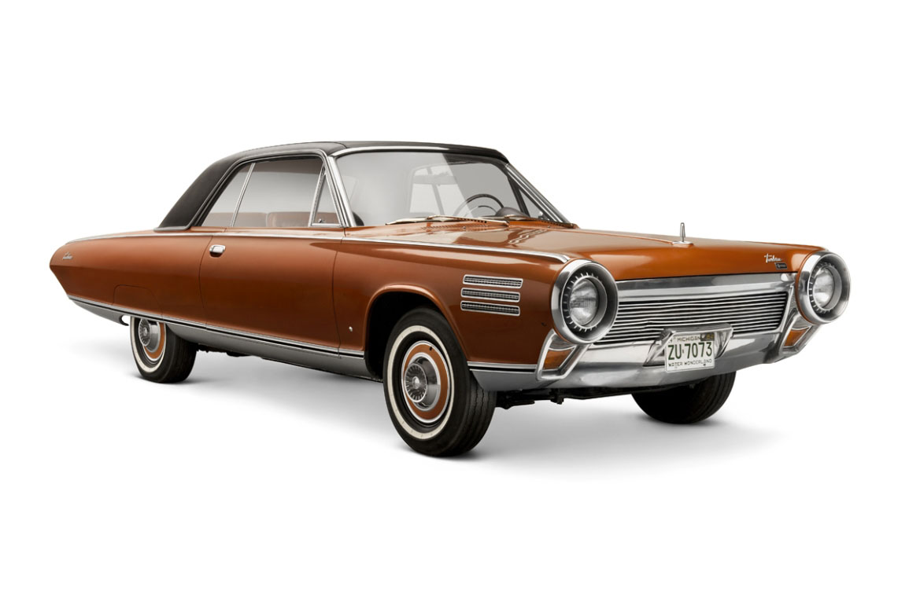




Electromagnetic properties of proton?
After 50 year of research is the proton still not understood to a desirable accuracy!
1963
2016
Notes:
This topic has of course a very long tradition and is being discussed
Since the early days of nucelar physics and work of Hostadter and his
Colleagues. Through the years there have been many measurements
done, ranging from the Pioneering experiments one in early 60s to high
precision measurements Done in last couple of years. And this year we
Are actually celebrating 25 years of MAMI contributing to this field. And
In my talk I would like to present you two of our most recent experiments
Related to the electromagnetic properties of the nucleon.

Slide 21
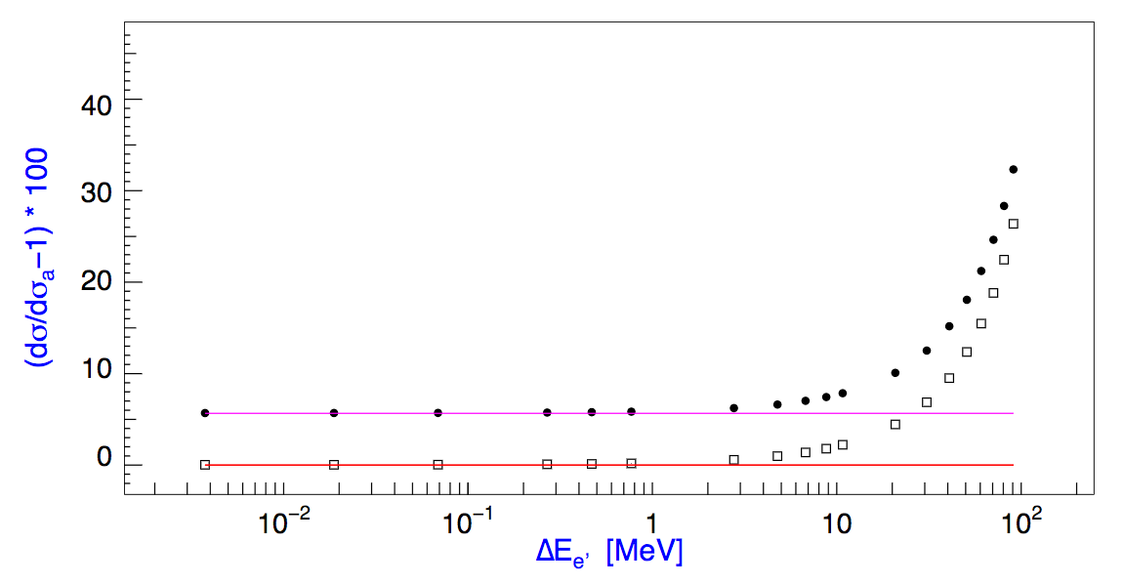
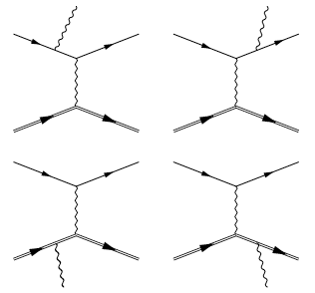
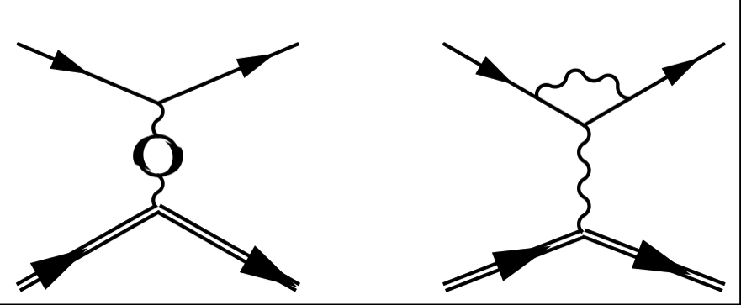
Simul++
Based on standard A1 framework for the VCS experiments.
Detailed description of apparatus.
Exact calculation of the leading diagrams for high precision.
ISR
J. Friedrich, PhD
Notes:
Of course, for a comprehensive comparison with the
Data and precise extraction of the FF we of course need a detailed
simulation. And what we use is the standard A1 simulation package,
Which has ben proven to work well for a serious of past experiments
And includes a detailed description of the spectrometer setup. For our
Experiment the framewark was used with a sophisticaed generator
Of events, that was written primarly for theestimation of the bacground
In the VCS experiments. This generator exactly calculates the Feynman
Diagrams for the first order diagrams shown here. This is crucial for a
Precise description of the radiative tail far away from the elastic line.
This plot shows the comparison of the full calculation with the standard
Approximation as a function of the deviation from the elastic line, and you
Can see, how the peaking approximation becomes unrealiable, when more
Than few MeV from the elasic line.
However, using exact first order calcilations was also good enough.
Then we also had to include higher order corrections.

Slide 22
Virtual corrections
Based on work of Vanderhaeghen et al. [M.Vdh, PRC 62, 025501, 2000]
Due to computational intensiveness used as effective corrections.
Only electrons considered in vacuum polarization loops.
Notes:
First the virtual corrections for which we are using the calculations of
Vanderhaeghen and his collaborators. Since the calculation of these loops
requires a lot of computation power, we evaluated their contribution
In a separate program and then used them a effective corrections to the
Cross sections. Here I need to emphasize that these calculations were
Also made for the VCS experiments, meaning that the integration is not optimized
For region very close to the elastic peak, where the photon is very soft.
This is important to remember, because you will see later that this causes
Us then some problems with the interpretation of the results.
Additionally,in the calculation of the vacuum polarization corrections we
Considered only electrons. The contribution of muons is in the permil level
And is considered only in the estimation of the systematic uncertainty.

Slide 23
Real corrections
Second order real photon corrections considered in terms of peaking approximation.
External radiative corrections (Straggling) considered using approach of Mo-Tsai.
Only contributions from Hydrogen and Air are relevant.
Notes:
For the calculation two-photon emission diagrams we do not yet have
Sophisticated code and we consider these effects using effective corrections
That are based on the elastic peaking approximation.
The External radiative corrections are based on the calculations of
Mo and Tsai, which should be accurate to 1% level.

Slide 24
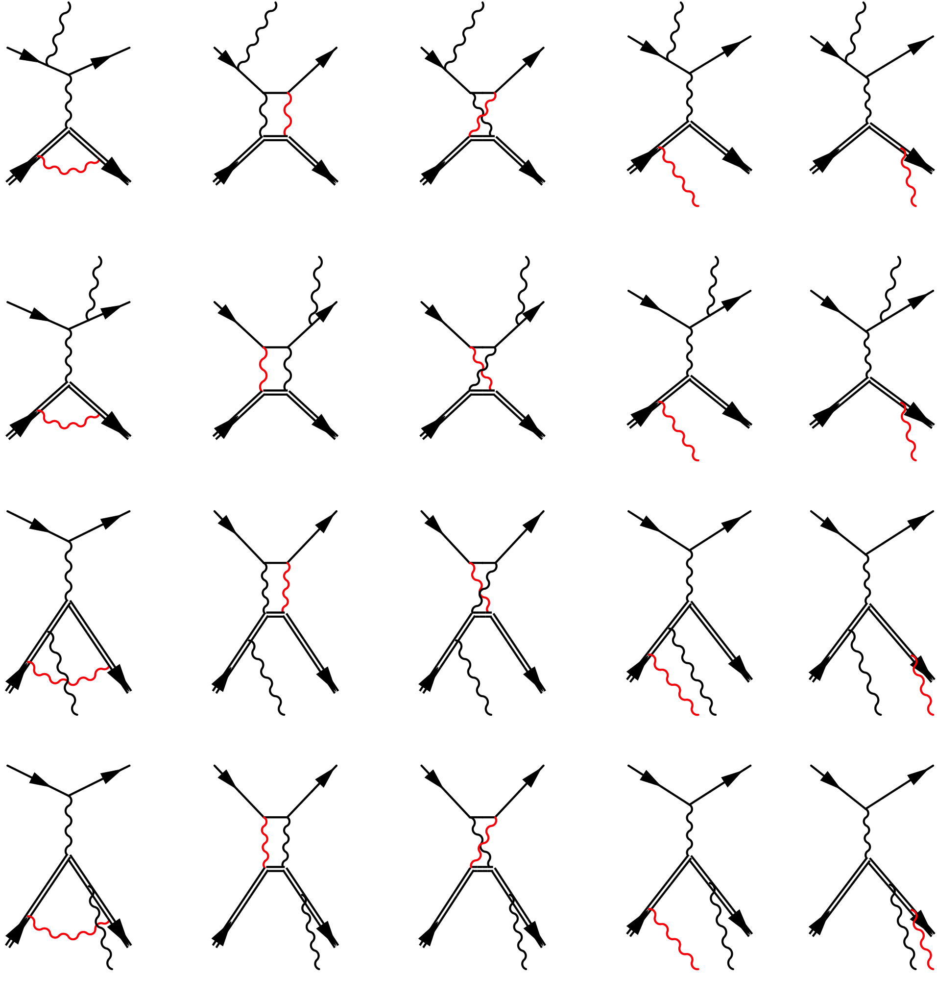
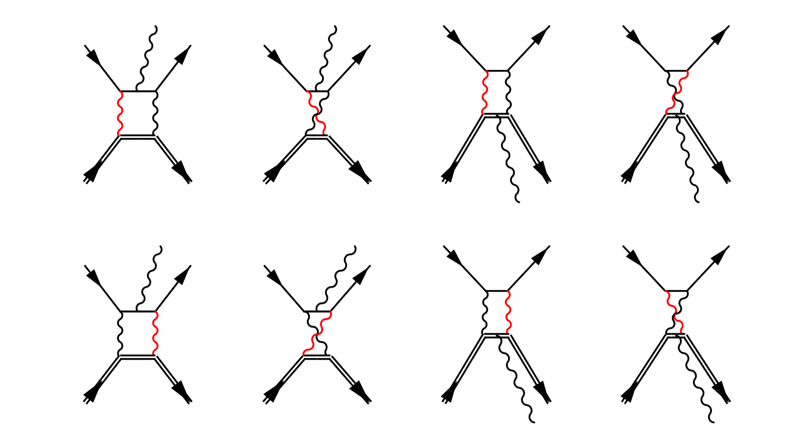
Hadronic corrections
Hadronic corrections considered in the limit of elastic scattering using approximation of Maximon-Tjon.
Proton is kept on-shell.
Notes:
The corrections on the proton size are expected to be small due to low Q**2 and are
Also approximated using elastic approximation. We use calculations of Maximon-Tjon,
Where we consider only part where proton is on the shell. The off-shel part, that requires
Vcs amplitudes is neglected.

Slide 25
The ISR experiment
Full experiment done in August 2013. Four weeks of data taking.
Spectrometer A:
- Luminosity monitor (const. setting)
- Momentum: 180, 305, 386 MeV/c
- Angles: 50°, 60°
Electron Beam:
- Energy: 195, 330, 495 MeV
- Current: 10nA – 1μA
- Rastered beam
BPM
SEM
Förster probe
Spectrometer B:
- Data taking
- Angle: 15.3°
- Momentum:
48 - 194 MeV/c (35 setups)
156 - 326 MeV/c (12 setups)
289 - 486 MeV/c (9 setups)
pA
Luminosity monitors:
- pA-meter
- Förster probe
- SEM
Spectrometer C:
- Not used
Beam control module:
Communicates with MAMI and ensures very stable beam.
BPM and pA-meter measurements performed automatically every 3min.
Notes:
In this experiment, rastered electron beam with energies 195,
330 and 495 MeV was considered in combination with the Liquid Hydrogen target.
Beam currents were chosen to be between 10nA and 1uA, depending on the setup,
and were measured by two probes. The non-invasive flux-gate magnetometer, which
is a usual cavity and an invasive pA-meter, which is A simple calorimeter and
We also added a Secondary electron emission monitor inside The scattering chamber.
Unfortunately at low beam currents and low beam energies neither of the probes is
accurate enough. Therefore spectrometer A was set to a constant
elastic setting and was employed as a luminosity monitor. For the
radiative tail measurements spectrometer B was utilized.
It was positioned at the fixed angle, while its central momenta were being changed to
record the whole radiative tail at each beam Energy.
Experiment benefited a lot also from a newly installed automatic
Beam position control, This small Computer module communicates
with MAMI and every three minutes automatically measures Beam
position using cavities in front of the target and then makes corrections
If necessary. Additionally, is also measures beam current using invasive
pA meter. This resulted in incredibly stable beam conditions.

Slide 26
Kinematic settings
Overlapping settings to control systematic uncertainty.
Length of the tail limited by pion production processes!
Overlap for ½ of
the acceptance
Notes:
The kinematic points measured in the experiment are shown on this next plot, together
With the corresponding values of the Q2 at the vertex. We measured CS in 56 kdifferent
points at three different beam energies, where the settings were chosen such, that two
neighboring settings overlap for Half of the acceptance, To minimize systematic uncertainties.
The reach of each setting in E’ is limited by the threshold for pion-production processes.,
Which we want to avoid.
The three energy settings were chosen such that they overlap, which gives us ability to
normalize them relative to each other, which leaves us with only one open
Parameter. And if all settings could be used, then even this remaining parameter
Could be fixed by using static FF limit at Q**2=0;
It took us four weeks to measure all the settings with enough statistics , and although the
Experiment was executed without major problems, we were still facing difficulties, all of
which were not foreseen before the experiment and caused the offline Analysis to be
much more difficult than originally planned.

Slide 27
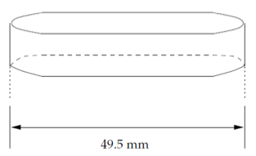
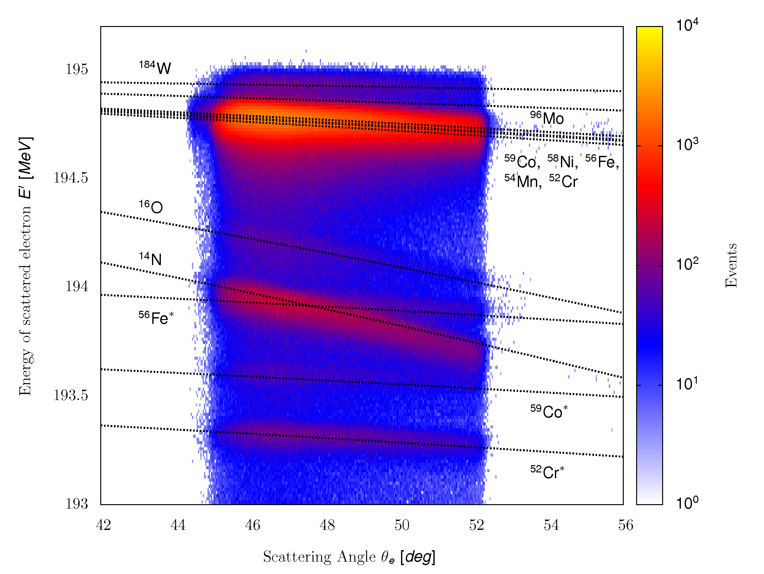
Cryogenic depositions
Disturbs Luminosity determination.
Good vacuum in target chamber (10⁻⁶ mbar)
Fixing Spectrometer A to elastic settings to see effects of snow gathering more clearly.
Spectrometer A has enough
resolving power for clear
identification of Nitrogen and
Oxygen.
Notes:
Since we were using the Cryogenic H2 target the frist challenge were the
Ccyogecin depositions that can gather around the target due to
The finite vacuum in the scattering cgamber and distort our measured
Spectra. This problem was know already from before and we took extra
Precautionsto minimize these effects. We installed extra aramid foils
Around the scattering chamber and this way ensured almost 2orders of magnitude
Better vacuum than before and significantly improve the conditions.
Than you see on this plot is a distribution of events along the target relative to
The first run for an old expeirment, and you can see that with time due to ice
Gathering, the amount of events coming from the walls grew. Then at this points
The high current run was taken which melted the ice and then the ration changed.
In the bottom you see the conditions during our experiment, and you can seen, that
We have almost perfect conditions, with only small amount of ice.
Then we also went even a step further and decided to precisely monitor
Also the residual cryogens. Therefore was one of the spectromers always positioned
Such, that were O2 and N2 elastic peaks within the acceptance and then used
The missing Mass spectra for identifying the amount of snow.
This plot shows a momentum distribution of scattered electrons as a function of scattering
Angle, for a typical production run. One can see that we have enough resolving power do
Distinguish elements inside the target walls and clearly see contributions of Nitrogen and
Oxygen.

Slide 28
Entrance flange contributions
Target
Good track
Collimator
Spectr. B
Bad track
Target
Nominal
acceptance
Spec. B encompasses a long entrance flange.
Events rescattered from the snout cover the whole vertex acceptance.
Notes:
The second issue that we hadn’t foreseen is related to the spectrometers B long entrance flange,
Shown here, which connects the scattering chamber and the magnet. And that happened was
Very similar to what we have seen before, Elastic events, and we have many of them, rescatter in
In the think metal pieces and reenter our acceptance with smaller momentum and different angles.
And on this plot I am showing the distribution of events at the entrance window of the
Spectrometer. So in the middle you see good events that go thorough the nominal acceptance
Of the spectrometer, and those on the sides, that hit the frame and scatter back into the acceptance.
And the problem is that with decreasing momentum this peak is larger and broader. And if we now
Project these events to the target is this what we get. When close to the elastic setting we see the
Target peak and small tail what comes from the snout. However, when at the end of the elastic line
You can seen that all that we see is only the snout!. Unfortunately such data can not be used for a
Detailed Analysis, of the CS and forced us to limit our reach to 1E-3 instead of 1E-4.

Slide 29
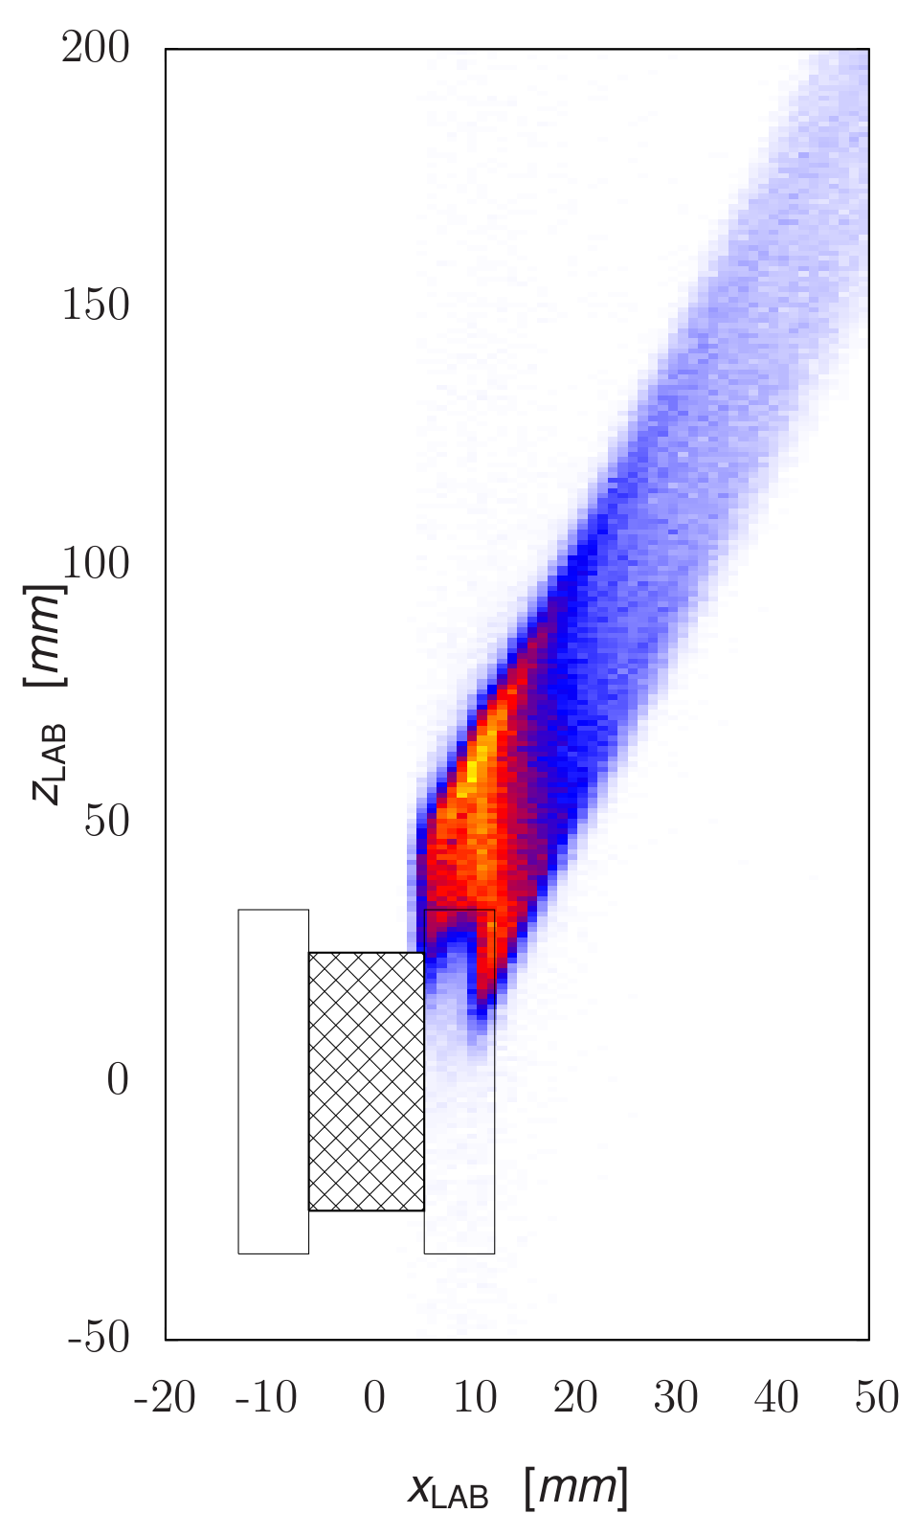
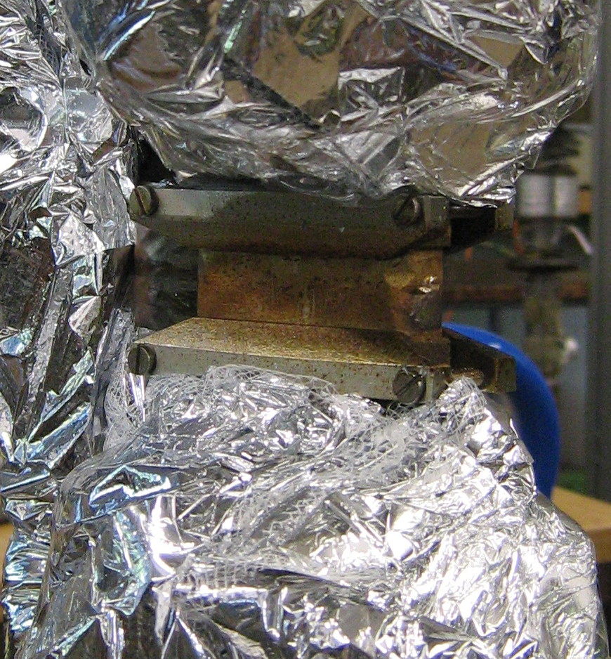
Target Frame contributions #1
Presence of target frame results in the deficiency of the elastic events .
Elastically
scattered
electron
Incoming
electron
Scattered electron
annihilated in
the frame
Projection
plane
Notes:
However, the effects that we did not anticipate is related to the support frame
Of the target. As you can see on this plot is our 5cm target mounted to the cryoloop
With help of these metal pieces which are usually outside the acceptance. However,
In our case the spectrometer B was standing at very small scattering angle, and there
The part of its acceptance was blocked by the frame. And this is excatly what you can see
On this plot. If we look at the projection of the Elastic! events detected by the spectrometer at this
horizontal plane, you can see, that the edge is missing.
Now you may say that this should not be a problem and that we should simply cut this part
Of the acceptance away. This would be true….

Slide 30
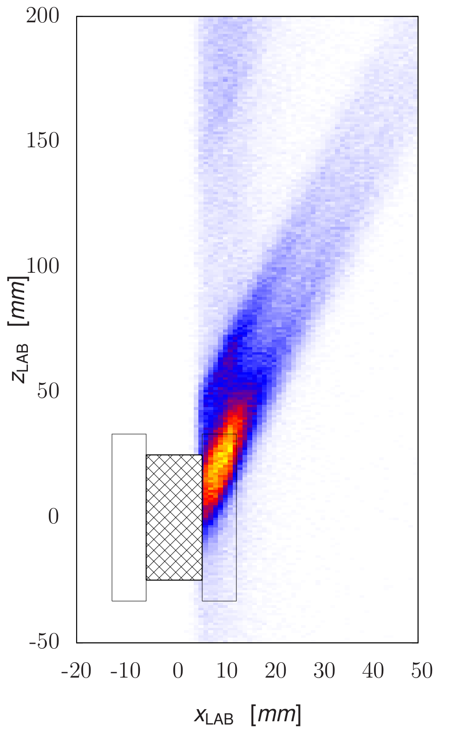
Target Frame contributions #2
… and in the abundance of bogus events in radiative tail of the elastic peak.
ISR+FSR
electrons
Incoming
electron
Projection
plane
Reemerging elastically
Scattered electrons
Notes:
… when measureiong than in the tail region these events would not reemerge and cause
The excess of events here. And since these events come out under different angles, our
Cuts had to be very strict, if we did not want to ne affected by this phenomenon. And
Because of this we lost more than ½ of the statistics.

Slide 31
Size of effective corrections
Elastic line
Precision of numerical calculations limited at the elastic line.
Notes:
And here are all corrections plotted together. The most important are the real and virtual lepton corrections
and the external corrections which are all of order of 10%. And what is even more important here than the absolute
Size is the shape of the corrections. You can see, that in the tail region there are all more or less flat, while
Near the elatic peak, all the corrections, where photons are emitted change very rapidly. And this is problematic,
Because even smallest mistakes in the calculations can lead to significant differences between data and simulation
And we need to be aware of this, when comparing the data to the simulation.
And now that the simulation is ready we can go and look at the data.

Slide 32
Uncertainty of effective corrections
Notes:
Of course, for a comprehensive comparison with the
Data and precise extraction of the FF we of course need a detailed
simulation. And what we use is the standard A1 simulation package,
Which has ben proven to work well for a serious of past experiments
And includes a detailed description of the spectrometer setup. For our
Experiment the framewark was upgraded by a sophisticaed generator
Of events, that was written primarly for theestimation of the bacground
In the VCS experiments. This generator exactly calculates the Feynman
Diagrams for the first order diagrams shown here. Then we also include
Second order virtual and real corrections. However, because the virtual
Corrections shown here require integrations of the loops, the calculations
Of these diagrams was done separattely and re used as effective corrections
to the crossections. And with all these things considered, the simulaion
Provides a subpercent description of the radiative tail in the region, that
Etends more than 100 MeV away from the elastic line.
And with the simulation available we could then go on and perform the experiment.

Slide 33
Hindrance at the elastic setting
Significant difference between data and simulation at the elastic peak!
Excess of simulated events.
Not a data problem!
Result of limited precision of corrections at the elastic peak when ΔE ~ 0.
Number of elastic events influences other corrections!
Notes:
To see the problem we need to stop looking at the logaritmic plot and
look at the relative difference between data and simulation very close
to the elastic line. Here you can see the difference as a function of the size
Of the energyloss and you can see, that the ratio is flat In the whole region
except of points eactly on the peak, where we see approx 10% excess of
The simulated events. We believe that this difference is a result of the
Limited theoretical description and limited numerical precision in this
Region and is consistent with the estimated systematical uncertainty shown
With the green line, and because of that we decided to limit our present
Analysis to only events in the tail.
If we now accept this explanation and limit our selves to the tail,
Then we can go a step further and use these results to extract
New values of the proton-charge FF.

Slide 34
Extracting G_{E}^{p} from data
Scattering angle of emitted photon offers clear separation of ISR and FSR and gives insight into the G_{e}^{p} depedence of measured cross-section.
A lookup table used to transform data to the G_{e}^{p} .
ISR
FSR
Notes:
To achieve this we first inspected simulation in the terms of the angle of the
Emitted real photon, which offers a good separation between the ISR here on the
Left and FSR on the right. Then we used this plot, we investigated how the simulated
CS changes if we change the FF for the ISR, while keeping the FSR peak at the same value.
Doing this for all the momenta we got a look-up table, which tells us,how the measured CS
Transform into the FFs. An applying this table to the plot in the previous slide,
We get our onw values of the FF…

Slide 35
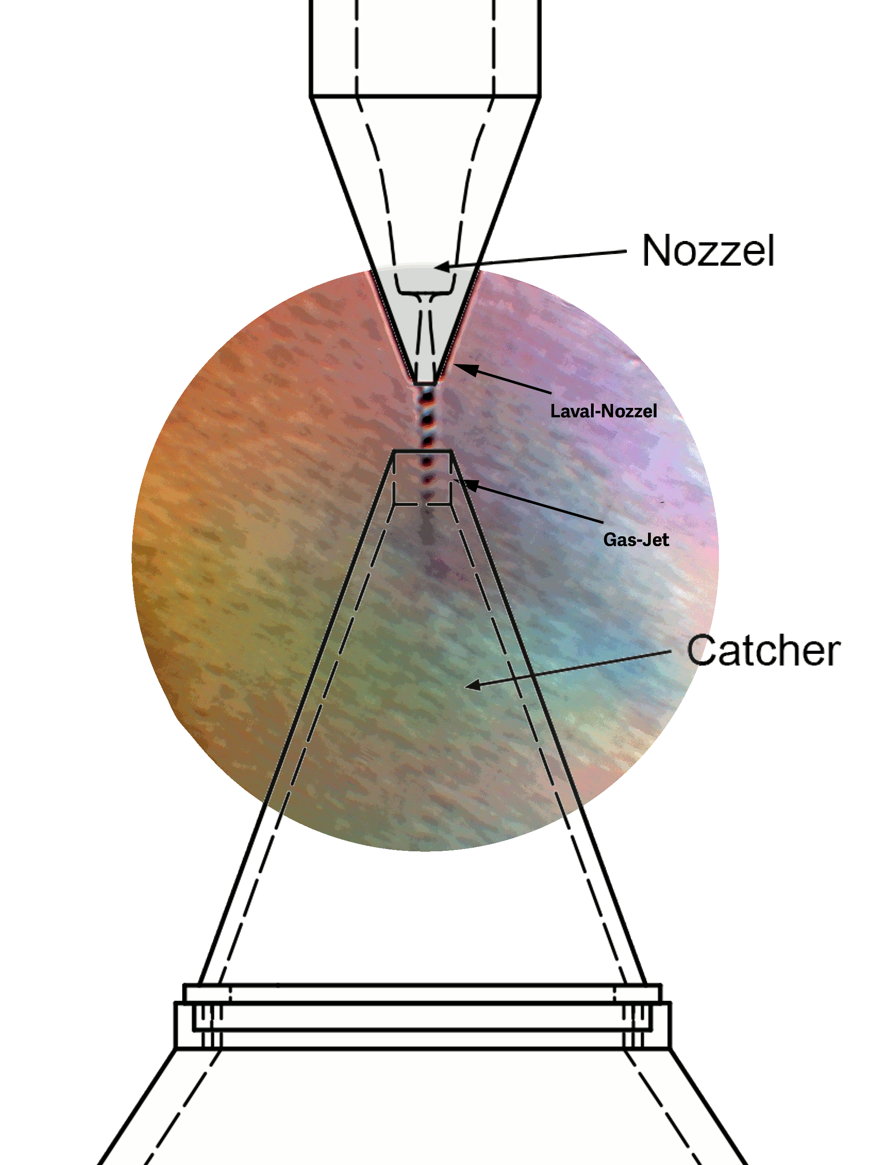

Future ISR measurements
Next generation of experiments foreseen at:
ISR valuable technique for future experiments.
Modifications to the spectrometer setup required.
A point-like target without extensive frame needed.
(Solid-state plastic target not an option).
Hypersonic gas jet target for measurements with minimal background contributions.
Notes:
However, to be able to perform better measurements, we need to modify the
Spectrometer setup, to avoid contributions of backscattered events and we
Need a new, point like-target withour extensive frame. And perfect for this
Will be the newly designed windowless hypersonic jet target that has been
Designed For the MAGIX experiment.

Slide 36
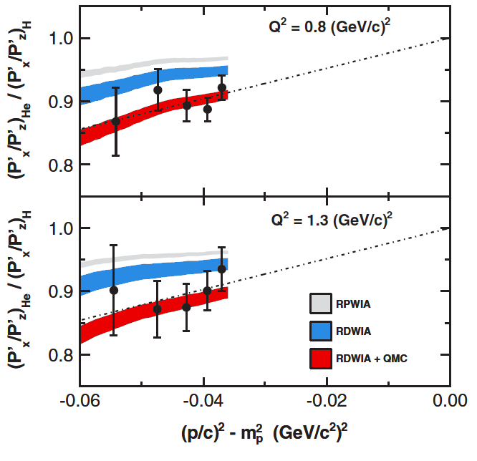
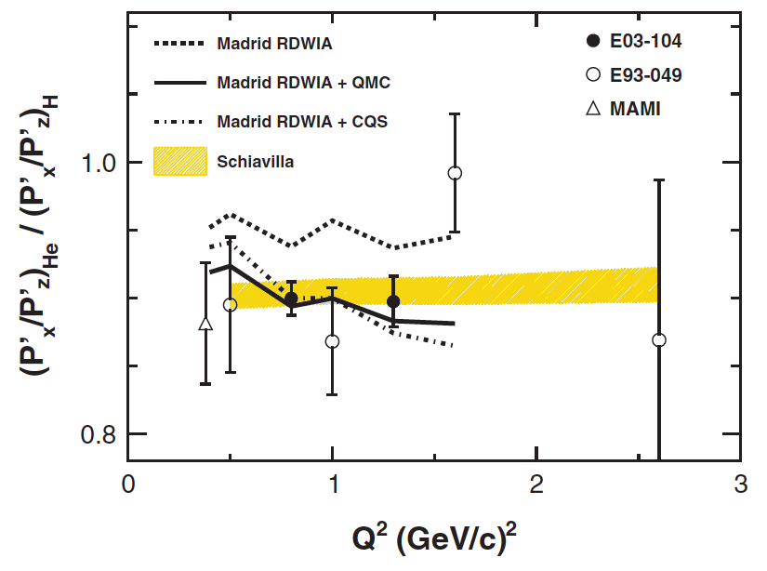
Polarization transfer in ⁴He @ JLab
Effect best studied in calculable tightly bound nucleus.
Data favor model including medium modified FFs.
Data can be explained also with the non-modified FFs using different treatment of FSI and MEC.
M.P., PRL 105, 072001 (2010)
Notes:
Now. If it is the nuclear density, which is responsible for the the deviation
of the ratio from the free proton, then the effect would be largest in a
Nucleii with high local density. And the perfect candidate is 4He, which
Is very dense and small enough to be calculable. The measurements
On this nucleus have been done couple of year ago at Jlab, and the results
That they obtain are shown on the this plot. What you see here, are there
Measurements as a function virtuality, together with a theoretical calulation.
Blue band shows result with an umodified FF, while red band shows
Calculation with the in-medium modified ffs. And you can see, that the
Data support the hypothesis of medium modification of the form-factor.
However, Schiavilla demonstrated with his calculations, that the same
Result can be obtained with standard free-space FF but with a different
Treatmend of FSI, meaning that the answer about the modifications
Is not answered and requires further investigations.
And what would be interesting to see, is what happens with this ratio, if
Go from tightly bound nucleus to a very weakly bound nucleus like deuterium.
And this is what has been done in Mainz.

