Slide 1
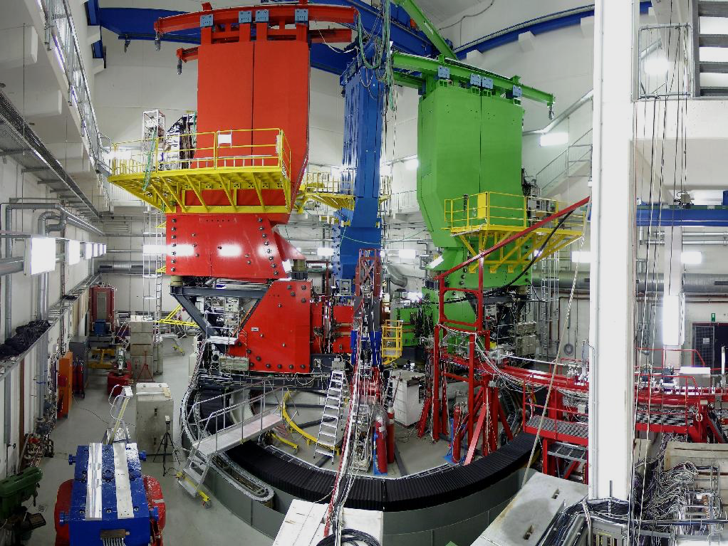
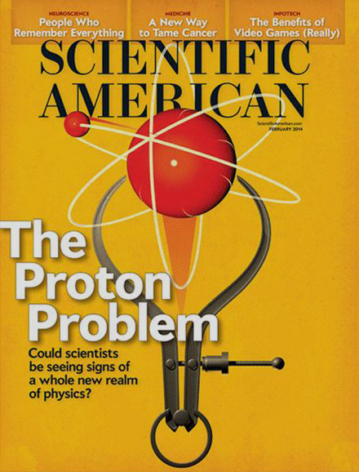
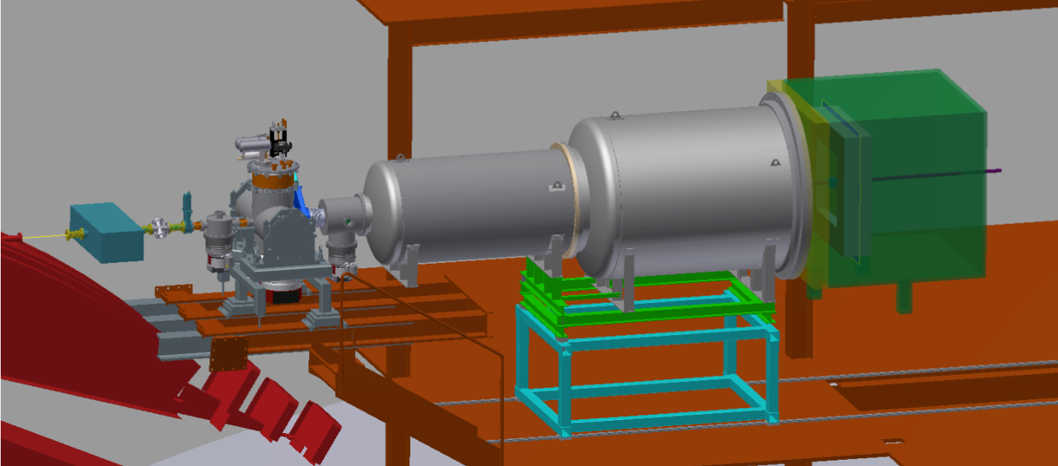



Ever-changing proton radius?!
Miha Mihovilovic
JGU Mainz and JSI
DPG-Frühjahrstagung, Darmstadt 2016
Notes:
Hello everybody and welcome to my talk. I would also like to thank organizers for
inviting me here and giving me the opportunity to talk about the proton our
Bacsic constituent of matter. Now the proton has been studied since the early days
Of hadronic physics and the way of its research is very similar to a child opening
A present.

Slide 2


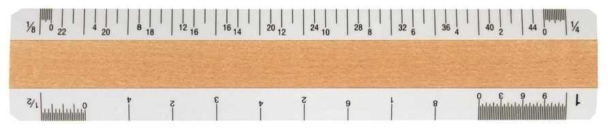

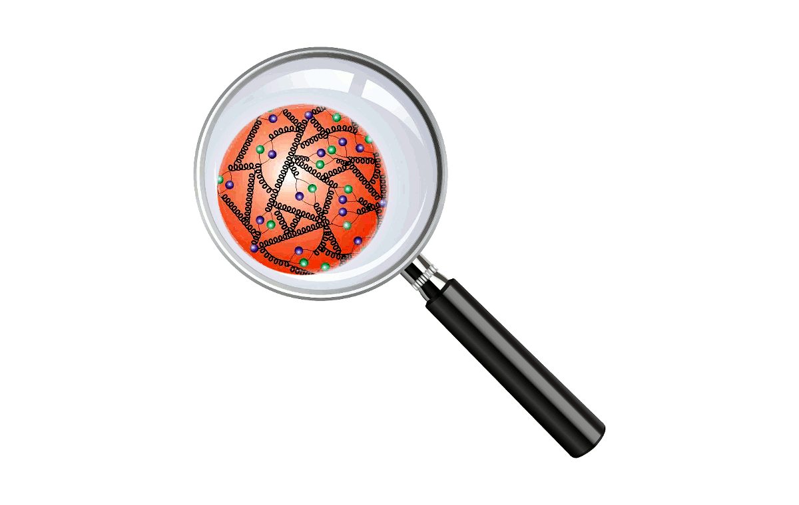
Elastic form-factors
Polarisabilities
Resonances
Parton distributions, spin, …
Notes:
When I child gets a present she/he first checks how big is the box, which is
Analogues to the our measurement of the electromagnetic formfactors and
Determination of the radii. Then applies some pressure to the sides to see,
If the box is hard or is again a sweater, which would correspond to measurements
Of the polarizabilities. In the third part he then shakes the box to get a filing
What is inside, which is analogous to our measuremnts of the exiited states of
The nucleons and in the last part he finaly opens the present and checks what is
Inside. This last part coresponds to the physics dedicated to determining the parton
Distributions and investigation of spin properties etc. Our S1 project deals only with the
First part of the story and tries to understand the electromagnetic properties of the nucleon
From varius different perspectives.

Slide 3
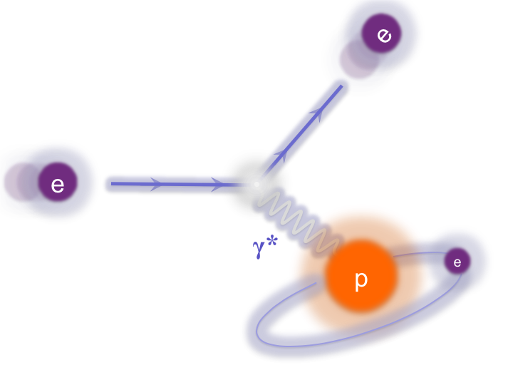
Notes:
Since the early 60s, the electromagnetic structure of the nucleon has been
Predominantly studied by scattering fast electrons off fixed hydrogen targets in
Facilities like MAMI.
In the born’s limit of one photon exchange, the CS for such process is described with the
Rosenbluth’s formula:

Slide 4
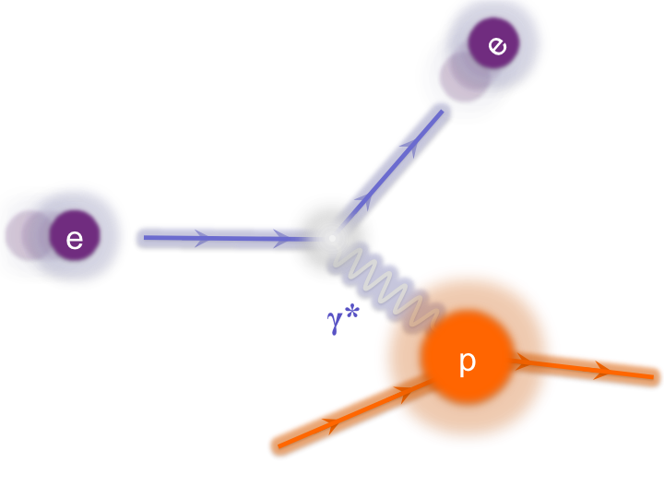
Elastic Cross-section
Lepton side is exactly calculable.
Electrons are the “cleanest probes”.
Direct insight into the structure of the nucleon.
Notes:
… written here. This formula is nice because directly shows the beauty of the experiments
With the electrons. The lepton part of the interaction is exactly calculable and is contained
Inside the Mott cross section, thus gives us the direct insight into the electromagnetic
Properties of the nucleons, which is contained inside the two Sachs form-factors GE and GM.
They carry information about the charge and magnetization distributions inside the nucleons
and depend only on the Q2, which is the square of the four momentum transferred to the nucleon.
Here tau is a simple kinematic factor, while epsilon represents size of the longitudinal polarization
Of the virtual photon.

Slide 5
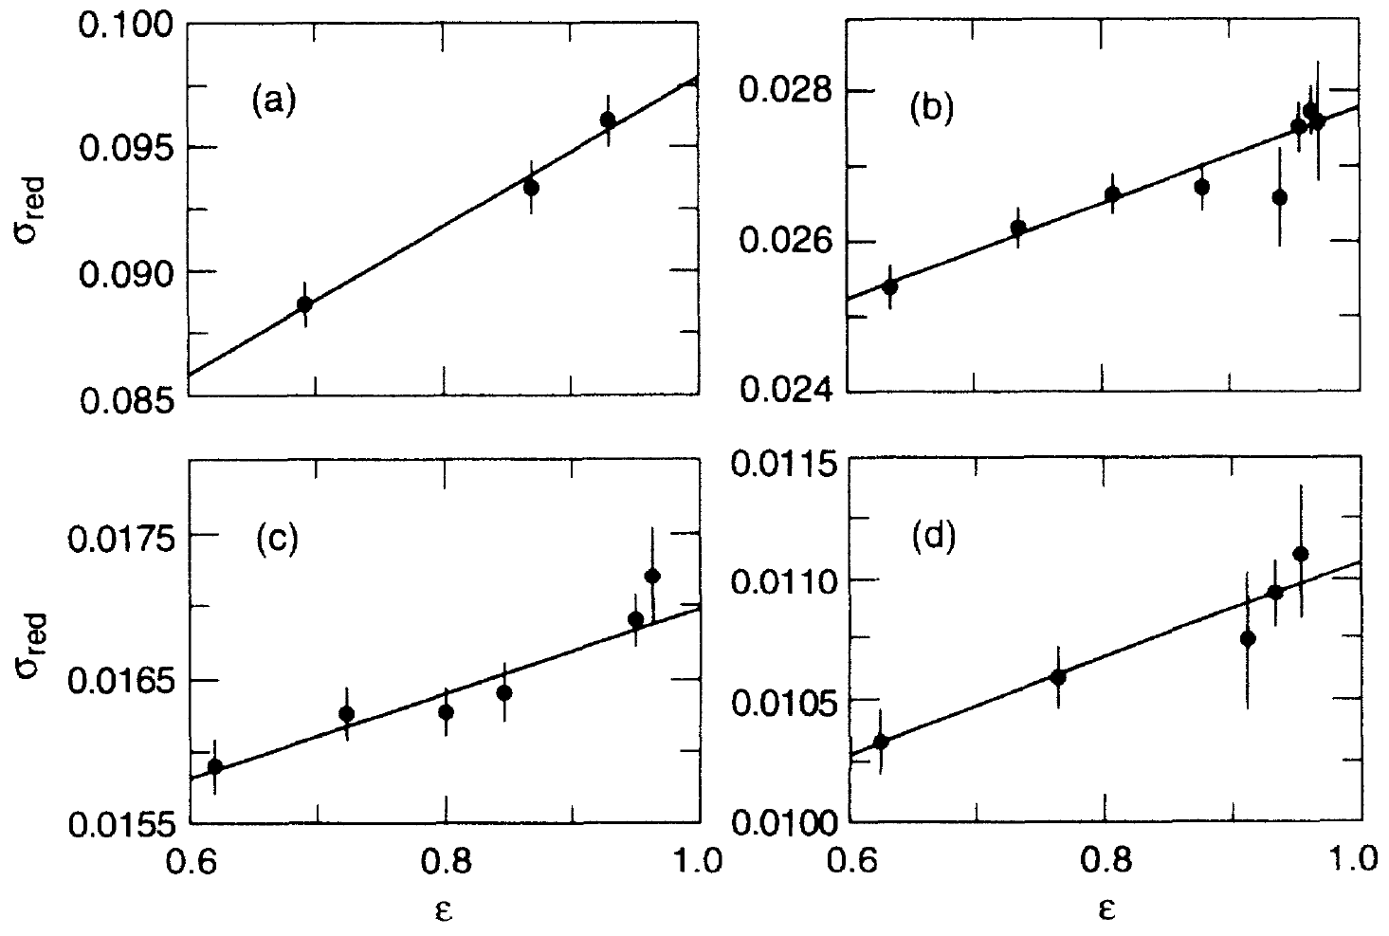
Rosenbluth separation
Extraction of FF via Rosenbluth separation:
R.C.Walker, PRD 49 5671 (1994)
Slope
Offset
Q²=1.0 (GeV/c)²
Q²=2.0 (GeV/c)²
ε
ε
Q²=2.5 (GeV/c)²
Q²=3.0 (GeV/c)²
Notes:
To extract both FFs from the measurements a technique
called Rosenbluth Separation is applied where
measruements are done at fixed Q2 but at different epsilon!
And if we now rewrite the CS formula, Into the reduced form
you can see, that this CS is a linear function Of epsilon, where
GE represents its slope while tauGM represents Its offset. Then,
to get the Q*2 dependence, the whole process needs To be
repeated at different Q*2.

Slide 6
Proton’s charge form-factor
Notes:
And here is the current status of the available data. Top plot shows GE/D as a function of
The Q2, while the bottom plot shows the GM/D. You can see various points corresponding
to of older/ stdandard type experiments and the curve, which are the Jans data. Again,
Because of the different approach in the analysis, his result is not a discrete set of points but
A smooth curve. You can also see that his results are precise until 0.8GeV2, whre he runs
Out of data points and his errorbars infplate. Furthemore, while his result GE is consistent with
Old measurements, his GM is systematically off!

Slide 7
Proton’s charge radius
Best estimate for radius:
Data available only for
Q² > 0.004 (GeV/c)².
Extrapolations to zero are needed!
Instabilities related to extrapolation are sources of systematic offsets.
Measurements accompanied by different reanalyzes of data.
Notes:
And once we know the charge form-factor, we can also calculate the radius,
Which is defined as a derivative of the form factor at Q2=0.
However, a known handicap formula is that the data are available only to Q2=0.004,
This means that in order to calculate the radius, the data need to be extrapolated
Towards zero, which can led to unwanted siystematic offsets. The radii obtained from the existing
Nuclear experiments are Are shown In this plot, where The first radius was determined by
Hand, while the best curent value Is, as I already mentioned, one from jan Bernauer.
The measurements have been accompanied By several different reanalyses of the data,
which are more or lest consistent with the Jans result.
Beside the nuclear scattering experiments, the radius can be determined from the atomic
Spectroscopy measurements.

Slide 8
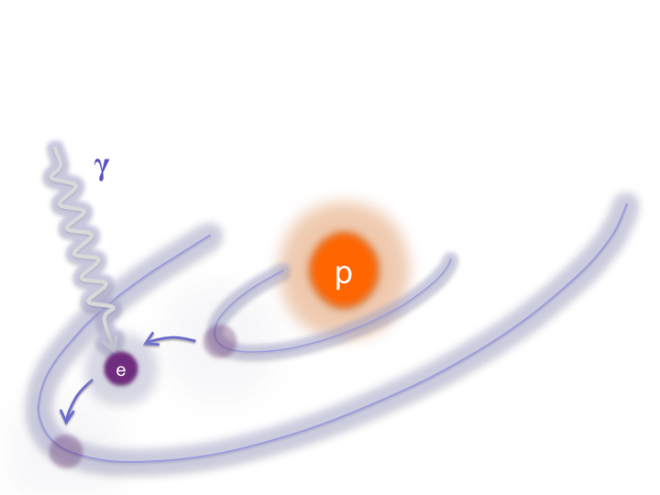
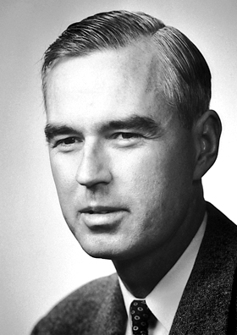
There is small difference in energy between
energy levels 2S_{1/2} and 2P_{1/2} due to QED
vacuum fluctuations.
2s
2p
Notes:
Here, the the radius determined by measuring the Labs shift, a small energy difference
Between the 2S and 2P levels, which arises mostly due to the vacuum fluctuations, and
was discovered by the Willis Lamb in 1947.

Slide 9
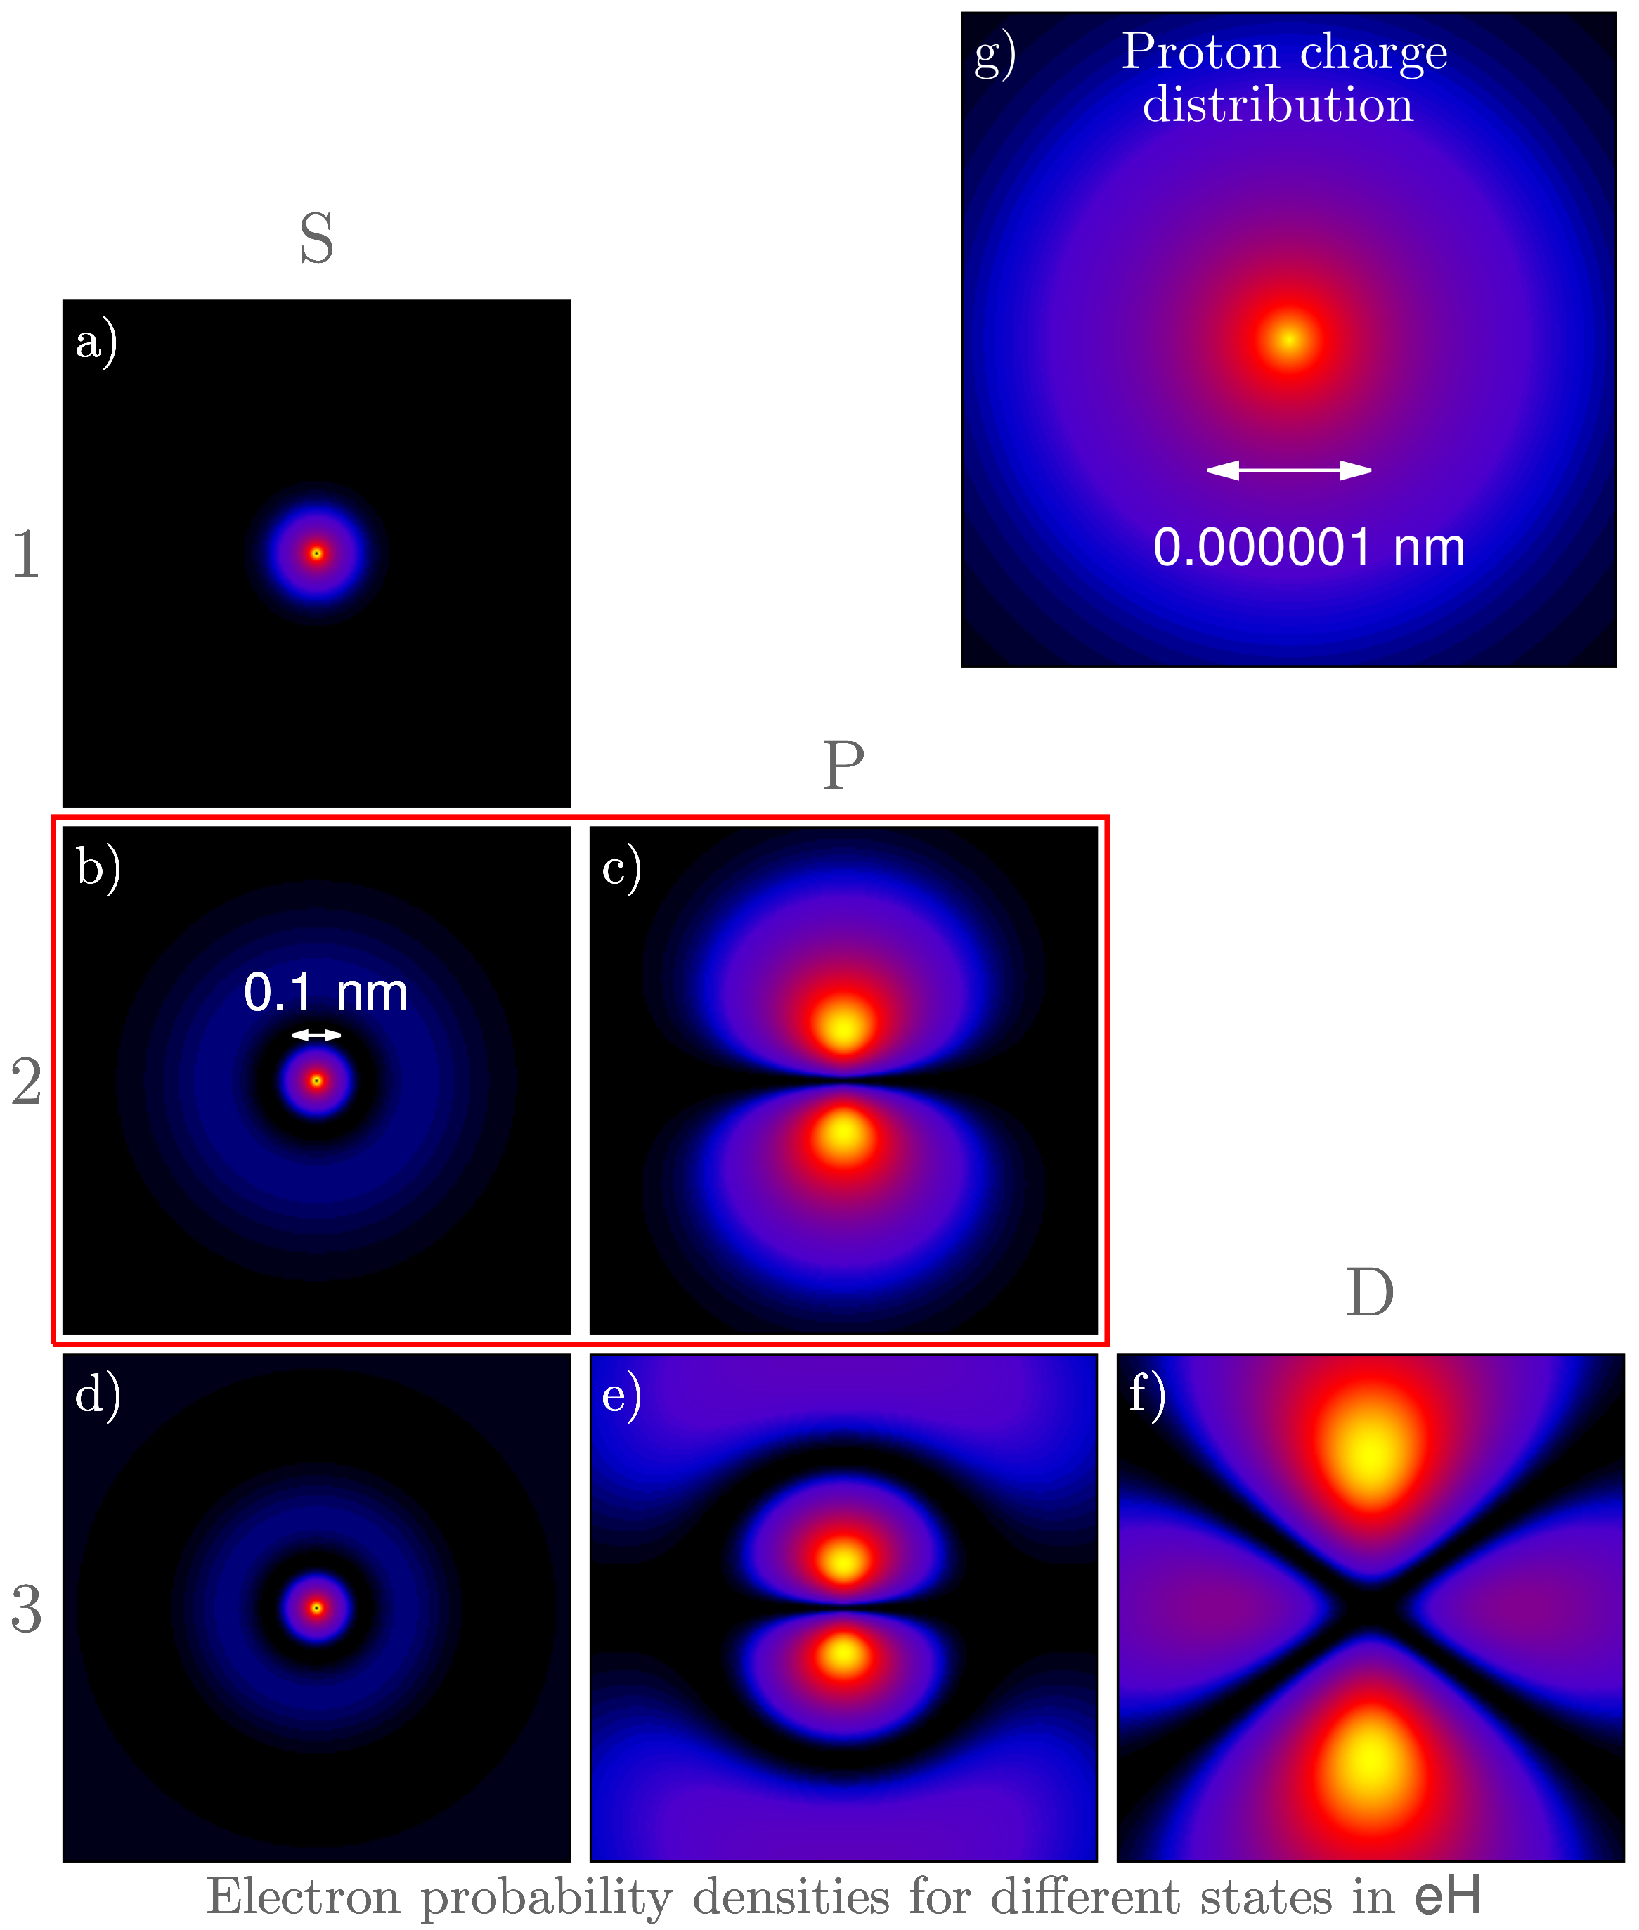
Lamb shift in Hydrogen
Change in level energy (approximately):
Significant effect only for S-states.
- The center of the hydrogen atom
is not empty. Proton is here!
Different n-dependence of the two terms allows the determination of r_{p}.
Notes:
Very roughly speaking is the change in the energy level
Proportional to the propability of finding an electron with quantum numbers
N and l in at the center of an atom.
This plot here shows the well known
probability densities for hydrogen atom for first few quantum numbers and
We can see, that in the S state electron spends most of its time at the center,
Which means that energy levels of the S states shift due to lamb effect.
The new energy levels can be Approximately written as a sum of a Bohr term
and a small Lamb Correction.
On the other hand, is for all the other states probability for finding
Electron at the center zero, which means, that are these states have
A negligible lamb shift.
Of course, the center of the atom is not empty but is occupied by the proton
With a finite size, which brings additional term to the lamb shift, that depends
on the proton radius. This is usually a small correction to the total Lamb
Shift but is the term that is exploited to determine the proton radius.
And from this formula we can already see, that there are many possibilities
How to do the measurements. If we are interested only in Lamb shift, we
measure 2S-2P transition. However, if we can combine for example
1S-2S and 1S-3S transitions and then use the different n depende of the
Two terms to extract both, the Rydberg constant and the radius.

Slide 10
Spectroscopic measurements
Direct (RF) and indirect (laser) spectroscopy measurements:
After Annu. Rev. Nucl. Part. Sci. 2013.63
Radius from spectroscopic measurements: r = (0.8758 ± 0.0077) fm
Notes:
Using this philosophy many different transitions have bean measured by
many different groups and then combined with the QED to determine
the the Ry and the radius. This table here summarizes the efforts in
determining the proton charge Radius and you can see all the
Transitions that have been studied. If we now calculate the average value
Of these points, we get

Slide 11

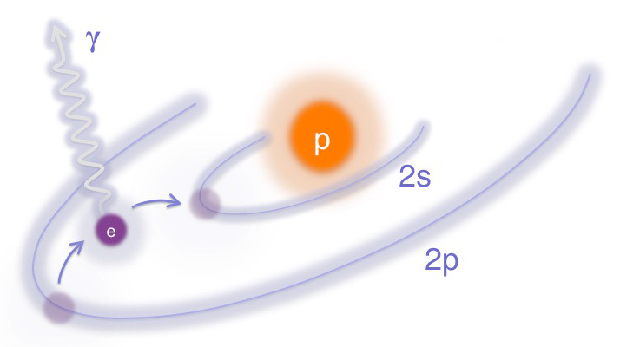
CODATA Radius
CODATA value:
r = (0.8775 ± 0.0051) fm
Notes:
And if we now combine the mean spectroscopic value with the best nuclear scattering
Results, we get the accepted or CODATA value for the radius, that is
Shown sith the orange line. And this was the status until until 2010, when
A new spectroscopic measurement with muonic hydrogen was presented.

Slide 12
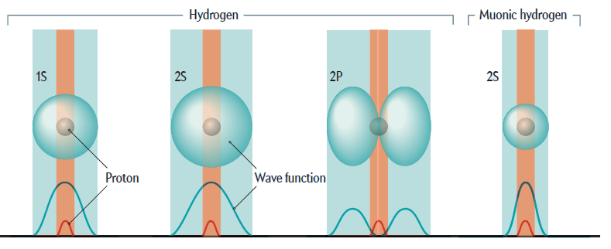
μH Lamb shift measurements
Due to larger mass muon much closer to the nucleus, resulting
in a more pronounced Lamb shift effect.
- The largest signal is given by the 2S_{1/2}^{F=1} and 2P_{3/2}^{F=2} transition.
The QED calculation predict:
- Finite size of the proton contributes 1.8% of the energy difference.
Sci. Amer. Feb. 2014 , 34
Notes:
Using Muons instead of electrons for the lamb shift measurements makes a huge difference.
Being 200x heavier than electrons, puts them on a much smaller
Orbit around the proton. This increases the overlap between the proton and the muon,
Significantly amplifies the lamb shift effect and alows for a very precise measurement of
The effect.
The effect can be best observed in the 2S to 2P transition, for which
The full QED calculation, Ect predicts the following energy difference. The relative
Contribution of the proton finite size terms here even smaller, but all together is
Effect much larger and allows for much better determination of the proton charge radius.

Slide 13
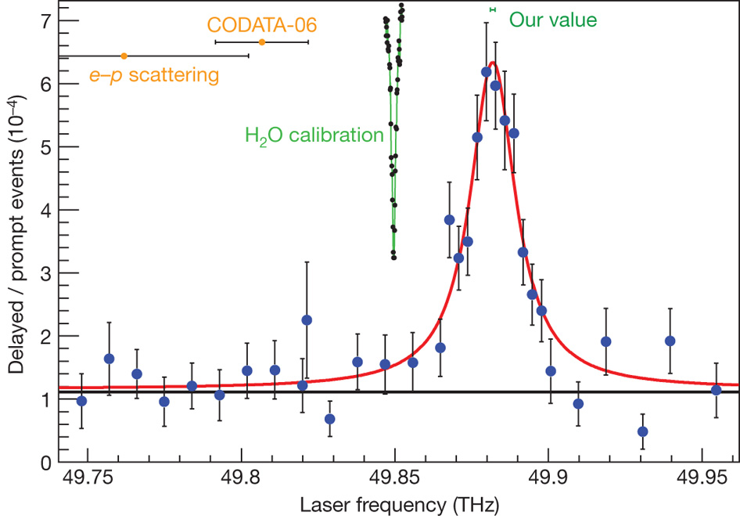
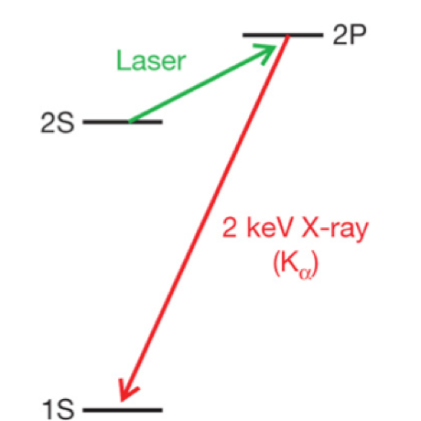
CREMA Experiment @ PSI
Nature, Vol. 466, 2010
The μs are stopped in H₂ target
where the excited μH is formed.
Tunable pulsed laser induces the
2S➔2P transitions.
The mean position of the peak:
2P states de-excite instantly to
1S, emitting 1.9 keV X-rays.
The whole resonance peak recorded
by changing the laser frequency.
Notes:
First spectroscopic measurement of the MuH was done the PSI by
Crema colaboraton. There muonic beam were used in combination
with H target to Generate atoms of muonic hydrogen in the excited
2S level. Then a tunable pulsed laser was used to excite these states to
2P state. If the frequency of the laser Was right, and the transition
was successful, the 2P states de-excite emitting 1.9keV X-rays,
which are then detected. Then, by changing the frequency of the laser,
The hole peak could be recorded, and the results that they got
Was a very nice sharp peak at approximatey 50THz, which represents
This energy difference. And if we now use this value in the QED calculations
We get a radius….

Slide 14
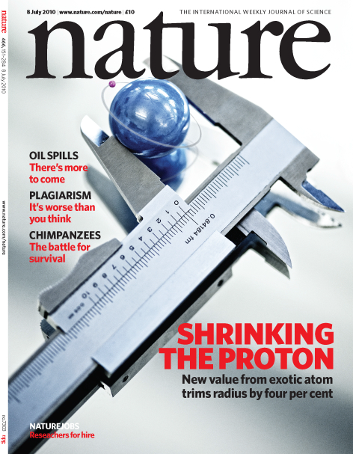
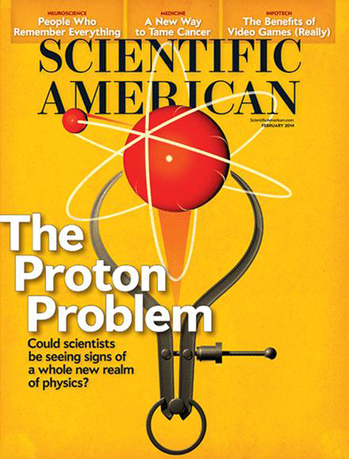
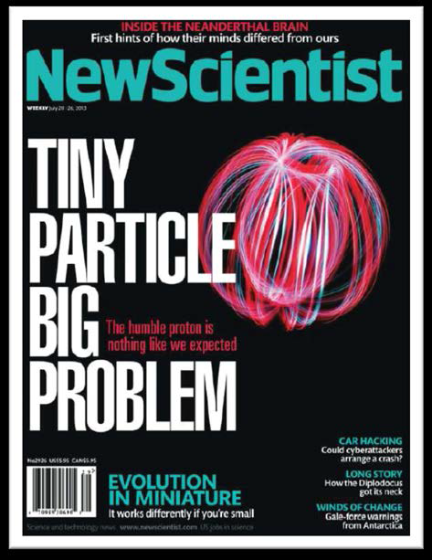
Proton radius puzzle!
Notes:
… show here, that is 4% or 8sigma
smaller than the CODATA value. And the question, which attracted
A huge interrest of physics community, now is, where
Does this difference in radii come from?
A possible scenario would be that there is sometrhing wrong with
The QED calculations, that combine the measured frequency and
And the radius.

Slide 15
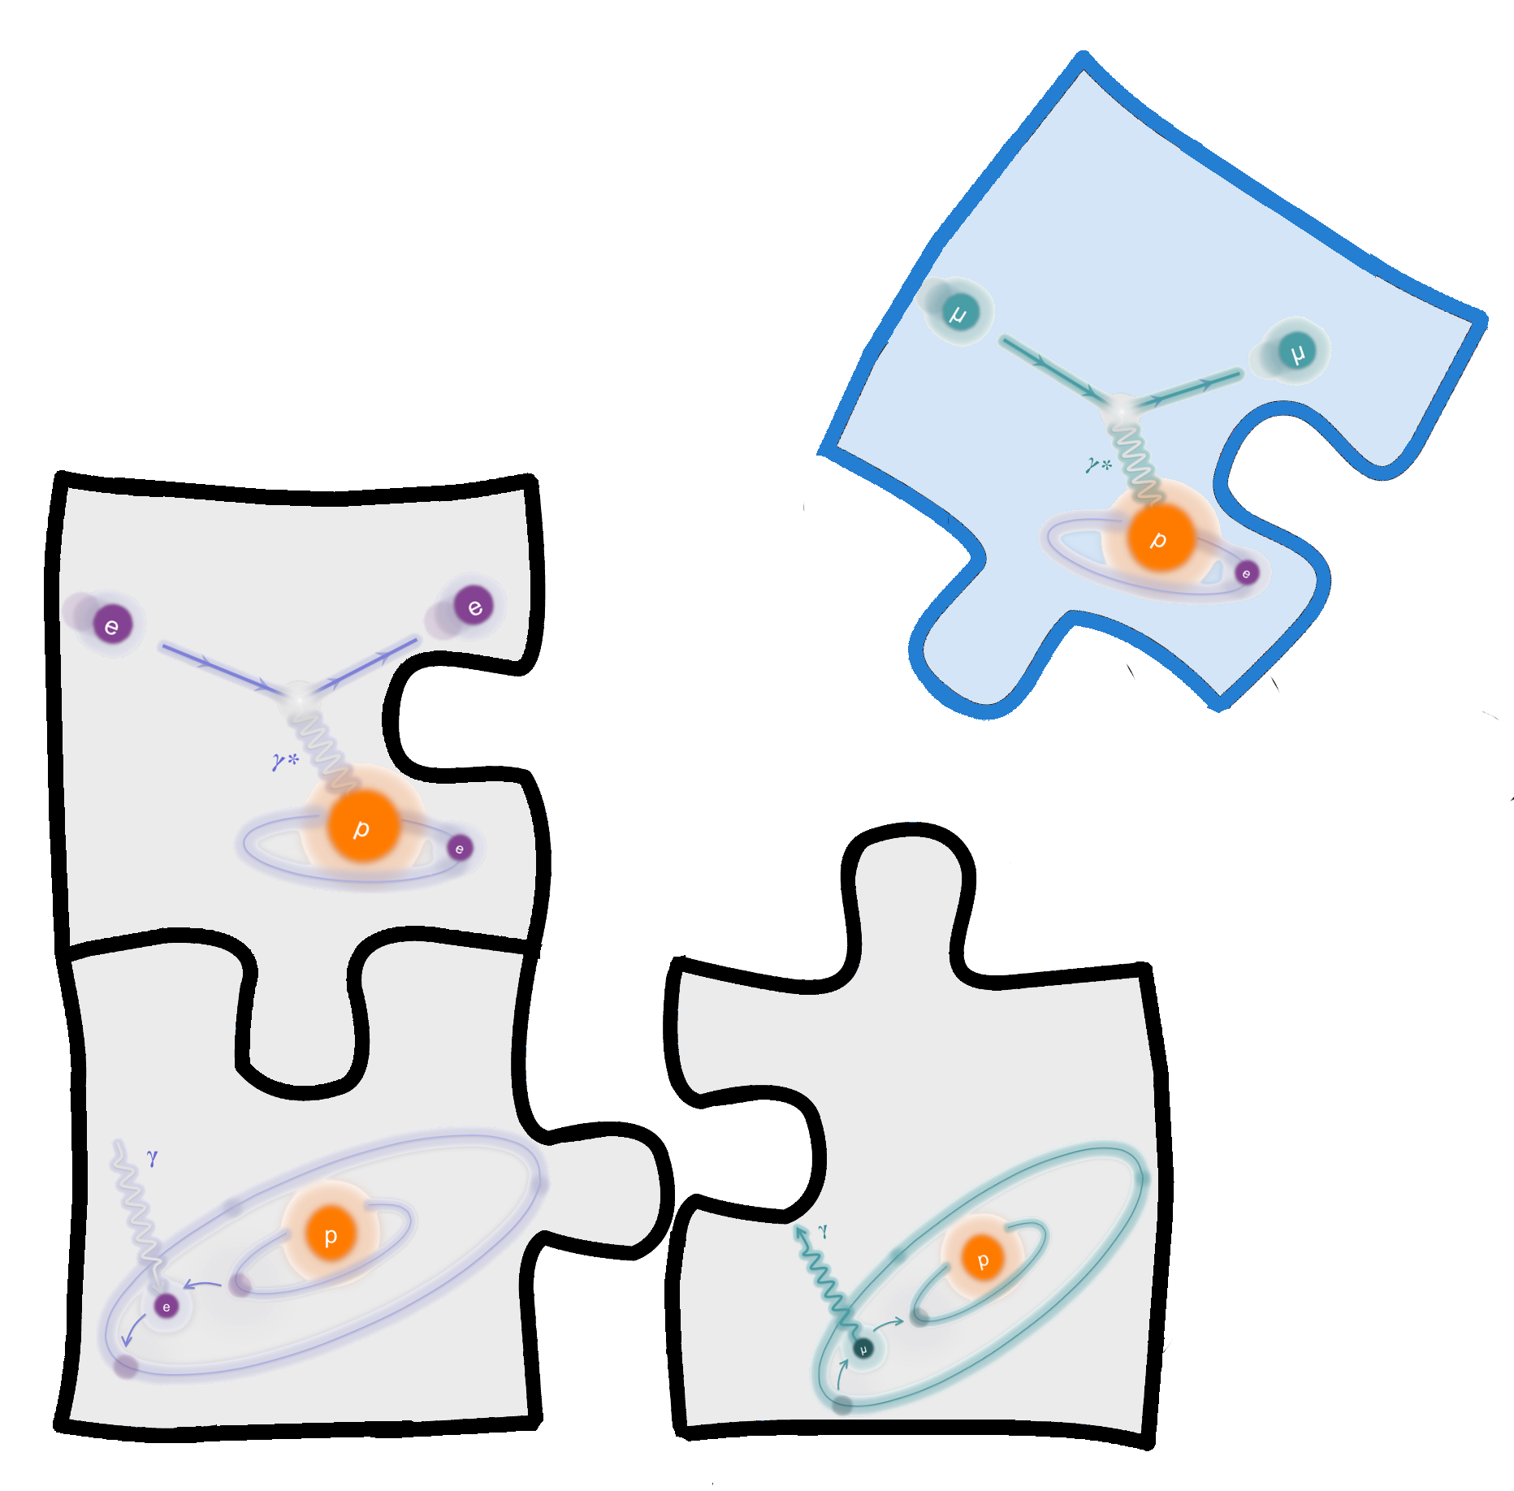
Seeing the whole picture …
… with the muon scattering experiment!
Notes:
However, it is also important to realize, that it is hard to find all the answers if
The pieces in the puzzle are still missing. What we have at the moment, is
Spectroscopic and nuclear reasults on Hydrogen which fit nicely together
And aspectroscopic result on muonic Hydrogen, which does not fit the picture.
Now, what is missing is the scattering experiment with muons, and will be interesting
To see, where this piece fits to.
… and the first experiment, which will investigate this missing part is the
Muon scattering experiment or MUSE.

Slide 16
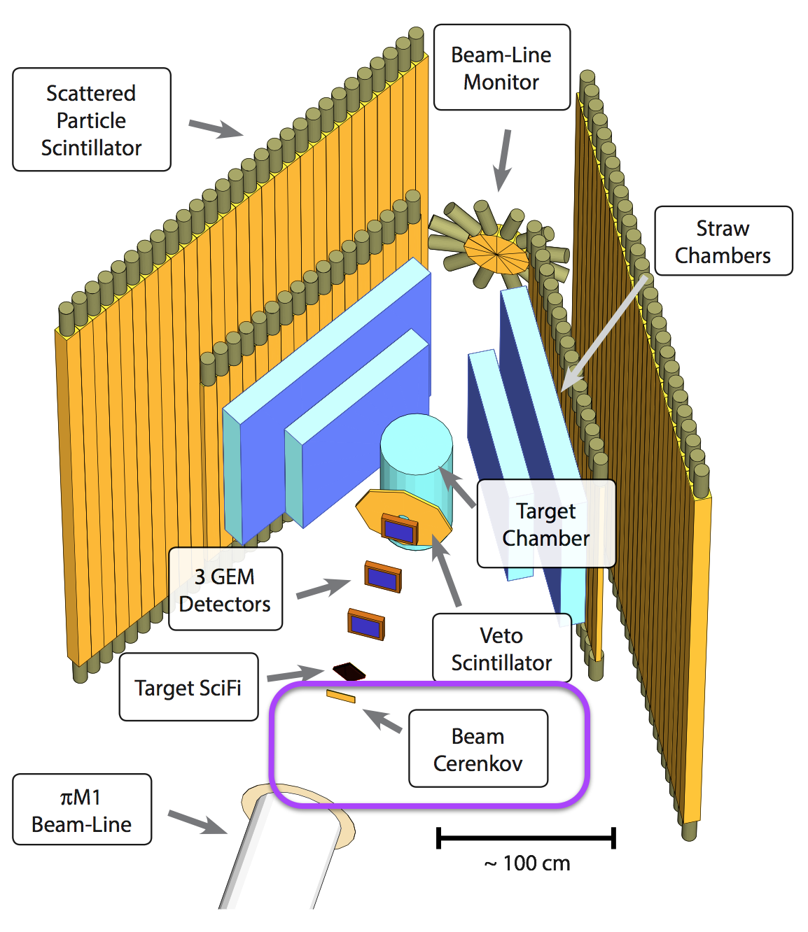
MUon Scattering Experiment @ PSI
Measurement of cross-section for μ± p, e± p scattering.
Precision (≤1%) measurement at Q² ≥ 0.002 (GeV/c)² with with non-magnetic detector setup
Precise proton radius extraction.
Ability to test the e-μ universality.
Ron Gilman, 2015
Notes:
The experiment aims to measure poton charge form-factor with
Muon beam using LH2 target and a non magnetic detector setup
Shown here. The goal of the experiment is to provide measurements
With 1% uncertainty for Q2 As low as 2E-3, which will allow for
For precise determination of the radius and also to test the universality, ie.
Because at the moment it is not clear, if the muons really behave the
Same way as electrons?

Slide 17
New electron scattering experiments
Determination of proton radius depends on the slope of FF (Q²->0).
No data at lowest Q².
- Region of Q² < 0.004 (GeV)²
is extremely hard to reach.
Kinematic range is limited
by available experimental
apparatus.
Novel techniques are
needed to explore
extremely low Q² regime.
?
Here no data exist!
For precise radius determination new measurements at even lower Q² are needed.
Notes:
But this is not the only possibility. Further insight can be obtained also
Wih new electron scattering experiments. As I mentioned before, to
determine the radius, we need to Know the derivative at Q2=0, while
we have data only until 4E-3.
So, what if there is a hidden structure in the region that has not
Been investigated yet, that would cause different initial slope and
Change the radius. Of course the problem of these measurements is,
that this Q2 region is Experimentaly extremely hard to reach,
requiring some novel approaches And ideas to investigate this
region.
One such experiment is Prad at Jlab, which will investigate this reagion
With a new non-magnetic detectors setting, that allows measurements
At lower angles.

Slide 18
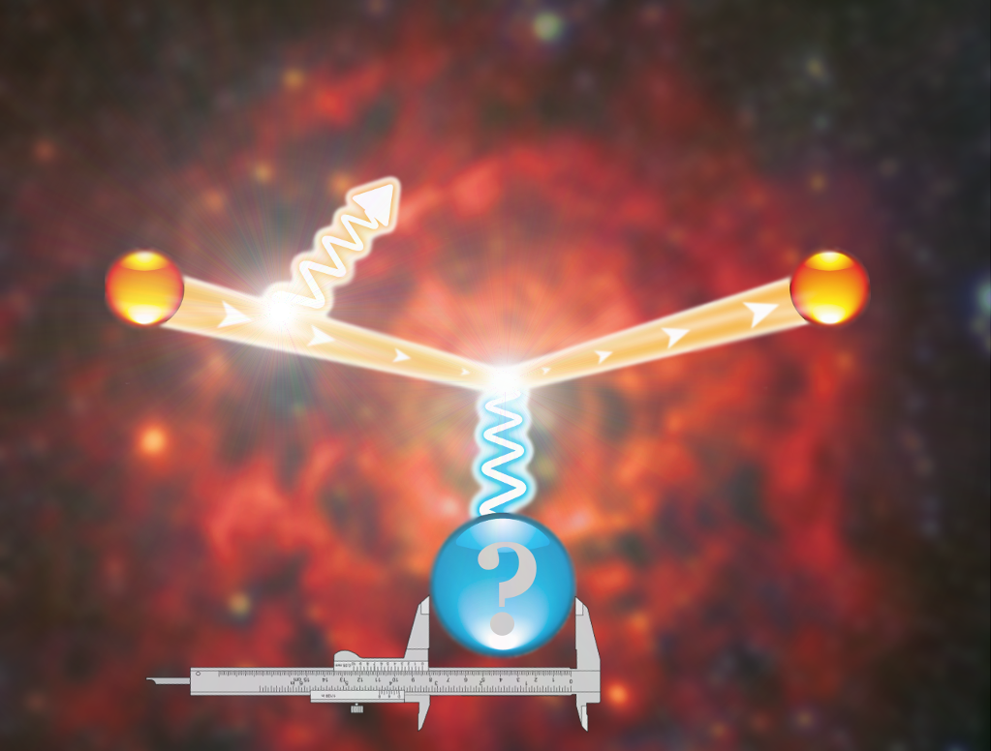
ISR Experiment at MAMI
Elastic
peak
#
Radiative
tail
p
Notes:
The second experiment, that aims to investigate the proton charge form-factor
At very low Q2 is the ISR experiment, that is already being performed at
MAMI. The idea of this experiment is to try to reach this region by exploiting the information
stored in The radiative tail of the elastic peak. In particular, we are interested in the
Processes, where electron emits photon before interacting With the proton. This
Lowers its momentum and allows us to probe protons structure at
Momenta which are much smaller than minimal available elastic setting.
In other words, this means, that the radiative tail contains the information about charge
form factors at smaller Q*2 than in the elastic peak, and
We are now trying to reach it.

Slide 19
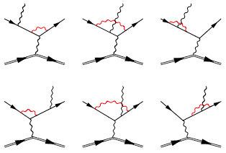
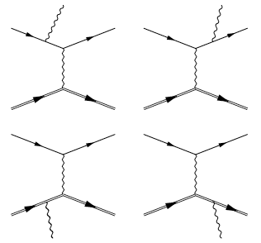
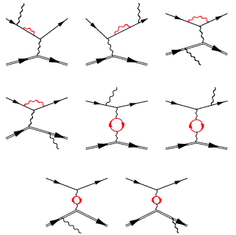
Going beyond simple approximation
The ISR process camouflaged with other processes.
To reach G_{E}^{p}, data need to be studied in combination with simulation.
ISR
For a sub-percent description a detailed theoretical description of all relevant contributing processes needed.
…
Notes:
Of course, is the ISR diagram not the only diagram that contributes
to the radiative tail, but is accompanied by the other three leading order
Diagrams and many different higher order corrections, which camuflage
The extraction of The Form-factos. Therefore, to reach precise information on the form factor
At low Q2, the experimental data need to be studied in conjunction with a simulation
That encompasses a detailed description of all relevant diagrams, which makes
This project a joint operation of the experimentalits who did the measuements
And theorists that performed the calculations.

Slide 20
Preliminary Results
Measurements from 2013.
Comparison of data and simulation for three overlapping settings for validation of approach.
Pion production processes contribute ~10% at smallest momenta.
Contributions from target wall not negligible.
Existing apparatus limits reach and resolution of present ISR experiment.
Notes:
The measurements for this experiment were performed in 2013
And here are our preliminary results. What you see here is The
Comparison between the data shown with black Points and simulation in
blue that was run with Bernauers parameterization of the form-factors. In
the analysis we also considered effects of the pion production
processes via Maid model and The residual contributions of the target
walls which contribute Due to finite resolution of the spectrometers.
Now on the bottom plot you see the comparison of the data to the
Simulation, and exhibits a good agreement between the two.
The measurements in the experiment were foreseen for momenta down
to 60 MeV, but due to the limitations Of the experimental apparatus obly
data to 130MeV could be analyzed.

Slide 21
ISR form-factors (Preliminary)
Sub-percent agreement validates ISR technique as a method for precise FFs measurement.
First measurement of G_{E}^{p} at 0.001 GeV² ≤ Q² ≤ 0.004 GeV²
Notes:
Now that we know the CSs we can also extract corresponding Form-Factors,
Which are shown on this next slide shown in red, tohetger with older measurements
And Bernauers results. The new measuemnets are going down in Q**2 to 1E-4
And extend the available reach for a factor two and you can se, that within the
Errorbars they are consistent with the Bernauer model. These results are
Still preliminary and some final touches still need to be done, but once
We are done, will we will add them to the collection of available data and
Determine next value for the proton radius.
Now although these results are nice, and this was our first try of such measurement,
We were hoping for even better results in this region, because with the
Given precision we can not compete with the uH results. So to avoild
Problems that limited present experiment and to reach the desired precision, a
Next Generation expeirment is already foreseen at the new accelerator MESA.

Slide 22
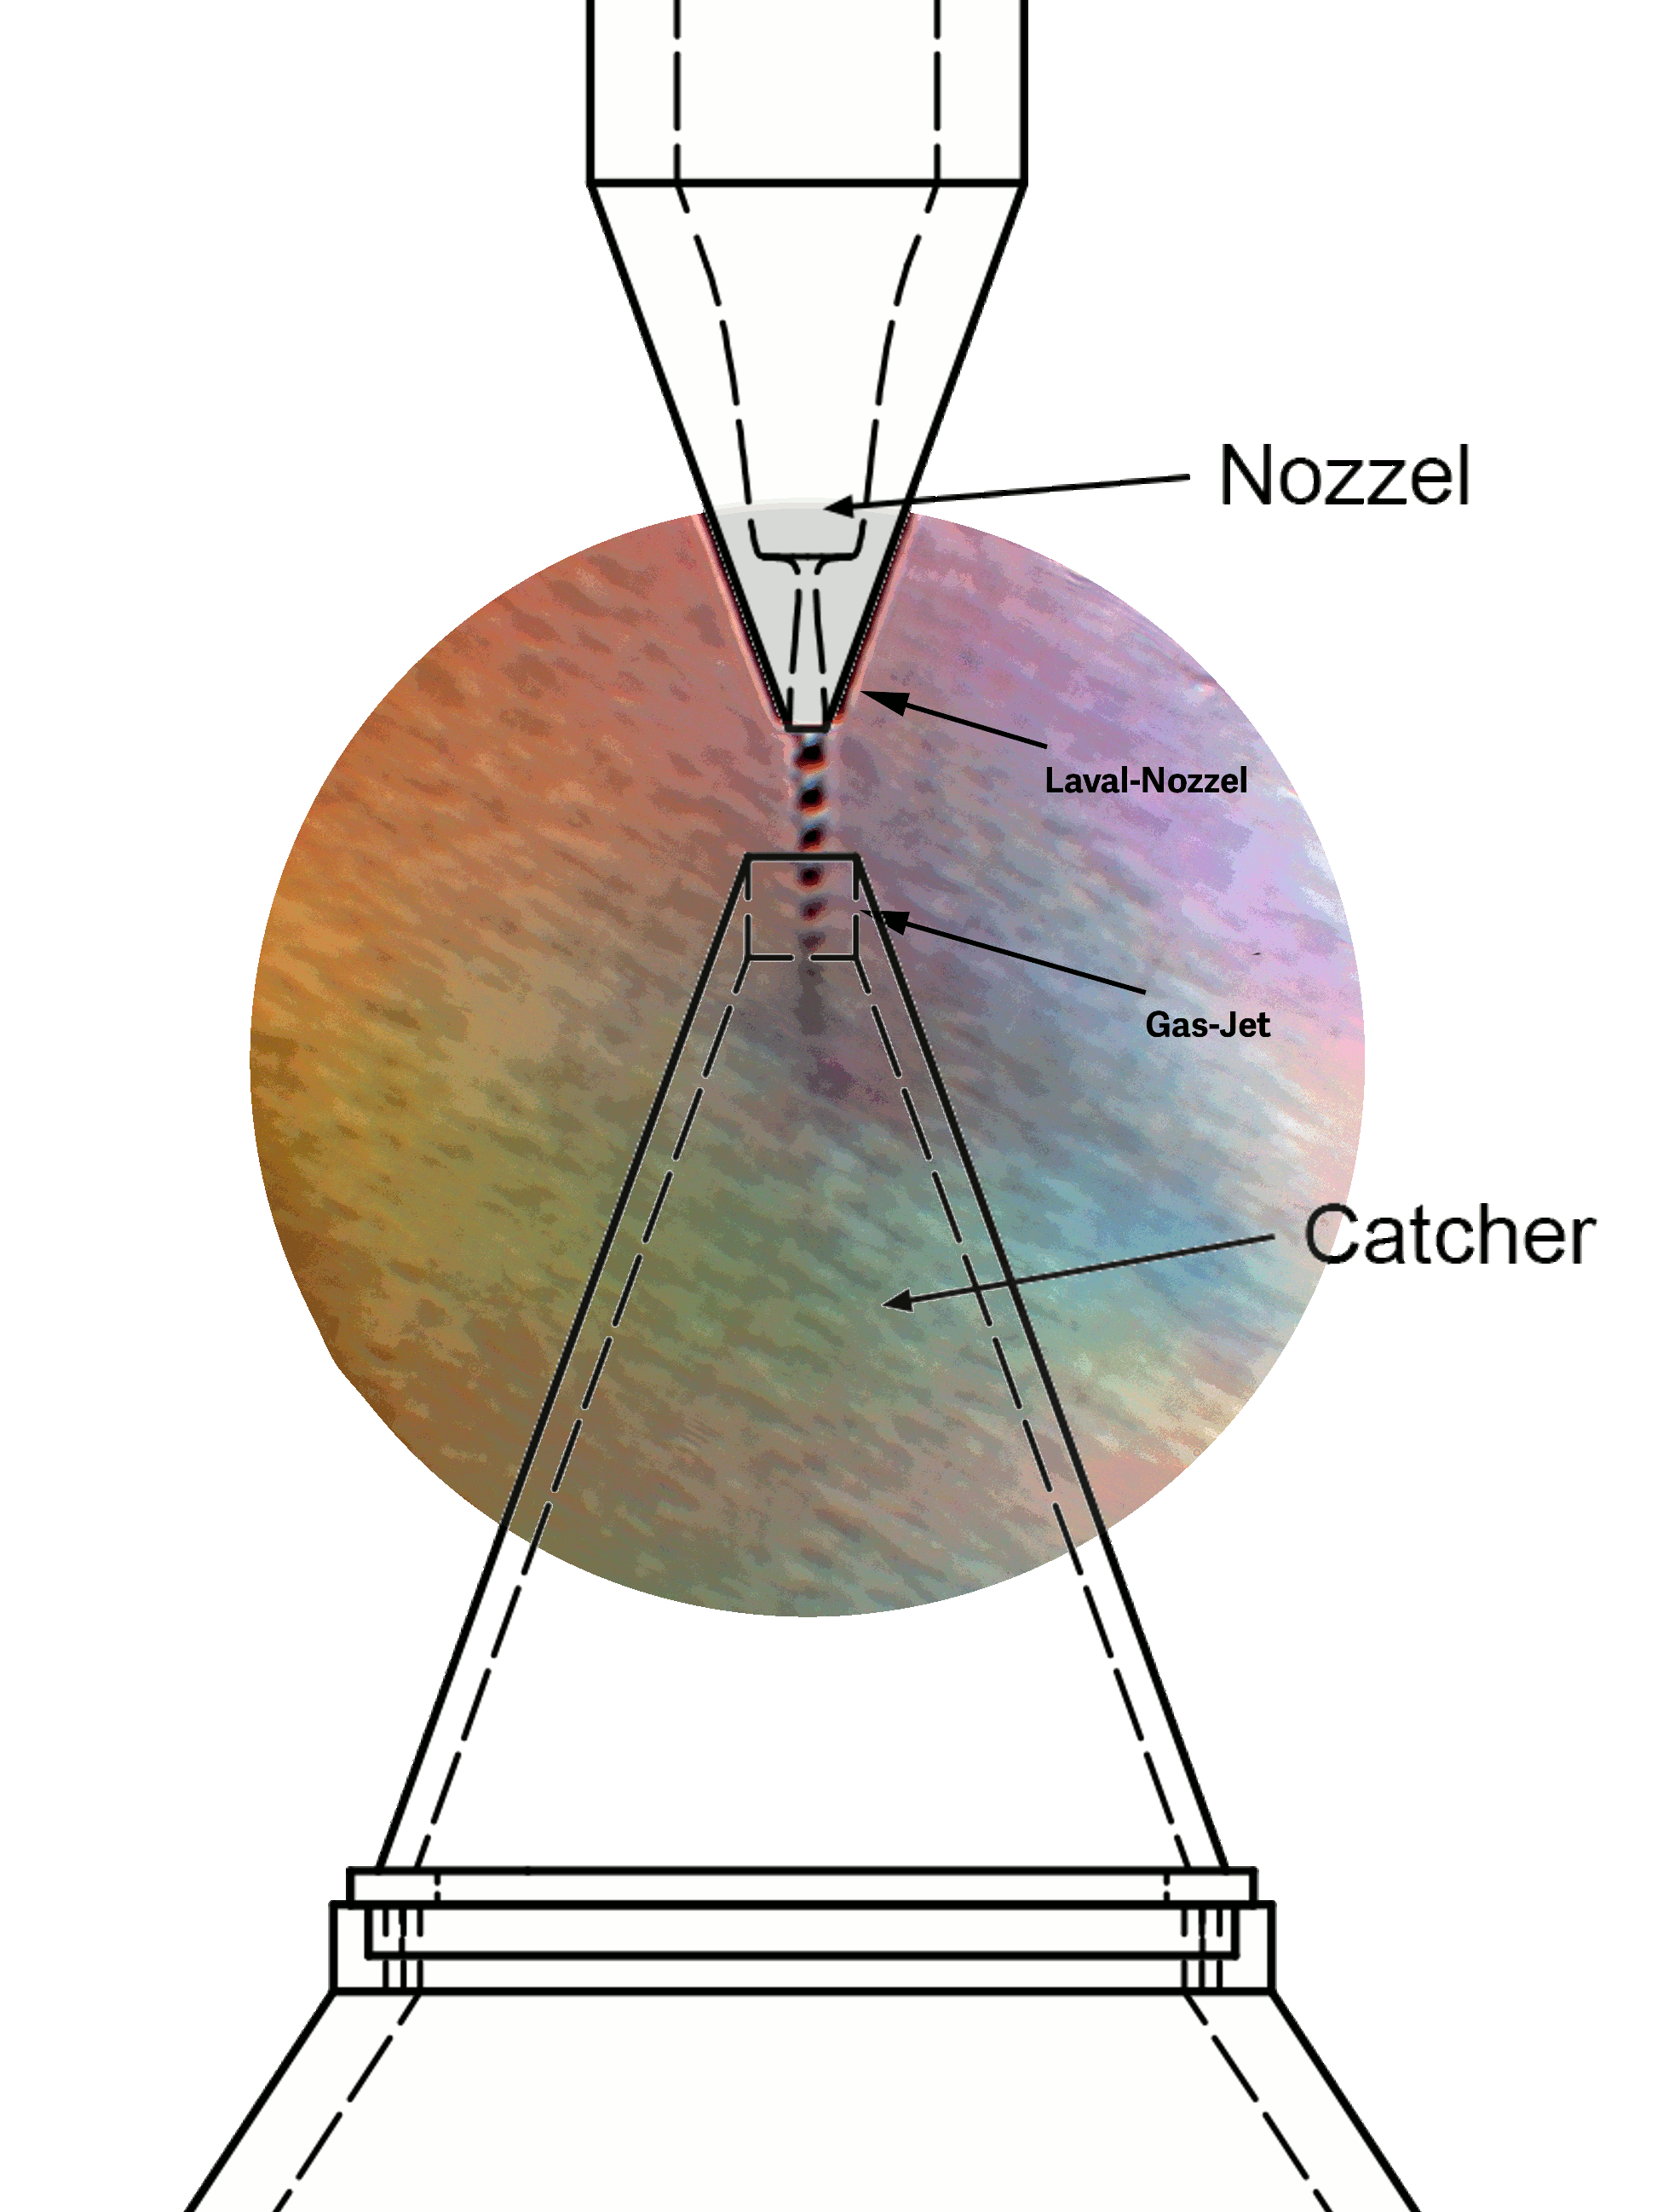
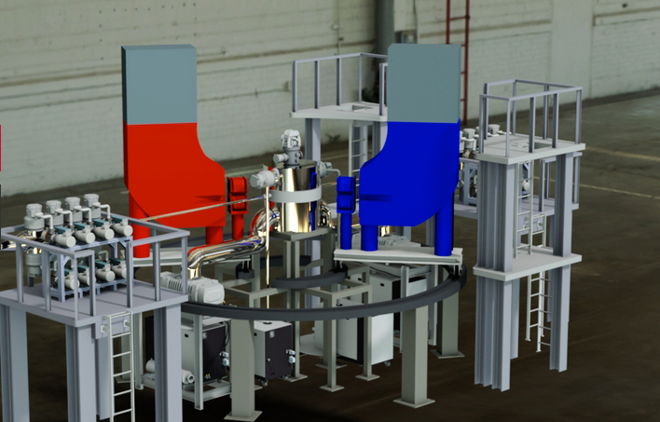
Future measurements @ MESA
Experiment MAGIX for the next generation ISR experiments:
Low energy (105MeV), high Intensity (1mA) electron beam.
High resolution magnetic spectrometers
Internal hypersonic gas jet target for
measurements with minimal background
contributions.
Dedicated MAGIX presentations:
HK 45.64 : S. Lunkenheimer
HK 45.65 : J. Rausch
HK 52.6 : S. Aulenbacher
HK 61.1 : S. S. Caiazza
HK 61.2 : P. Gülker
Notes:
Using newly designed windowless hypersonic jet target in combinations
With MAGIX experiment and high intensity electron beam will offer much
Better conditions for the measurement of FFs at low Q2 than were possible
With the present setup of the A1 colalboration.

Slide 23

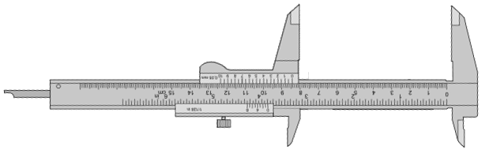
Summary
Proton radius puzzle is a persisting
open question of nuclear physics.
Indication of a new interaction beyond standard model or a fundamental problem with QED?
New measurements are scheduled examining different aspects of the problem (spectroscopic and nuclear scattering).
Additional insight via investigations of heavier nuclei (²H, ³He, …)
Notes:
So at the end you can see, that proton remains a mistery, a surprise if you will.
It is not only the details about the protons structure that are puzzling us, but also
The basic property like its radius remain a mistery. Since the observation of the
Discrepancy huge progress has been made in the understanding of the
Problem and tramendous effors were dedicated to the matter, both experimental
And theoretical. Many new expreiment are being performed or foreseen for the next
Year, also on the heavier nuclei like D and 3He, which also provide additional
Insight into the matter… all this with the purpose, to finally determine, how big
Is this basic constituent of matter.

Slide 24
Thank you!

Slide 25
BackUps
Notes:
A special thing about this experiment is, that simultaneously with the measurement
Of the elastic cross-section, they will also measure the Moeller cross section,
Which is theoretically well understood understood and could be used for absolute
Normalization of the cross-section.
The benefit of such approach is that all the problems related to the determination
Of the Luminosity dissapear, leaving them only with the uncertainties related
To the detector efficiencies and acceptance. However, if they decide to run such
That only single Moeller electron is detected, than even these uncertainties
Dissapear, offering them a nice chance for a very precise measurement of
The form factor with a sub percent uncertainty.

Slide 26
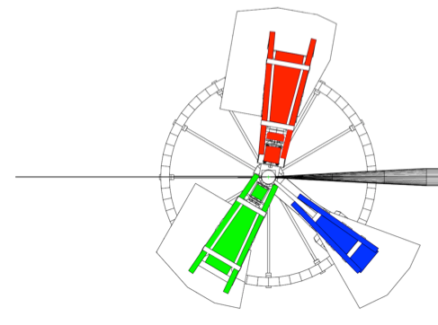
Scattering Experiment @ MAMI
About 1400 measured cross-sections with Statistical precision better than 0.2%.
Data for 0.004 ≤ Q² ≤ 1(GeV/c)² .
Direct fit of all the data points.
Spectr. A
Förster probe
pA
Spectr. C
Spectr. B
LH₂ Target
Notes:
The best present FF measurement is that of JC Bernauer that was measured at MAMI and
Published in 2010. In this experiment with the spectrometers of A1 collaboration,
cross-section was measured in 14 hundred different points covering the Q2 range From
0.8 GeV/c^2 down to obly 4E-3 GeV/c^2 as demonstrated in this picture.
This rich set of data could then be used in the Rosenbluth separation. Howerver, the problem
Of this approach is that when looking along epsilon, the measurements are never made at the
Exactly same Q2, which introduces some systematic uncertainty. Furthermore, he would loose a
Part of the acceptance. To avoid this problems, he considered a different approacth, where he
Devised models for the form-factors and fitted them directly to all the measured data points for
All Q2 and all theta. He tested different models, which all gave similar and very precise results.

Slide 27
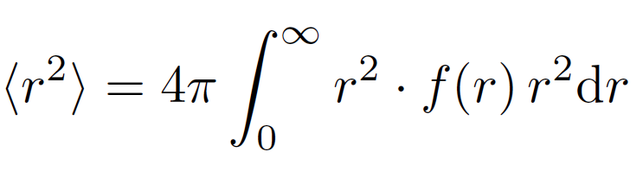
Proton charge Radius
Best estimate for radius:
Data available only for
Q² > 0.004 (GeV/c)².
Extrapolations to zero are needed!
Instabilities related to extrapolation are sources of systematic offsets.
Remark: Contrast to the analysis of heavy nuclei, where radius is determined from charge distribution.
Notes:
And once we know the charge form-factor, we can also calculate the radius,
Which is defined as a derivative of the form factor at Q2=0.
However, a known handicap formula is that the data are available only to Q2=0.004,
This means that in order to calculate the radius, the data need to be extrapolated
Towards zero, which can led to unwanted siystematic offsets. The radii obtained from the existing
Nuclear experiments are Are shown In this plot, where The first radius was determined by
Hand, while the best curent value Is, as I already mentioned, one from jan Bernauer.
Here it is also important to emphasize that there is a very important difference between
Determining the radius of the proton and radius determination of the heavy nuclei. With the
heavy nuclei, we first derive a physics model for the charge distribution which parameters
Are determined by fitting its fourier transformation to the data. And once we know the distribution,
We use this formula to determine the radus. However, with the proton, we somehow do not
Care about the charge distribution, and determine the radius directly from the form-factors.
And if we now compare the nuclear scattering results with the high precision results from the
Lamb shift Measurements, about which Aldo Antognini was talking about,…

Slide 28
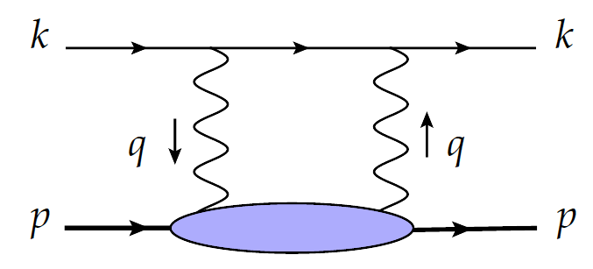
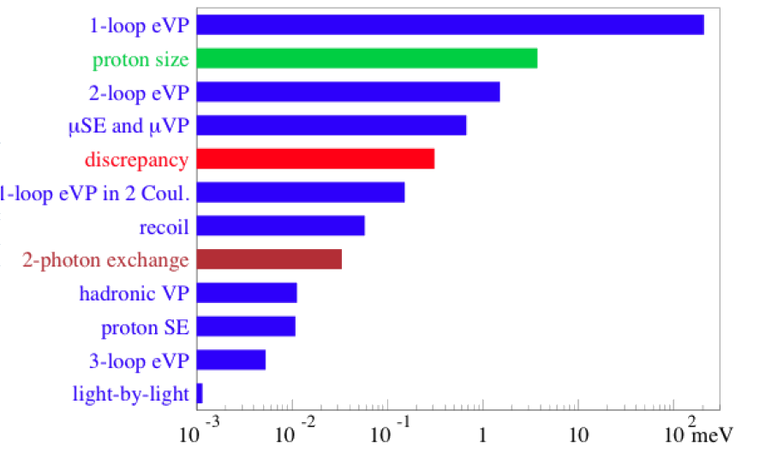
Two photon corrections
Problem or missing term in calculations?
Lepton correction well known!
Could it be the hadronic two photon corrections?
The correction 10x too small.
ΔE_{2P-2S}(discrep.) = (320)μeV
ΔE_{2P-2S}(TPE) = (33 ± 2)μeV
Notes:
So, could it be, that there is a term missing in the calculation? Since the the lepton
Corrections to the leasing diagram are well known and calculated by different
Groups, the diagram, that coould contribute the missing 320ueV is the hadronic
Two photon exchange diargam. And here comes in the first contribution of the S1
project and our theoretical collegaues (especiall M. Gorstein), Who evaluated the
contribution of this two photon exchange diagrams. Unfortunately, they determined,
That this diagram contributes only 30ueV, which is 10x smaller than what we need,
And means that a missing term in calculation could also not be the answer.

Slide 29
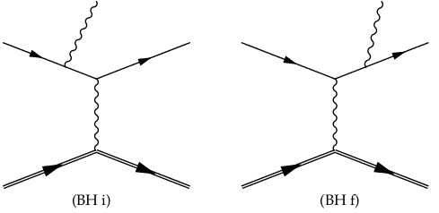
Initial state radiation
Radiative tail dominated by coherent
sum of two Bethe-Heitler diagrams.
2
Unknown
FFs
+
=
Known
FFs
G_{E}
In data ISR can not be distinguished from FSR.
Combining data with the simulation, ISR information can be reached.
Idea behind new MAMI experiment to extract G_{e}^{p} at Q² ~ 10⁻⁴ (GeV/c)²
Redundancy measurements at higher Q² for testing this approach in a
region, where FFs are well known.
Notes:
The radiative tail of the elastic peak is dominated by the contributions of two Bethe-Heitler
diagrams. The initial state radiation graph, where the incident electron emits real photon
before interacting with proton and final state radiation diagram, where photon is emitted
only after the interaction.
The plot here on the right shows the results of the MC simulation for the elastic scattering,
Considering The initial state and final state radiation, as a function of measured or
reconstructed Q2 and The vertex Q2, so true Q2 of a photon that interacts with the proton.
You can see, that in the case, when real photon is emitted before the interaction
Q2Reconstructed agrees with the Q2 at the Vertex. However, when the scattered electron
emits real photon, then Q2Vertex remains constant, While the reconstructed Q2 is lowered
for the energy taken away by the real photon.
Unfortunately in the experiment we can measure only ReconstructedQ2, which means, that
Looking only at data, we can not distinguish ISR from FSR. However, by combining the data
to this simulation, we believe that information corresponding to ISR can be reached. And this
Is the basic idea of this new MAMI experiment, which will hopefully allow us to extract FFs for
Q2 as low as 10E-4.
The experiment is desiged such that the data also at higher Q2s are collected, such that tail of all three
settings overlap. This will allow us to test our procedure in a region where FFs are well understood.
In other words, in these tests, we will extract FFs from that radiative tail and compare it to the FFs
from the peak.
The measurements for this experiment have been performed last year and now we are at the
Stage of doing the analysis. I believe that this is a very nice project and idea, but some people
Will be always skeptic, because we need to relay on the simulation in order to extract the data.

Slide 30
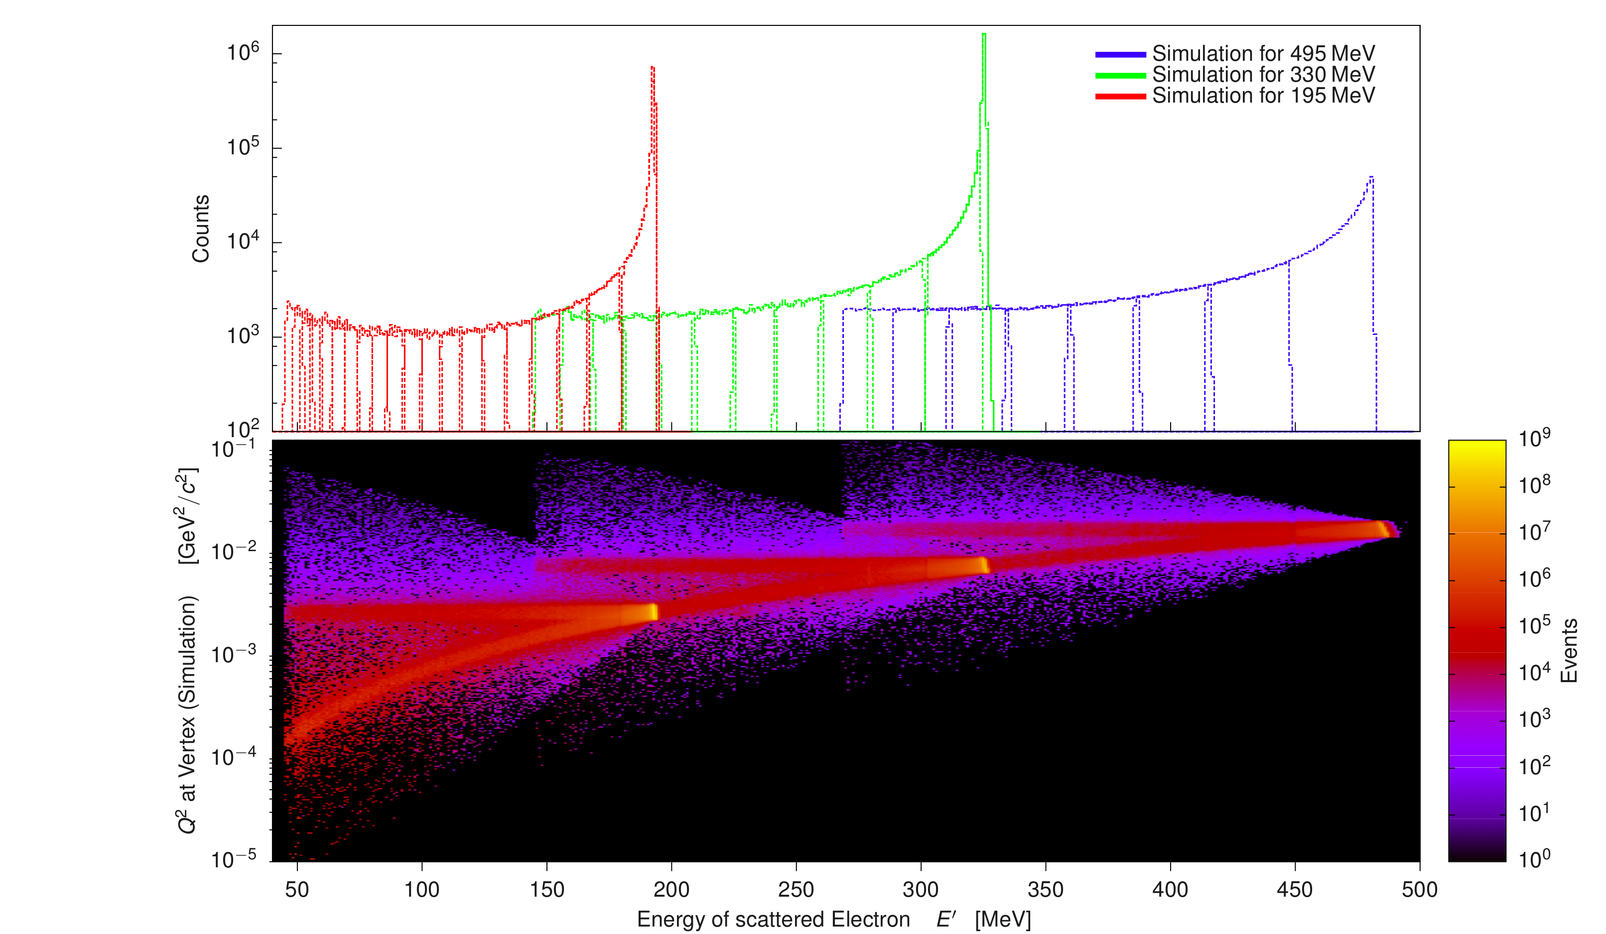
Kinematic settings of the full experiment
Measured kinematic points and corresponding Q² at vertex.
Three kinematic regions overlap to verify ISR approach.
Test of ISR
Overlap for ½ of
the acceptance
Notes:
This plot shows the kinematic points for which we collected our data,
Together with the corresponding Q2 at the vertex. Settings are chosen
such, that two neighboring settings overlap for Half of the acceptance,
To minimize systematic uncertainties.
As already explained, kinematic points for all three energy settings
Overlap, which will give us ability to test the ISR approach, by comparing
The FF from the peak with those extracted from the tail.

Slide 31

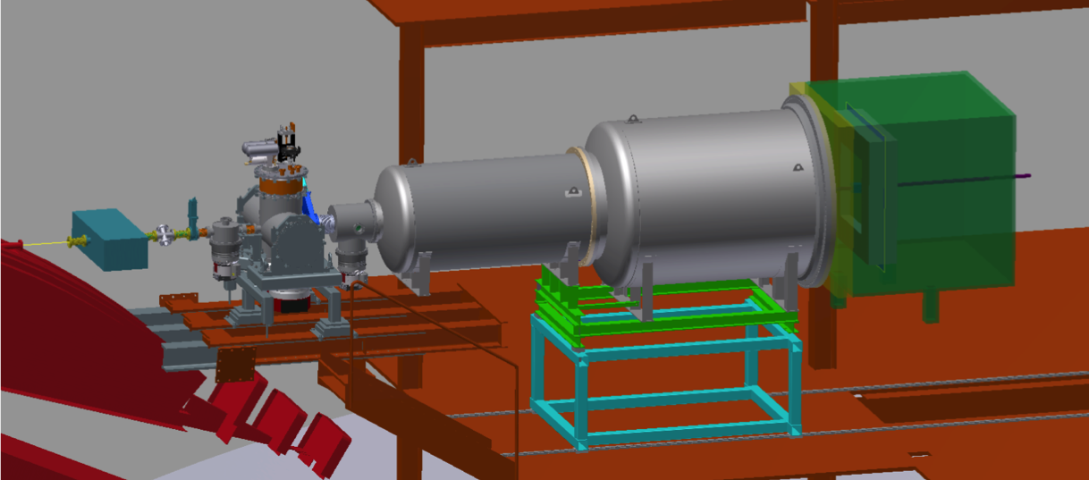
Prad experiment @ JLab
Investigating FF in region of 10⁻⁴ ≤ Q² ≤ 10⁻² (GeV/c)².
Using magnetic spectrometer free method at Hall-B.
Experiment fully approved and scheduled to run in 2016.
Windowless cryo-cooled
Hydrogen gas target
Vacuum box
A. Gasparian, JLab, 2015
Incoming
beam
HyCal calorimeter
with GEMs
Notes:
The first such experiment, that will be able to reach smaller Q2 is the
Prad experiment at Jlab. The experiment will be performed at Hall-B
In 2016 and will use a windowsless gasous target and a highly segmented
forward angle calorimeter. This magneticspectrometer free approach
allows them to reach extremely small scattering Angles and consequently
measure FF at Q2 as low as 10-4.
The experiment was fully Approved by PAC and is scheduled to run in Hall-B in 2016.

Slide 32
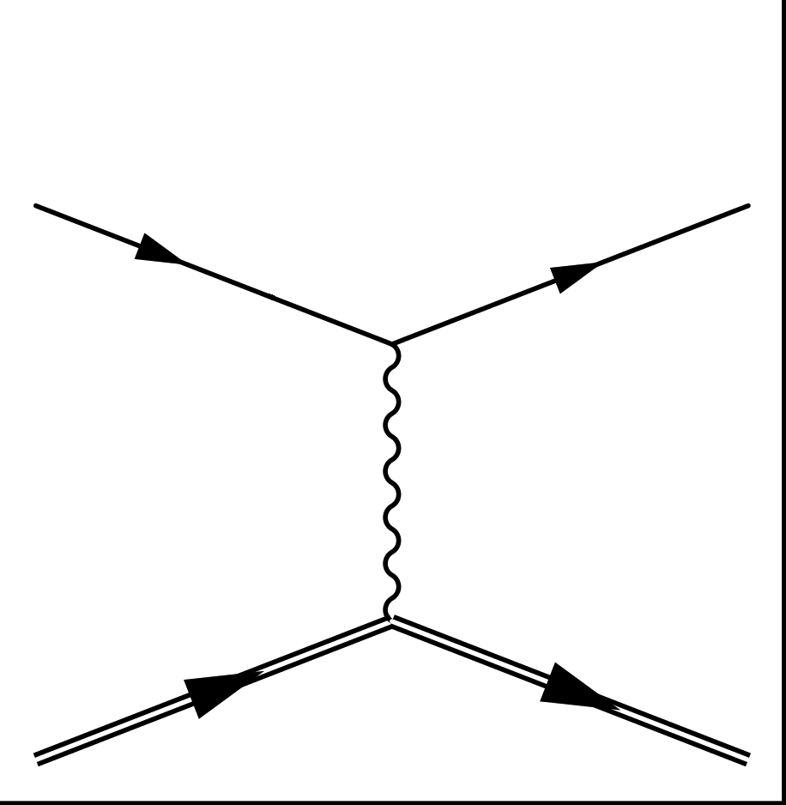
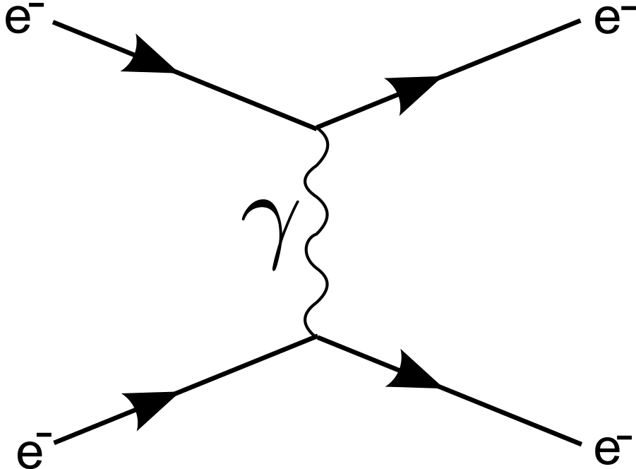
Prad experiment @ JLab
Elastic cross section for e-p scattering normalized to Møller scattering:
e⁻
e⁻
p⁺
p⁺
For single Møller electron detection uncertainties related to luminosity, detection efficiency and geometrical acceptance dissapear.
Expected total uncertainty ≤ 0.55%.
Notes:
A special thing about this experiment is, that simultaneously with the measurement
Of the elastic cross-section, they will also measure the Moeller cross section,
Which is theoretically well understood understood and could be used for absolute
Normalization of the cross-section.
The benefit of such approach is that all the problems related to the determination
Of the Luminosity dissapear, leaving them only with the uncertainties related
To the detector efficiencies and acceptance. However, if they decide to run such
That only single Moeller electron is detected, than even these uncertainties
Dissapear, offering them a nice chance for a very precise measurement of
The form factor with a sub percent uncertainty.

Slide 33

Possible explanations ?!
- Errors in the measurements:
Spectroscopic and scattering data reexamined.
No problem found.
Coulomb and 2γ effects incomplete:
Effect is negligible at Q²≤1(GeV/c)² .
Radiative corrections in the eH Scattering:
Well under control. Simulation precisely
describes the tail of the elastic peak tail.
Problems with μ-H theory:
* Unexplained proton structure effects.
* Clandestine problem with one loop vacuum polarization term.
* Fundamental problems with QED.
Effects of three body physics:
Contribution of molecuar ions? pμe⁻, ppμ⁻ are unstable.
Physics beyond standard model?
Notes:
There are many many different potential explanations now on the market,
Ranging from the trivial errors in the measurements down to the controversial
Claims that there must be something fundamentally wrong with the QED and
Ideas about effects and physics beyond Standard model.
However, in order to confirm or deny any of these scenarios further theoretical
and experimental efforts are required.

Slide 34
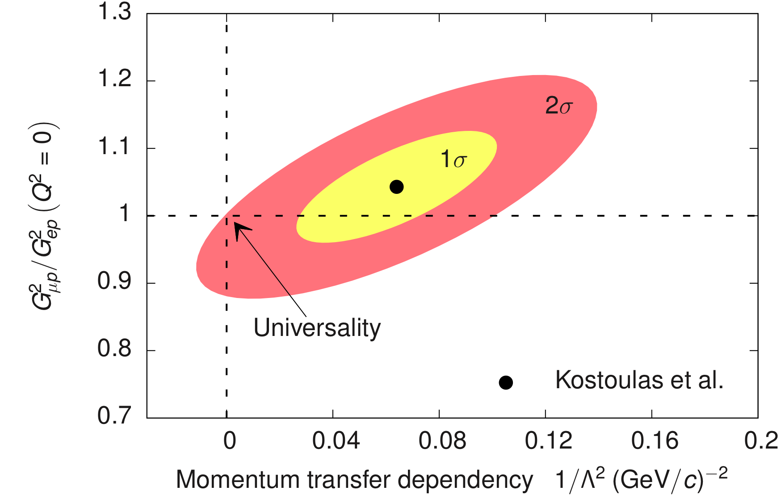
Physics beyond the Standard model
Puzzle could be explained by
breaking the e-μ universality.
New interaction could also
explain the (g-2)_{μ} puzzle.
The universality tested, but
constrains loose enough
for such explanations.
Various new interactions proposed.
Constraints on new forces limit the possibilities.
Most interesting candidate: A new U(1) gauge boson mediating the
interaction between dark matter and the Standard model particles.
Notes:
So, what if there is an interraction that causes muon to couple differently
To the proton ans electron. The idea of new force and corresponding mediator
Particle in the GeV scale is interresting also because, it could at the
Same time explain the muonic g-2 puzzle. The e mu universality has been
Of course tested but the constraints are still loose enough to allow for such
Explanations. This plot shows the results of one of the early universality
Checks. The y axis is a proton formfactor ratio at Q2=0 for measurement
With muons and and electrons, while x axis corresponds to how fast
The universality breaks with the increasing Q2. What they measured
Is a point, that is 2sigma away from the ideal iniversality point.
There have been different mediator particles proposed, but the most interresting
Is most deffenetly the U(1) gauge boson, that mediates interraction between
The dark matter and the standard model. The search for this particle
Has also been a hot topic nowadays, but has unfortunately not been found yet.

Slide 35

Extensive experimental efforts trying to solve the puzzle.
Upcoming measurements:
Scattering experiments (ISR, Prad, MUSE)
Spectroscopy of electronic Hydrogen:
Improve eH Lamb shift results. More precise
measurement of R∞.
μ-d Lamb shift measurement:
Proton radius extraction via isotope shift.
- Spectroscopy of exotic atoms:
Measurement of leptonic states e⁺e⁻ and μ⁺μ⁻ provides strict tests of QED.
μ-He and (Z > 3) Lamb shift measurement:
Interesting for the comparison with the scattering data.
Notes:
There are many new experiments foreseen for the near future that aim to shed light on this topic. In this
Presentation I would like to mention only one of them, the Initial state radiaton experiment, that we are
Performing in Mainz.

Slide 36
Reanalyzes of data
Different extractions of the radius from available data.
?
Are all fits trustworthy?
Requirements for a credible fit:
Efficient
Unbiased
Robust
Consistent
Physical
Notes:
At the end I would like to mention, that the cross-section data discussed in the
Beginning are being accompanied by many different reanalyses, with their own
Extraction of the radius, that are shown here. And looking at this plot I can not
get rid of the feeling, that after 2010 these Results somehow tend to lower values.
So the question is, can all of these Fits be thrusted? I do not want to judge the results,
but would like to emphasize four criteria, that credible fit should obey.
It should be efficient, meaning that the the variance of the fit should be minimal.
Then the fit should be unbiased, meaning that if we generate pseudo data with a give
Radius, the fit to these data should return the same value. Fits should also be robust,
So that it does not change dramatically if small perturbation is applied. It should
Also be consistent, meaning that if we expand the fitting range, the parameters
Should change accordingly and it should Be physical. With that I mean, that it is not
Enough just to find the fit that agrees with the data, but should result in meaningful
Charge distribution in coordinate space , without poles etc.

Slide 37
Physically meaningful fits
For radius “exponential” distribution needs to be integrated to r > 3 fm.
Information on pion cloud complements limited data at low Q².
Width of charge distribution depends also on the form factors at high Q².
For valid radius determination data at all Q² need to be considered.
Notes:
If we decide go to a special Breit coordinate system of no Energy transfer, there Form-factors
Get especially nice intepretation. There the FFs depend only on the momentum transfer three vector
And can be interpreted as the Fourier transformation of the charge distribution. Hence, if we measure
The FFs as a function of the Q, we can determine how are the magnetization and charge distributed
Inside the nucleons. If the measured FF is constant, then we get point like charge distribution, if the
FF has a dipole form, than the distibution is exponential, and if we get a oscillatory shape of the FF, than
This usualy results in a spherical charge distribution with a diffuse surface. And, measuring FF and determining
The parameters of the charge distribution of the nucleon is actually our fundamental goal.

Slide 38

New physics with ISR experiment?
Searching particles on a MeV scale?
What if a massive vector boson?
iεeγ^{μ}
A_{x}
σ_{Mod} ≈ σ₀(1+2ε²)
Finding new physics improbable.
Notes:
To exercise this idea, I made a simple model, and added a diagram
To my simulation with a heavy vector boson and a vertex weighted
And interaction vertices weighted with coupling constant epsilon.
And there results that I got are shown here, where you can see the
relative difference between the modified and standard cross section
As a function of mass of the boson and the available Q2. And you can
See that for this unphysically large coupling constant we get a percent
Difference, meaning that finding new physics with ISR is very unlikely.

Slide 39
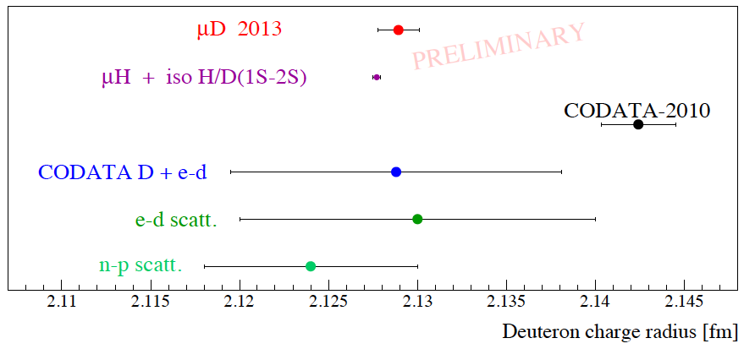
Deuteron charge radius
Isotopic shift and proton radius used to calculate deuteron charge radius.
Comparison with the direct measurements.
μH and μD data again inconsistent with eH data.
Accuracy of current D(e,e’)D data insufficient.
R. Pohl, PSI Sept.2013
New eD scattering experiment underway at MAMI. It will offer independent
input to differentiate between CODATA-2010 and atomic μ-X measurements.

Slide 40
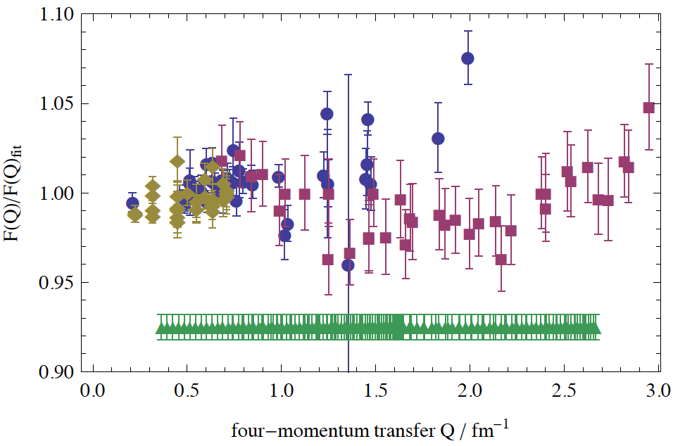
Deuteron scattering experiment
Tiny contributions of G_{Q,} G_{M} at low Q².
Maximum sensitivity of the data to the
charge radius in region Q ≈ 1fm⁻¹.
Statistical accuracy better then 0.2%.
Experiment performed in March 2014.
Data collected at three different
energies and 232 different setups.
M.O. Distler, MAMI PAC 2012
Notes:
In the scattering experiments the radius of a proton is obtained indirectly by measuring
the cross-section for the electrons off Hydrogen.The measured cross section depends on
two form factors GE and GM, which carry the information about the charge and magnetization
distribution inside the proton. To extract these form-factors from the data, Rosenbluth separation
is employed, or a more sophisticated Super-Rosenbluth separation developed by Jan Bernauer,
where the FF are determined by comparing the data directly to the simulation, that uses different
FF parameterizations. The parameters of this parameterizations are determined using a Chi2
Parameterization. Then, Considering that FF are Fourier transformations of charge distributions,
the best value of the charge radius can be determined by this formula. In an approximation that
GE can be described by the dipole function, this means, that proton charge distribution
obeys the exponential function.
Of course, A known problem of this technique is, that for calculation of charge radius a derivative
of the FFs at Q2=0 is required, where no data exist. The measurements exist at very small values,
but data at Q2<0.005 are still missing. Therefore we need to rely in our Calculations on the
extrapolation of the Form-Factors to Q2. This means, that If by any chance something strange is
happening with FFs at very low Q2<0.005, this could result in a different value of the Proton charge
radius.

Slide 41

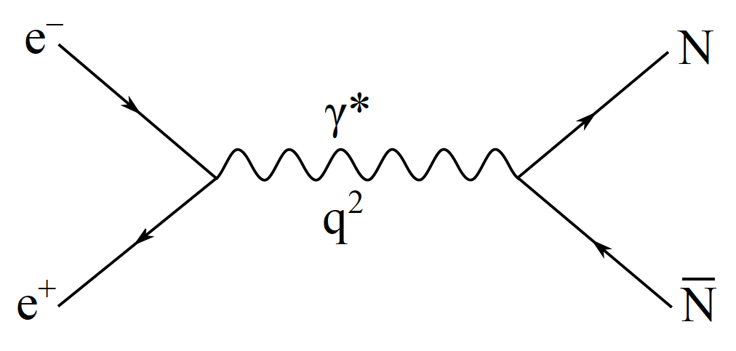
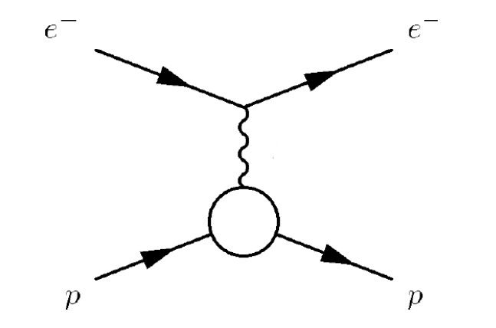
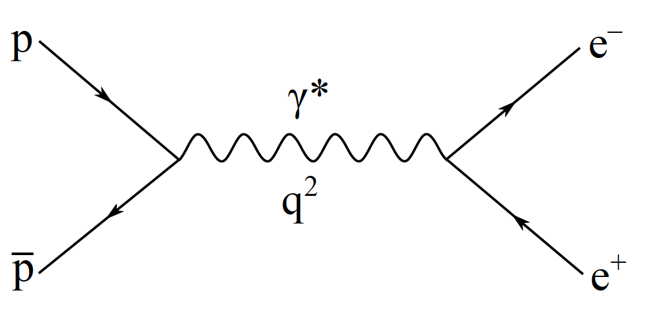
Two sides of a story…
F(Q²)
Timelike:
Spacelike:
radius
-4M²
0
Q²
Notes:
Now…. I would like to point out, that investigating the Formafactors
with the electron scattering experiments in the space like region is only
One side of the story. Form-factors also have another face in the
The time-like region that is very poorly understood and can be investigated
Via the anihilation or ckreation of the nucleon-antinucleon pairs.

Slide 42
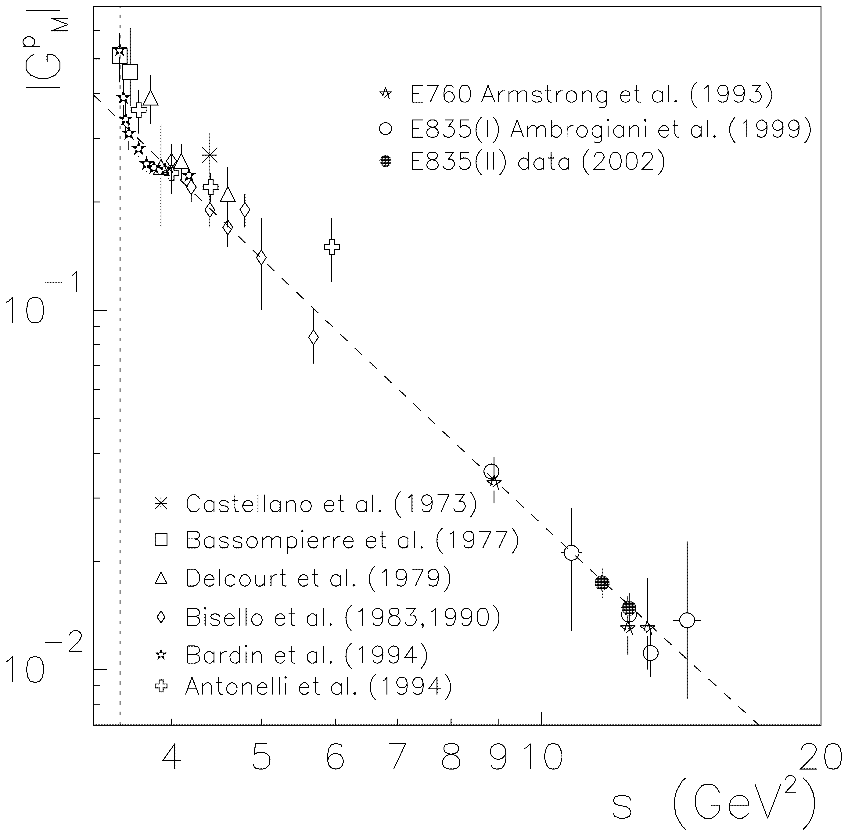
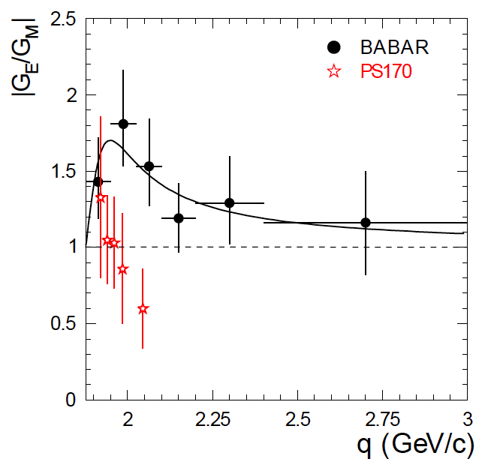
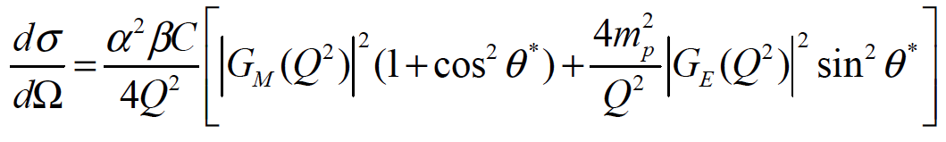
FFs in Time-Like region
Andreotti, PLB 559, 20
Denig, arXiv: 1210.4689
Problem #1
G_{M}^{p}(-s)
Problem #2
Analog to the Rosenbluth formula.
At Q² > 4m_{p}² contribution of G_{E}^{p} negligible.
QCD prediction for Q² >> 0 : G_{M}^{p}(Q²) = G_{M}^{p}(-Q²).
Problem #2
Notes:
The cross-section for creation of the nucleon-antinucleon pairs via anihilation
Of the lepton pair has very similar structure to the Rosenbluth formula,
Again depending on the GE and GM. And there are two important facts to know
When investigating such processes. First at high Q2 the GE becomes
Irrelevant and second, at high Q*2 the QDC predicts from basic principles,
That the form factor in the timelike regioin should agree with the one n the
Spece like region.
However, the experiments discovered, that the measured FF is much larger
than its brother in the specelike region, which is the first open question: where
Does this difference come from? The second open question is related to the
Measurment of the FF ratio, where two experiments gave excluding results.

Slide 43
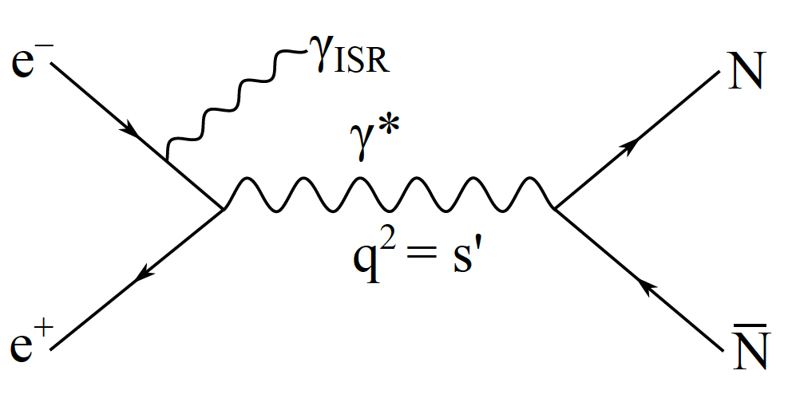
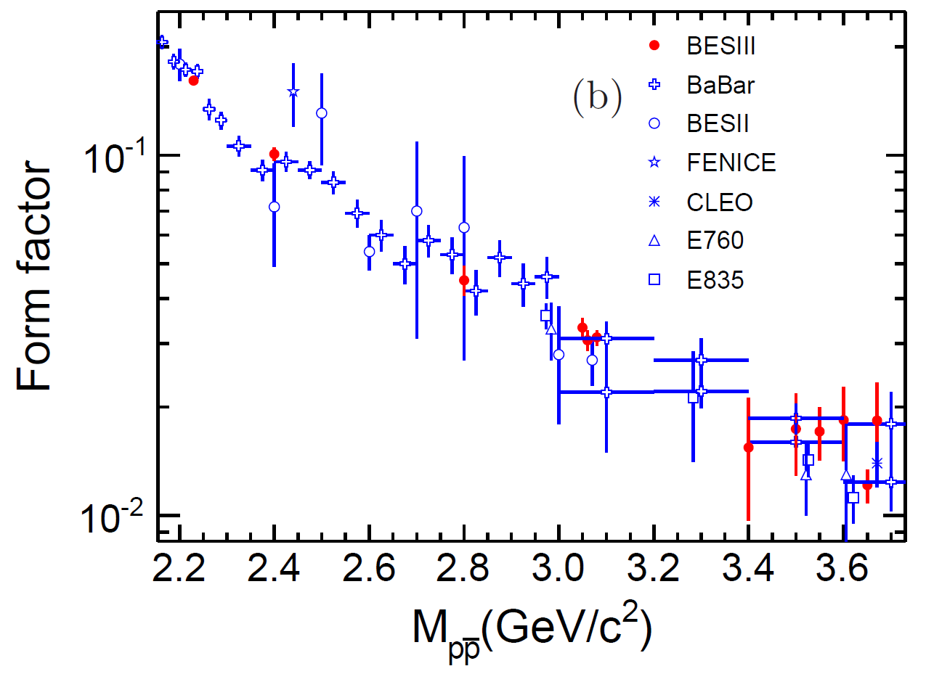
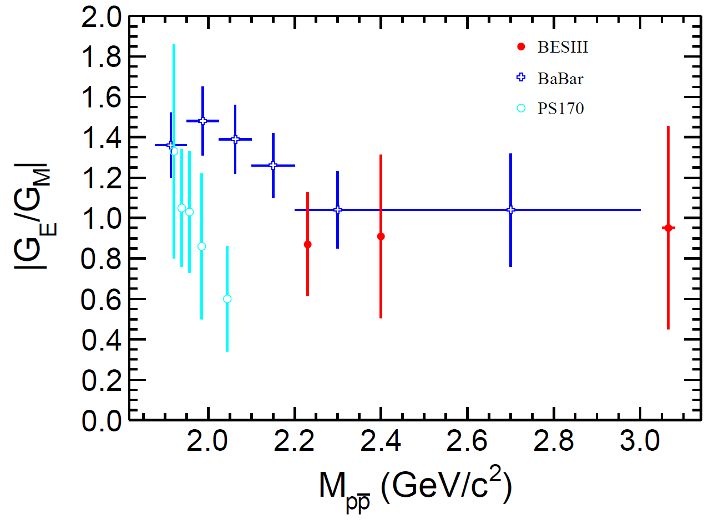
BESIII measurements
New measurements at BESIII using ISR technique.
Data for 2.2 ≤ s ≤ 3.7 GeV²
Ablikim, arXiv: 1504.02680
Results of first scan already worlds best!
Full measurements already done and analysis is underway!
Notes:
So, To improve the current situation, the Mainz group started an initiative at BES
Which aims to remeasure the form-factors in the timelike regoin with
Much better precision. Since, BEPC is the fixed energy machine, they
Also use the ISR approach to be able to measure at the more than one energy.
What you see here on these two plots in red, are their results from the
First quick energy sweep of the region, which already produced world
Best results. Once, proving that the approach works, they performed a much
More detailed sweep last year, which data are now under the analysis, and will
Provide even further constraines to the form-factors in the time like region.

Slide 44
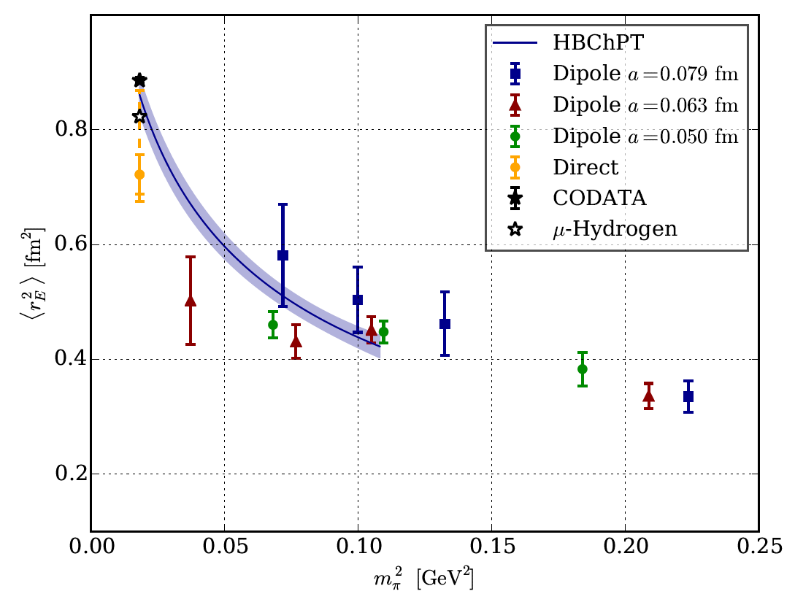
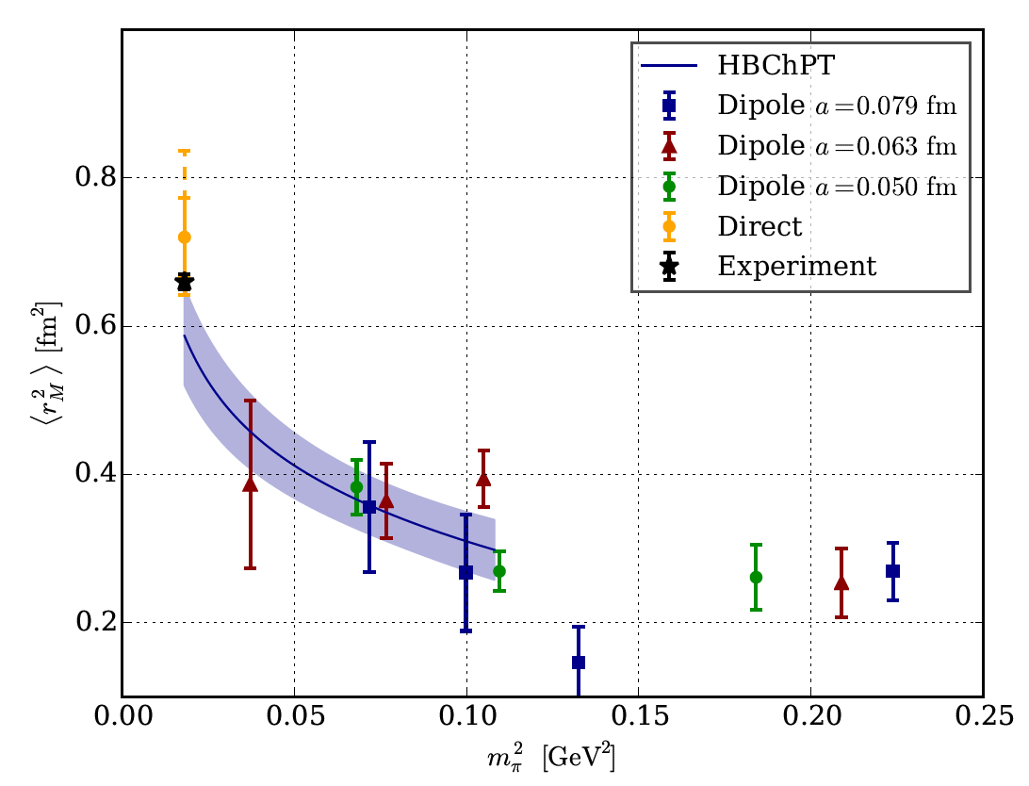
Lattice Calculations
Understanding FFs from the fundamental principles of QCD.
Tremendous progress made in last years M_{π} ≤ 200 MeV/c² .
For the first time calculations with full error budget.
Calculations agree with the experiments.
Notes:
Of course, our ultimative goal is to understand the behaviour of the form factors and the
Undelying electromagnetic structure of the nucleons from the basic QCD principles. And this
Is excatly what the Lattice QCD community is trying to achieve. There has been a tramendous
Progress done in the last couple of yrear. Now, majority of the groups are calculating with
Pion masses smaller than 200MeV and thanks to the Mainz group, who precisely investigated
The error budged of their calculations, they can also provide the errorbars on their results.
These two plots show the results of their latest calculation of the charge and magnetic radius
Of the proton as a functon of the mass of the pion and you can see, that within their errorbars
They are consistent with the experiments.

Slide 45
Importance of the Proton radius puzzle
Notes:
And judging from the number of publication you can see that community
Indeed took this problem very seriously. Only last year more than 60 papers
Were written on this topic indicating an extensive effort dedicated to this matter.
Now lets take a brief look, how are the radii determined in both types of of the
Experiments.

Slide 46


e-H vs. μ-H
Different diagrams govern Lamb shift in eH and in μH. Effects are
in opposite directions.
Contribution | Electronic Hydrogen | Muonic Hydrogen
Self-energy and vertex | 1011.41 MHz | -0.66788meV
Vacuum polarization | -27.13 MHz | -205.028meV
Other corrections | … | …
QED sum | 1057.844(18) MHz | -205.9771meV
Experimental value | 1057.845(9) MHz | -206.2949(32)meV
Difference | 1kHz (10⁻⁴%) or 4×10⁻⁹meV | 0.31meV (0.15%)
A good agreement for the eH represents a precise verification of QED.
What could explain the 0.15% discrepancy in the case of μH?

